Slide 1
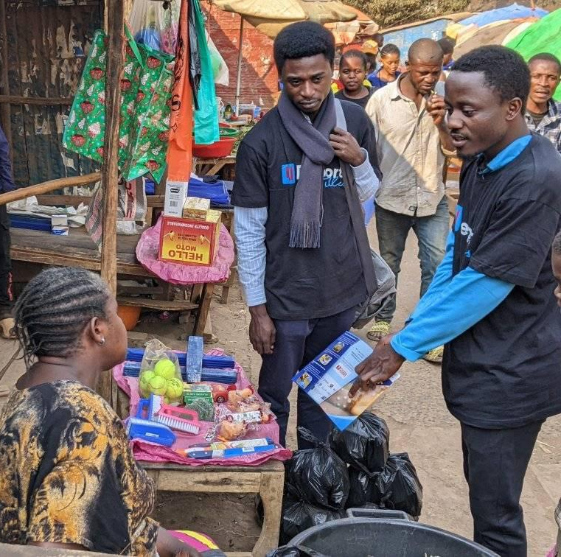
RCCE Mpox Briefing for Volunteers September 2024

Slide 2
Mpox - Basics
Mpox is caused by the mpox virus, previously known as the monkeypox virus. This virus is closely related to the variola virus, which causes human smallpox. The exact natural reservoir of the mpox virus is unknown, but it is believed that small mammals like rodents, monkeys, and other animals in parts of Africa, where the disease is endemic, may carry the virus.
There are two distinct genetic types/variants of the mpox virus, referred to as clades: clade 1,and clade 2. Clade 1 is known to cause more severe illness and deaths, while clade 2 is associated with milder infections.
A subvariant of the clade 1 mpox virus, known as clade 1b, emerged in 2023 and appears to have higher human-to-human transmissibility. However, there are still uncertainties regarding its transmission patterns and severity, including its impact on children. These uncertainties explain the concerns raised by the spread of clade 1b.

Slide 3
Populations at risk of severe mpox
Children. Where data are available, infants and children under 5 years of age are at highest risk of severe disease and death, particularly where prompt high-quality case management is limited or unavailable. Recent data show that children under 5 years of age, particularly those under 1 year of age, are at highest risk of severe disease and death. This is mainly due to their immune system being largely underdeveloped. In some contexts, existing comorbidities (for ex., severe/acute malnutrition) or concurrent infections potentially increase the risk of adverse outcomes in children.
Pregnant women. Pregnant women have a higher susceptibility to severe mpox infections, due to the physiological and immunological changes induced by pregnancy. Available data suggest that mpox can cause adverse pregnancy outcomes including miscarriage, stillbirth, preterm delivery, neonatal mpox, and foetal death before delivery.

Slide 4
Populations at risk of severe mpox
People with severely weakened immune systems. Immunosuppressed patients include those who have undertaken cancer treatment, organ transplant, advanced/untreated HIV disease, primary immune deficiency disorders, and other illnesses that can weaken the immune system. Patients with weakened immune systems are more likely to spread mpox and die from it. Furthermore, a patient’s immunocompromised status might increase their susceptibility to prolonged infection, resulting in a longer length of stay in hospital and more complications.
People with a history of eczema. Eczema weakens the skin’s barrier to infection. As a result, people with eczema may be at an increased risk of contracting mpox. Mpox symptoms also tend to be more severe in people with eczema.

Slide 5
Mpox transmission
Direct person-to-person : occurs primarily through close or intimate contact with infectious lesions on the skin or mucosal surfaces, such as those found in the mouth or on the genitals.
This includes:
Direct skin-to-skin contact with mpox lesions – the main mode of transmission.
Contact with saliva, respiratory secretions (nasal mucus), and bodily fluids or lesions around the anus, rectum or vagina from a person with mpox.
Intimate contacts during oral, anal or vaginal sex with someone with mpox.
During pregnancy, the virus can be spread to the foetus, or to the newborn during or after birth through skin-to-skin contact. At this point, it is not known if mpox is transmitted through breastmilk.
Via respiratory secretions like saliva during prolonged close contact, such as talking or breathing during face-to-face interactions with a person with lesions in their mouth.
These modes of transmission imply that household members are at risk of contracting the disease, including children during play, and crowded living conditions. Sexual partners of persons with mpox are also susceptible. Individuals with multiple sexual partners are at higher risk.

Slide 6
Mpox transmission
Indirect transmission: mpox can be contracted from contaminated objects such as clothing, bedding, towels, or surfaces that have not been disinfected after being used by someone with mpox.
Animal-to-human (zoonotic) transmission: in endemic regions of Africa, this has been the predominant route of virus spread to humans. Transmission occurs through direct contacts with infected animal sources, such as through bites, scratches, or exposure to blood, bodily fluids, or lesions, typically during hunting, skinning, or whilst preparing these animals to eat.

Slide 7
Populations at highest risk of contracting mpox
The population at risk varies according to country context and the epidemiology of the disease, and includes:
Individuals having close contact with confirmed cases, putting health care-workers at particular risk.
Children, especially those under 5 years of age, and pregnant women.
Sex-workers and individuals having intimate (sexual) contacts with multiple partners.
People who are immunocompromised, including people with untreated and advanced HIV/AIDS.
Populations with limited access to healthcare, poor sanitation, and crowded living conditions.

Slide 8
Mpox signs and symptoms
Mpox disease typically presents with a range of signs and symptoms that generally appear within 6–13 days after exposure.This period can extend up to 21 days.
The initial signs and symptoms of mpox include fever, intense headache, muscle aches, back pain, general fatigue or low energy, and swollen lymph nodes (a key distinguishing feature).
Skin rash, the typical sign of mpox, appears one to three days after initial symptoms. The rash often starts on the face, then spreads to other areas including hands, feet, and mucosal surfaces.
People with mpox are infectious from the onset of the very first symptoms, until the vesicles have scabbed over, and the scabs have fallen off.
In addition to the symptoms commonly reported by adults, some children also experience breathing difficulties and trouble swallowing.

Slide 9
Mpox diagnosis
The diagnosis of mpox relies on patients’ medical and contact history, physical examination, and laboratory testing based on samples taken from the skin rash.
Contrary to popular belief, diagnosing mpox can be challenging, as severe and widespread rashes may not be the main presentation of the disease; the disease may present as isolated or localized rashes.
In addition, mpox can look like skin conditions common among children such as scabies, chickenpox, measles, bacterial skin infections, and medication-associated skin eruptions. In adults, conditions that can be misdiagnosed as mpox include other skin infections such as syphilis or herpes.
Laboratory diagnosis of mpox is the preferred laboratory test for mpox, with samples taken from the rash fluid or rash crust collected by swabbing. Access to adequate laboratory facilities remains a challenge in the mpox response

Slide 10
Mpox Treatment
Most mpox cases, including in children, are mild and resolve on their own without the need for specialized treatment. Hospitalization for mpox is usually not necessary unless the clinical conditions warrant it.
There are currently no specific treatments for mpox, so supportive care, adapted to patient needs, is the cornerstone for managing mpox, focusing on relieving symptoms and preventing secondary infections.
Mpox supportive treatment includes skin care, hydration and nutrition support, pain and fever management, and management of secondary bacterial infections, if they occur.
In some settings, an experimental antiviral drug, Tecovirimat,18 has been used to treat severe cases of mpox caused by clade 2. The effectiveness of Tecovirimat against clade 1 has not been demonstrated.

Slide 11
Mpox Treatment (cont)
It is crucial to assess and address potential comorbidities that may predispose individuals, especially children and pregnant women, to more severe forms of the disease. These comorbidities include malnutrition and nutritional deficiencies, concurrent infections, and advanced and untreated HIV disease
Health staff treating mpox should be orientated on basic psychosocial support skills, enabling them to provide compassionate, supportive, and dignified care that responds to the social and emotional impact of the disease, as well as the physical symptoms.
Children care: When hospitalization is needed, UNICEF strongly advocates against the separation of an affected child from their caregiver. However, in cases where a caregiver has mpox and cannot safely care for the child, it is critical to provide support for alternative (family-based) care arrangements to ensure the child’s protection, safety, and physical and mental wellbeing.

Slide 12
Prevention Measures
Human to human transmission
To protect yourself and others against mpox, know the signs and symptoms, how the virus spreads, what to do if you get ill, and the risk in your area or community. Most people with mpox will recover within 2–4 weeks.
If the virus is spreading in your area or in your community, have open conversations with those you come into close contact with about any symptoms you or they may have.
Avoid close contact with anyone who has mpox, including sexual contact.
Clean your hands frequently with soap and water or an alcohol-based hand rub.

Slide 13
Prevention Measures (cont)
If you think you might have mpox:
Contact your healthcare provider for advice
Self-isolate in your own room if possible and open windows
Wash hands often with soap and water or hand sanitizer, especially before or after touching sores/rash
Wear a medical mask and cover lesions when around other people until your rash heals
Keep skin dry and uncovered (unless in a room with someone else)
Avoid touching items in shared spaces and clean and disinfect frequently touched objects and surfaces
Use saltwater rinses for sores in the mouth
Take warm baths with baking soda or Epsom salts for body sores
Take over-the-counter medications for pain, like paracetamol (acetaminophen) or ibuprofen.

Slide 14
Prevention Measures (cont)
If you think you might have mpox:
DO NOT
Scratch blisters or sores, which can slow healing, spread the rash to other parts of the body, and cause sores to become infected; or
Shave areas with sores until scabs have healed and you have new skin underneath (this can spread the rash to other parts of the body).
To prevent spread of mpox to others, people with mpox should isolate at home following guidance from their healthcare provider, or in hospital if needed, for the duration of the infectious period (from onset of symptoms until lesions have healed, scabs fall off and new skin has formed).
Covering lesions and wearing a medical mask when in the presence of others may help prevent spread. Using condoms during sex will help reduce the risk getting mpox but will not prevent spread from skin-to-skin or mouth-to-skin contact.

Slide 15
Vaccination
vaccines against mpox are currently limited. Vaccination against mpox targets people identified at higher risk of contracting mpox or developing a severe form of the disease.
Mass vaccination is currently not recommended as part of the response to the outbreaks of mpox. Vaccination is also not currently recommended for the general public.
In the current context of limited mpox vaccine availability, vaccination should be prioritized for those at the highest risk of contracting the disease or those at high risk of severe outcomes, as determined by health authorities.
vaccines are one of the tools that are used to reduce risk and protect communities against mpox and should be used in combination with other countermeasures such as hand washing, avoiding being in close contact with an infected person, infection prevention and control and case management.
Using vaccines alone will not stop the outbreak and curb transmission.

Slide 16
Risk Communication and Community Engagement (RCCE)

Slide 17
Real time exchange of information, opinion and advice between frontline responders and people who are faced with the threat of public health events and outbreaks to their survival, health, economic or social wellbeing.
What is risk communication?
Notes:
Ask for examples: (radio spot, megaphone, community meetings/door to door)

Slide 18
Mutual partnership between public health events and outbreaks response teams and individuals or communities in affected areas, whereby community stakeholders have ownership in controlling the spread of the outbreak.
What is community engagement?
Notes:
Ask examples (e.g. micro plans by the community//religious leaders involved in the response//WASH committee., etc )

Slide 19
Community Engagement
Establish methods for understanding the culture, concerns, attitudes and beliefs and practices of key audiences
Identify existing community influencers (e.g., community leaders, religious leaders, health workers, traditional healers, etc.)
Identify community organizations and networks (e.g., women and Youth groups, community health volunteers, FBOs, Charitable organizations,) that can be repurposed for community engagement

Slide 20
RCCE
Consider community leaders as experts in their own culture, tradition and practices.
Engage well-respected leaders as key influencers
Engage communities to analyze and take ownership of their own situations.
Work through existing community structures.
Build trust - do not preach, lecture, or blame.
Avoid potential stigma.
Include all vulnerable groups.
Adopt participatory (two-way) communication on all channels.
Recognize and promote people in the community who continue to practice behaviours that stop /reduce the spread of public health emergency.
Identify common myths and address them

Slide 21
Why is RCCE important?

Slide 22
Epidemics start and end in communities.
It is the actions of community members that will sustain, or end, an epidemic so they need to be active partners in the response
Behaviour change is complex
One-way messaging and awareness raising is not enough
The community knows best
Communities know better than anyone how to encourage safer, healthier practices and what could prevent them
Trust is a key ingredient
If communities don’t trust us, they will not listen, contribute, or follow the actions needed to control an epidemic and may even react with hostility and violence
To build trust, we need to listen and act
Feedback is crucial to understand community perceptions and adapt our response to stay relevant and effective
Because…

Slide 23
Provide timely, relevant and actionable life-saving information through the most appropriate communication approaches to encourage people to adopt safe health practices and reduce fear, stigma and misinformation.
Listen to community feedback to understand the beliefs, fears, rumors, questions and suggestions communities have about the health risk/outbreak and use it to guide the response.
Use innovative approaches to encourage behavior change and take steps to prevent and reduce the spread of disease.
Identify and support community-led solutions to control the outbreak, ensuring active participation of the population in the response.

Slide 24
Activity – Good communication
When you are in communities, talking to people about a disease outbreak, what do you do and what do you not do?
What would a good communicator do?
What would a bad communicator do?
Notes:
This can be a discussion in open plenary and not necessarily a group activity, but either way, write ideas of good and bad communication on a flipchart. .
Answers and discussion points
Good communication
Use simple and clear words – not scientific terms
Use the local language – people will be more likely to understand
Be sincere and honest – don’t make false promises or make up answers to questions if you don’t know the actual answer
Listen to and answer people’s questions first - It is important to listen to communities before you start talking. Find out what they already know about the outbreak and add to their knowledge or answer specific questions. Before sharing information find out the rumours and beliefs in the communities that might block the effectiveness of the new information shared. At times, only after addressing those rumours new information will work in the communities
Explain things clearly and give reasons – don’t just say wash your hands, but explain why this is important in simple language people will understand
Be humble, give the community a chance to speak as much as you
Respect peoples’ views
Listen to what people are saying and ask for clarification if you are not sure what they mean
Check people understand you by asking them to repeat or summarise key information you have shared
Be well prepared before visiting the community and know what you want to say
Coordinate messages across the whole team
Look at people when talking to them and maintain eye contact
Keep calm and express views gently
Show interest and respect by not interrupting people and listening to everyone’s contribution
Matching the posture of the person with whom you are communicating
Understanding and empathizing with people’s problems
Be responsive to what the community are telling you and adapt your own behavior accordingly
Bad communication
Using technical or scientific language
Not letting people talk – just talking at them
Dismissing their questions as silly or stupid
Interrupting people when they are talking
Shout or lose your temper
Lecturing
Not knowing what you are talking about – make sure you understand the facts before you go to the community
Making up answers to questions you don’t know the answer to – it’s ok to say ‘I don’t know but I will find out and come back to you with an answer later’
Watch the language you use and avoid using discriminatory terms like ‘victim’ or calling someone a ‘spreader’

Slide 25
How to communicate during a public health emergency
Simple and clear words – not scientific terms – adapted to your audience background and language
Be sincere and honest – don’t make false promises or make up answers to questions
Listen to communities before you start talking.
Find out what they already know about the disease and add to their knowledge or answer questions.
Before sharing information find out the rumours and beliefs in the communities
Explain things clearly and give reasons – don’t just say drink safe water, but explain why this is important
Be humble, give the community a chance to speak as much as you and respect peoples’ views
Check people understand you by asking them to repeat or summarise key information
Be well prepared before visiting the community and know what you want to say
Coordinate messages across the whole team
Look at people when talking to them and maintain eye contact
Keep calm and express views gently
Show interest and respect by not interrupting people and listening to everyone
Understanding and empathizing with people’s problems

Slide 26
Lets Practice! Play Role
Notes:
Divide the participants in groups (or if no time, ask volunteers to come on “stage”) and ask them to use the banner during a simulation/role role of a community dialogue and/or a small group discussion with communities.
The way it works: Volunteers use the images to trigger the discussion. They ask population what do you understand in these images? Can you describe them? Ask a few volunteers to “perform” (one pretends to be the mobiliser/volunteers, some other (or more than one) pretend to be the community. At the end ask what was done well or less well (interaction between volunteer and community//, dialogue instead of monologue, clear messages// addressing specific questions, etc).

Slide 27
Collecting communities' feedback
Why is it important?
Notes:
Open discussion in plenary –,

Slide 28
Communities’ Feedback
It the right of the communities!!! And our obligation (AAP)
Helps building trust
Helps inform & improve outbreak response
Ensures the right topics and targeted interventions are addressed
Helps detecting problems in an early stage
Highlights cases of fraud and abuse
Makes work more efficient and sustainable
Can protect frontline volunteers/workers

Slide 29
Managing Feedback
It is not enough to collect feedback, issues to be addressed
Depending on the type of feedback, the response can be information and/or action
Ensure that the response/action is well understood and meets the needs
Ensure specific management of complaints and serious complaints
Make sure community feedback leads to changes to the program if needed and/or higher level advocacy and decisions
For “dangerous” rumors, be sure to give the correct information as quickly as possible.
Make sure to close the loop (communities have the right to know what was done)
Notes:
HERE IS IMPORTANT TO EXPLAIN HOW THIS PROJECT WILL DEAL WITH THAT. WILL THE CBV HAVE A FORM TO COLLECT FEEDBACK? HOW WIL STOP MANAGE THAT?

Slide 30
Types of feedback (examples)
Rumors, observations and beliefs - information that may be partially or completely inaccurate
Questions - anything the community wants to know
Requests for help
Suggestions - ideas from the community on how to address the issues or what we could do better or differently
Thanks and praise - praise from communities on the response
Sensitive comments – e.g. Complaints about the behavior of staff or volunteers
Security/ Statements that constitute a threat – e.g. individuals threatening staff or volunteers collecting feedback

Slide 31
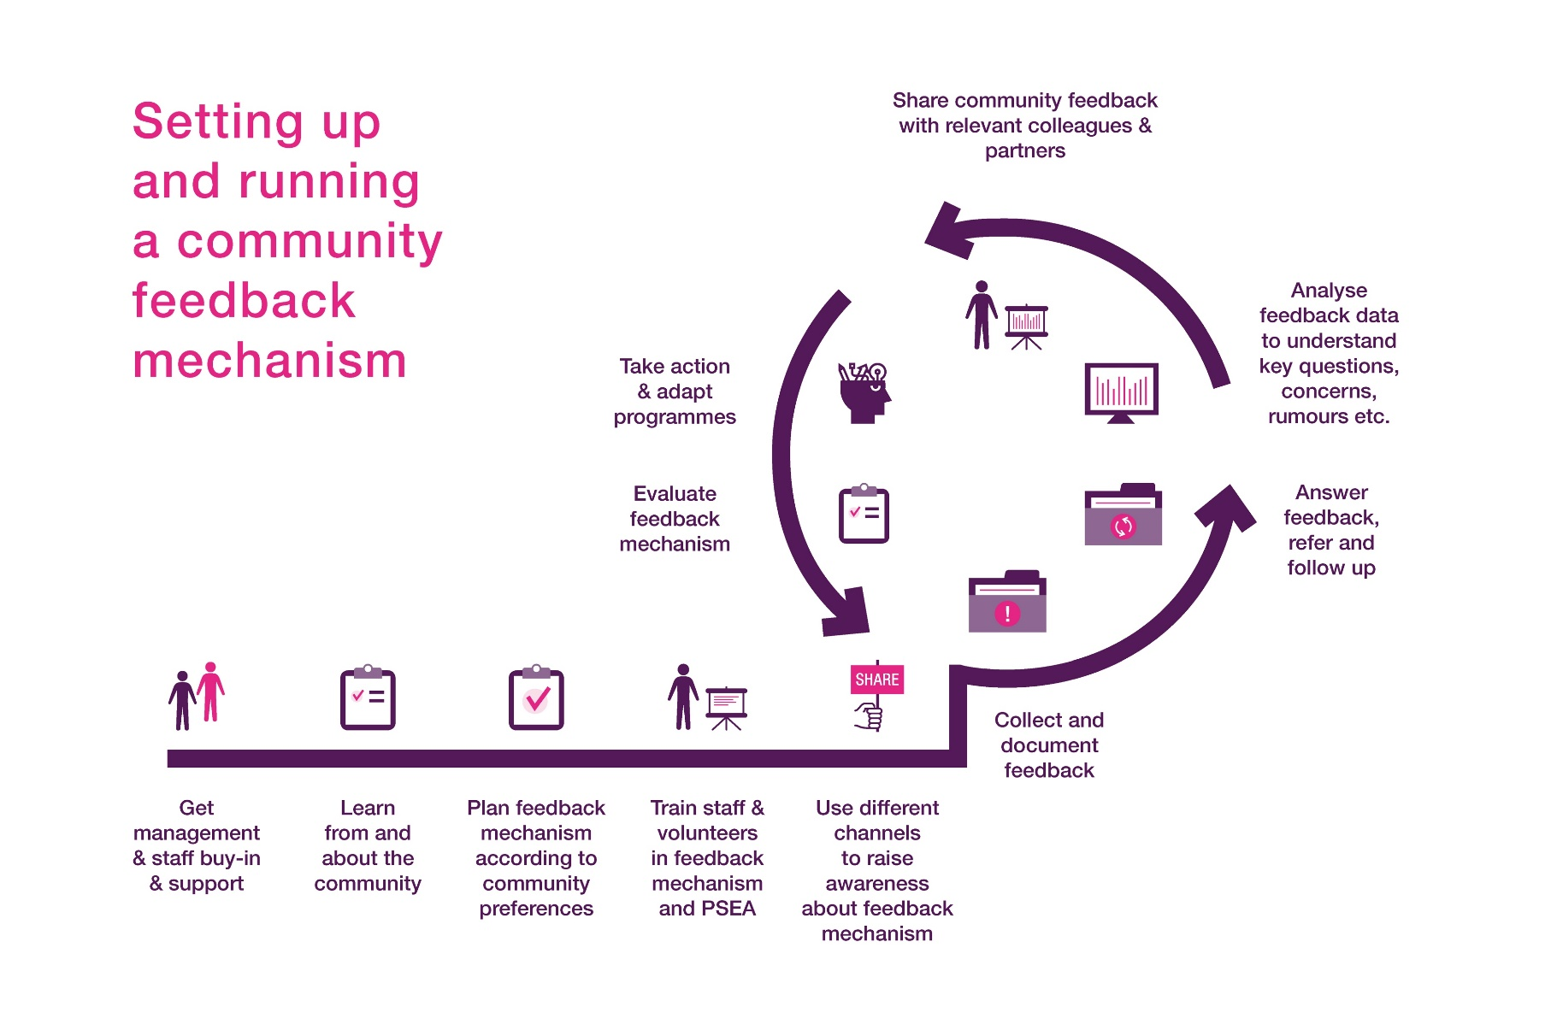

Slide 32
How to manage Rumours?
Listen
Verify
Respond

Slide 33
STEP 1 - LISTEN
How to manage Rumours?
Establish a system for listening and capturing Rumours.
For example: Organize a weekly Questions & Answers with the community on the outbreak. Or ask trusted community members to tell you when they hear a rumour.
Engage in open and unstructured conversation with people
Ensure you listen to a diverse group of people
Don’t just ask about rumours, and don’t dismiss what people say.
Creating trust is critical

Slide 34
How to manage Rumours?
SHOULD YOU RESPOND TO THE RUMOUR ? Ex from Cholera
What are the potential consequences of this rumour, if it spreads?
Will people’s health or life be at risk?
Could it impact the spread of the disease? (cholera e.g: people not coming to the ORP or people doing practices that put them at higher risk of cholera?)
How likely is it that the rumour will spread if no action is taken?
Who is spreading the rumour? Do they have a lot of influence?
How much has it spread already?
What are other people thinking about this rumour? Are they believing it?

Slide 35
How to manage Rumours?
WHAT COULD BE THE CONSEQUENCES ? Example from Cholera outbreak
Eating garlic can help prevent cholera
People who drink chlorinated water will get sick with cholera
If you go to a cholera treatment center, you will die
People who get cholera are poor, dirty, ignorant people / category (fishermen)
Cholera is transmitted by “bad air”
Cholera does not exist. It is an invention of the government / organization to get funding from donors
Cause Harm
Stop people from accessing services
Cause conflict or stigmatization
Lead to Risk Behavior
Put group of people at risk
Put response teams at risk
Impact gov/organization reputation

Slide 36
STEP 2 - VERIFY
How to manage Rumours?
Is the rumour true or false? Check with the experts & get the facts → Contact your supervisor or Health staff
Speak to the source of the rumour if possible, or to the community for more information
Triangulate with a few independent sources in the community
Understanding why it happened can help you address it and prevent more rumours
Be careful not to spread false rumours in the process of verification!
Notes:
Importantly, consider how they know what they know and don’t be afraid to ask them that. You don’t want someone’s opinion; you want the facts, so it is helpful to consider a person’s qualifications, position, interests and biases.
1. Explain to your contact that you are verifying a rumour, which may or may not be true, and explain the rumour that you have heard.
2. Ask them what is true/untrue20 about the rumour and to state in simple terms the facts and how they know them.
3. Ask for any supporting documentation, or where members of the community could get more information.
4. Repeat to them what you have heard to check that you have understood correctly. You should finish with a clear understanding of the facts – if you aren’t sure ask again.
• Understanding what triggered the rumour can help you plan a response and prevent it from being repeated. For example, did the rumour start because a badly worded message? Something a volunteer said? A Government announcement? Or because of the way we carried out activities – for example around safe and dignified burials?

Slide 37
STEP 3 - RESPOND
How to manage Rumours?
Don’t just ignore or deny the rumour!
Replace it with factual information and support people to make informed choices
Use trusted communication channels
Use the right language
Respect local customs and culture
Engage in conversation and check you are being understood
Ensure all staff and volunteers are armed with the right information
Notes:
Responding to rumours
• Don’t just ignore or deny the rumour. Replace it by sharing factual information through trusted communication channels using words and the language that the community best understand
• Check that the messages and the new narrative are being received, understood and believed by the community
International Federation of Red Cross and Red Crescent Societies
• Make sure all staff and volunteers, especially community mobilizers are regularly informed about the latest rumours and how they should respond if they hear them.
• Respect local beliefs! For instance, a common rumor during the Ebola outbreak was that Ebola is caused by witchcraft; the conventional response was to refer to Ebola as a virus. However, more useful would have been to accept this alternative explanation and create recommendations consistent with community mind-set (e.g., don’t touch this person unprotected, but provide food [and prayers] as a token of empathy).

Slide 38
REMEMBER:
How to manage Rumours?
Don’t ignore rumours, they can:
Paralyse programming
Put people at risk
Instead see rumours are an early warning system. Harness them for good and use to improve our work
Address the critical ones to protect communities and staff and volunteers
Discuss rumours in meetings with supervisors, other health staff and communities

Slide 39
Behavioural Science for Mpox Prevention Messaging
Behavioural science studies how people make decisions and how they act on them.
By applying behavioural insights, we can craft messages that encourage communities to adopt healthier practices. As religious leaders, community leaders, teachers, or health volunteers, you are trusted voices in your communities.
Leveraging behavioural science can help you influence your audience more effectively, promoting behaviours that prevent the spread of Mpox.
Different framing techniques for your messages are presented in the next slides (these are high level suggestions but should be tailored and adjusted for your given context and audience)

Slide 40
Messenger Effect
What It Is: The messenger effect refers to the phenomenon where the credibility and trustworthiness of the communicator influence how the message is received. People are more likely to accept information from sources they trust and respect.
Why It Works: Trusted figures like community leaders or healthcare providers can significantly influence decisions because they are seen as knowledgeable and so their behaviour becomes a reference for a successful life.
How to Apply
Example Messages:
" As a community leader, I’ve been closely following the advice of health experts, and I want to assure you that simple actions like washing hands regularly and avoiding close contact with those showing symptoms can keep our community safe“
"As a teacher I have been consulting reliable sources such as the site of MoH, WHO posts, to keep me informed on how we can maintain our school safe, ensuring handwashing points have soap and are available in classroom entrance"
Tip: Use your respected status to endorse health recommendations, reinforcing trust and credibility, or refer to someone that the community hold in high regard, e.g. a celebrity.

Slide 41
Incentives
What It Is: Incentives involve highlighting the benefits of taking action or the costs of inaction to motivate behaviour change.
Why It Works: People are motivated by rewards and the avoidance of negative consequences. Emphasizing the personal and communal benefits of preventive actions can encourage compliance.
How to Apply:
Example Messages: "Preventing Mpox is simpler and less costly than treating it. By taking precautions now, you save time and protect your health.“ “Getting the vaccine is a free and easy way to you and your family from an expensive visit to the hospital”
Tip: Highlight immediate, tangible benefits and reduce perceived barriers to action.

Slide 42
Social Norms
What It Is: Social norms are the accepted behaviours within a community. People often look to others to determine how to behave, especially in uncertain situations.
Why It Works: Individuals are influenced by the actions of their peers. If they believe that most people are engaging in a behaviour, they are more likely to do the same.
How to Apply:
Example Messages: "90% of families in our community who have had a member contract the virus is reporting their infection, seeking help and limiting transmission."
Tip: Share positive examples and statistics that show widespread adoption of preventive measures. Do not use an example of a behaviour that most people are not practicing as this will have the opposite effect.

Slide 43
Commitment
What It Is: Getting individuals to make a public or private commitment to a behaviour.
Why It Works: People like to be consistent with their commitments. Once they agree to something, they are more likely to act accordingly.
How to Apply:
Example Messages: "Let’s all make a commitment to check in with our families daily at breakfast to check if anyone has any signs of symptoms.” “Let’s make our village mpox free, by installing public handwashing points at starting a community surveillance monitoring system.”
Tip: Encourage them to make a pledge or sign a commitment.

Slide 44
Implementation Intention
What It Is: Encouraging people to make a plan or express their intent to take a specific action. This is similar to commitment, but emphasises stating very clear steps to implement the behaviour.
Why It Works: Verbalising or planning an action increases the likelihood of follow-through due to a sense of commitment and consistency.
How to Apply:
Example Messages: "If I feel any symptoms like a rash or fever, then I will immediately isolate myself in [state the room or space] and contact the local health clinic [state where] for advice.“ In a school context: “Every morning, at the beginning of classes, I will promote a 5 minute briefing and dialogue on mpox with students.”
Tip: Help them set specific goals and offer assistance in planning.

Slide 45
Emotional Appeals
What It Is: Leveraging emotions to motivate behaviour change.
Why It Works: Emotions can be a stronger driver of behaviour than rational arguments. Connecting on an emotional level can inspire action.
How to Apply:
Example Messages: "Imagine the relief of knowing you’ve done everything you can to protect your loved ones. By following simple health measures, we can all feel that sense of security.“ “Our families are our greatest treasure. By taking action now, we are showing our love and care for those closest to us, keeping them out of harm's way.”
Tip: Share heartfelt stories or testimonials that resonate emotionally.

Slide 46
Ego
What It Is: Appealing to one's self-image or identity.
Why It Works: People are motivated to act in ways that enhance their self-esteem or align with their desired identity.
How to Apply:
Example Messages: "By taking these precautions, you are being a responsible and caring member of our community.“ “By convincing your classmates to join the school mpox activity, you are being a role model for your school community."
Tip: Reinforce their positive self-image when they engage in desired behaviours.

Slide 47
Reciprocity
What It Is: Encouraging action by highlighting the mutual benefits and responsibilities we share within the community.
Why It Works: People are more likely to engage in positive behaviours when they feel they are reciprocating a good deed or supporting those who have helped them.
How to Apply:
Example Message: "Healthcare workers are putting their lives at risk to protect us. By following health guidelines, we’re helping them and doing our part to keep everyone safe.“ “Volunteers have been working day and night to protect our community. By following the prevention measures, we are contributing to their effort while protecting our community.”
Tip: Remind people of the sacrifices others have made and how their actions can give back to the community.

Slide 48
Ego
What It Is: Appealing to one's self-image or identity.
Why It Works: People are motivated to act in ways that enhance their self-esteem or align with their desired identity.
How to Apply:
Example Messages: "By taking these precautions, you are being a responsible and caring member of our community.“ “By convincing your classmates to join the school mpox activity, you are being a role model for your school community."
Tip: Reinforce their positive self-image when they engage in desired behaviours.

Slide 49
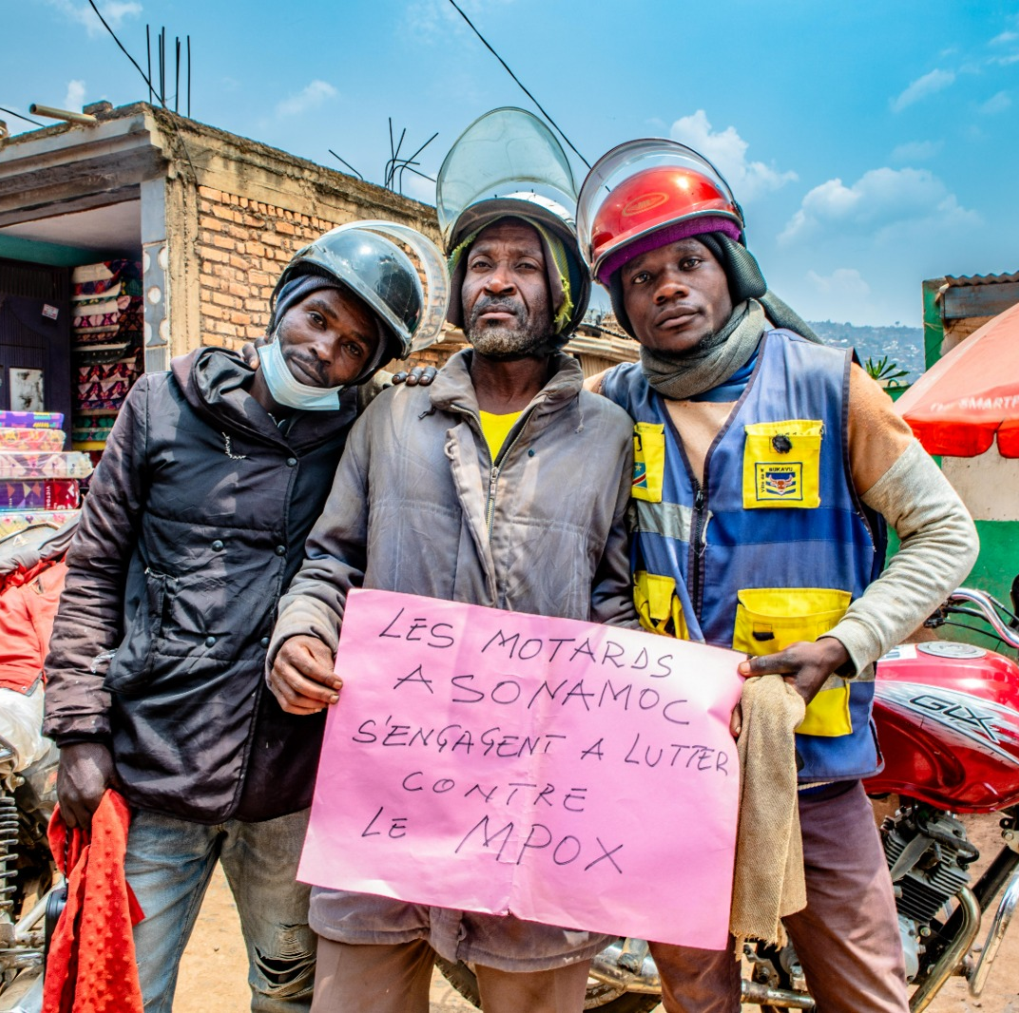
Mpox RCCE Preparedness and Response (for RCCE practitioners) August 2024

Slide 50
MPOX RCCE INTERVENTIONS
Preparedness
Map high-risk areas by leveraging data sources, latest epi data, and assessment of modes of transmission, existing practices and health seeking behaviours (consider the current most affected groups, namely children and caregivers).
Collect and triangulate existing social and behavioural data from high-risk areas.
Strengthen local health workforce capacity and train community actors on outbreak preparedness and response, considering the different dynamics with previous outbreaks.
Support (re)establishment and mobilization of local partner and networks for coordinated RCCE responses, including media, community platforms etc. Map existing actors & establish collaboration.
With partners and community representatives, co-develop, pre-test and disseminate evidence-based key messages (life-saving information, information on rights and entitlements, and services available). As data and feedback is collected, key messages will change and must be updated accordingly including in child-friendly formats.
RCCE must take into consideration the uncertainties regarding the transmission dynamics of mpox and its impact on children and pregnant women.
RCCE interventions need to be child-focused, particularly in settings experiencing clade 1b, understand the different dynamics with respect to previous outbreaks, and have a strong focus on preventing misinformation and stigma.

Slide 51
Use social and behavioural data to drive preparedness and plan the response
A clear understanding of disease transmission dynamics, behaviours and settings associated with increased risk is critical, particularly in the case of mpox and the uncertain dynamics around the disease and different variants. It is also critical to identify trusted local voices and channels to ensure life-saving information reaches affected communities
Engaging communities in research design and decision-making mitigates concerns about experimentation and builds trust. There is also a need for improved understanding of cross-border movements, and actions taken to address cross-border transmission.
Communicate risks to affected populations through accessible, trusted channels and manage risk perceptions to support behaviour change
Risk communication is key, including to address stigma. This includes promoting knowledge of mpox symptoms, associated risk factors (settings, behaviours and practices), and preventative and treatment measures through key messages.
Identify key audiences: this must include caregivers of infants and children, women who are pregnant or breastfeeding, and people who are immunocompromised, as well as some key population groups, people living with HIV, and people who work/have contact with animals.
Identify regularly accessed and trusted information channels, including social networks, influencers and community groups who have access to high-risk groups of people. Note that regularly accessed and trusted channels may not be the most appropriate for mpox, and thinking outside of the box in terms of partners may be needed, context specific.

Slide 52
Communicate risks (cont)
Stigma is likely to play a role in holding people back from seeking treatment for mpox. Take steps to avoid the use of language that may be perceived as stigmatizing or defamatory: Focus communications on the behaviours – not the people - that are fuelling the outbreak. Avoid framing mpox as only a sexually transmitted disease to mitigate stigma and avoid giving a false sense of security. Avoid using language, photographs or graphics that spread fear or place an emphasis on a particular group, activity or community. Use the correct/accurate language to describe the nature of transmission: people ‘acquire’ or ‘contract’ mpox through close contact. Messages should not exclusively be about avoiding contact but should also provide strategies on how to safely support those who are suffering, and promote safe community self-help, preventing the risk of spreading fear, and community fragmentation. Reiterate that stigma and discrimination harm response efforts.
Use data from online and offline social listening systems and/or feedback mechanisms to address misinformation/rumours and any communities’ questions, suggestions, etc. Identify and train spokespersons to speak to the media and the general public. Focus on actions to protect individuals from exposure to mpox.

Slide 53
Engage and include communities as key planners and implementers
This may include local healthcare workers, professionals working with children, social workers, caregivers of infants and young children in wasting treatment programmes, pregnant women, faith-based groups, organizations working with some key population groups, people living with HIV, and people who work with animals.
Community engagement approaches should focus on enabling: Improved access to hygiene measures, infection prevention and control Effective case management: ensure availability of well-trained community health workers and volunteers capable of identifying, managing, and referring cases to healthcare facilities. Community-based surveillance (CBS): CBS relies on active community participation, including community-based health workers and others community structures. Vaccination campaigns: active involvement of community leaders and social mobilizers in the design, planning and implementation of campaigns, co-designing communication material and approaches to improve vaccine uptake in targets population. • Psychosocial support: engage frontline workers and communities and provide them with basic psychosocial support skills, train them to co-lead psychoeducation activities to reduce fears, change harmful beliefs, while addressing stigma and supporting community resilience. • Safe gatherings: engage event organizers, venue managers, school managers and others involved in gatherings to implement prevention measures and share up-to-date, practical and targeted information about mpox with customers, staff, students, volunteers and communities.

Slide 54
Establish feedback loops with communities and hold two-way conversations
Collaboratively create and implement a feedback and rumour tracking system with the affected community, ensuring the inclusion of child-friendly mechanisms.
Regularly review programmes and activities, updating information based on community feedback and contextual changes.
Continuously monitor the performance of the feedback mechanism by analysing the volume of feedback received, the recommendations implemented, the completion of the feedback loop, and the diversity of sources, to ensure inclusivity.

Slide 55
 | RCCE INDICATORS EXAMPLES
Coordination | Functional RCCE coordination group established and RCCE plan operationalized
Data and Feedback | Availability of nationally representative situational social and behavior data to inform community engagement interventions % people from the affected population/targeted populations that have been consulted and/or participated in all phases of the programme cycle, including: a) Identifying priority needs b) program design c)Program implementation d) program Monitoring & evaluation" # people sharing their concerns and asking questions through established feedback mechanisms
Risk Communication | # of affected people (children, caregivers, community members) reached with timely and life-saving information on how and where to access available services.
Community Engagement | # children, their caregivers and communities members engaged in community level preparedness actions and programme design # of people engaged in reflective dialogue through community platforms during a humanitarian crisis, response, and recovery. # of people engaged in reflective dialogue through social media and digital platforms during a humanitarian crisis, response, and recover.(HAC)
Capacity Development | # of people trained to manage, facilitate, or engage in community engagement processe (suggested from HAC methodological indicators guidance)

Slide 56
 | RCCE INDICATORS EXAMPLES
Suggestions for longer term (non high performance) indicators | Prevention: Percentage of individuals who report practicing recommended measures to protect themselves from mpox (broken down by behavior) Percentage increase in public knowledge about Mpox transmission and prevention measures. Percentage of individuals who know correct symptoms of [name of PHE] Percentage of individuals who will get a vaccine if it is available to them Percentage of individuals who believe they are at risk of contracting [name of PHE] CE: Percentage of targeted areas where community members play an active role in the delivery of public health services to respond to [name of PHE] Percentage of targeted areas where community members actively participate in the public health decision-making processes Feedback: Percentage of targeted areas where mechanisms are in place to capture and use community feedback

Slide 57
Toolbox
Guidance
2024
UNICEF RCCE Mpox Guidance and Resources August 2024 and Summary RCCE Mpox presentation (August 2024)
Mpox RCCE Training for volunteers (Sept 2024)
Risk communication and community engagement readiness and response toolkit: Mpox (2024)
WHO RCCE Messages (24th August 2024)
MPOX Q&A (WHO 17 August 2024)
Mpox (who.int) – Facts 26th August 2024
2022
Risk communication and community engagement (RCCE) for mpox outbreaks: Interim guidance, 2022 (2022)
Risk communication and community engagement public health advice on understanding, preventing and addressing stigma and discrimination related to mpox 2022
Testing for mpox: individuals and communities and Testing for mpox: health workers
Recovering from mpox at home Infographic (2022)
Mpox (Monkeypox): What we know Infographic and Mpox: What you need to know infographic (2022)
Public health advice on mpox and congregate settings: settings in which people live, stay or work in proximity (2022)
Public health advice on Mpox (monkeypox) and sex-on-premises venues and events (2022)
Public health advice for gay, bisexual and other men who have sex with men on the recent outbreak of monkeypox (2022)

Slide 58
Toolbox
Evidence – NEW- 2024
U-Report Chatbot in FRA and ENG
Template for U-Report poll on mpox (ENG August.2024) and U-Report Poll en Français (FRA August 2024)
Quantitative Questions bank for mpox (22.08.2024) and Quantitative Questions bank for mpox FRA (24.08.2024)
Mpox qualitative questions bank draft (Sept 2024)
WHO Social listening Taxonomy (August 2024)
Key Considerations: Risk Communication and Community Engagement for Mpox Vaccination in Eastern DRC (ENG and FRA) 2024
UNICEF Social Listening Report (August 2024)
Useful links:
Mpox​ Risk Communication and Community Engagement (sharepoint.com)
https://www.rcce-collective.net/resources/thematic-kits/mpox/

Slide 59
Thank you!

