Slide 1
Data Collection Tips

Slide 2
Field Note - tips
Begin each entry
Leave space
Take notes strategically.
with the date, time, place, and type of data collection event.
on the page for expanding your notes, or plan to expand them on a separate page.
It is usually practical to make only brief notes during data collection. Direct quotes can be especially hard to write down accurately. Rather than try to document every detail or quote, write down key words and phrases that will trigger your memory when you expand notes.
Use shorthand.
Cover a range of observations.
Arrive early and leave late.
Because you will expand and write/type up your notes soon after you write them, it does not matter if you are the only person who can understand your shorthand system. Use abbreviations and acronyms to quickly note what is happening and being said.
For example, even if your question is around specific events (e.g. food distributions) you should be documenting informal conversations, people’s body language, moods, or attitudes; the general environment etc
Some of the most interesting/important observations may occur before or after
Consider using present tense: .
This can increase the level of detail you capture.

Slide 3
Note Write-ups: Instructions
Type up notes:
After typing up notes, swap with your partner (interviewer/notetaker) to review and add any missing information
Include:
Date Location / Site Type of activity (FGD, KII with caregiver)
Type of activity (FGD, KII with caregiver)
Interviewer name Notetaker name Sociodemographics If you have it in your written notes, include it in your typed notes! Include your observations

Slide 4
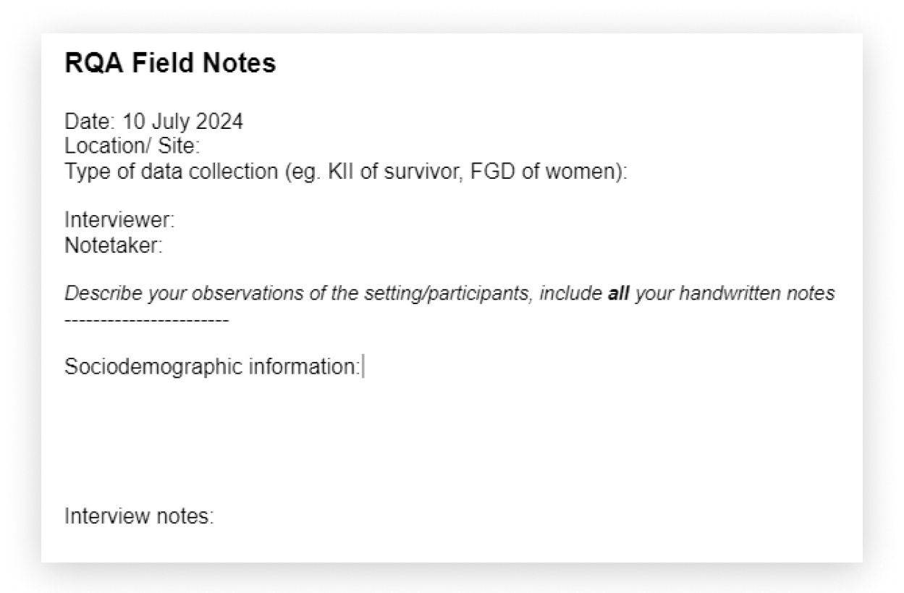
Note Write-ups: Instructions

Slide 5
Be a good listener: be patient, focus on the person speaking, do not interrupt ‘Talk less, listen more’ Start off with an easy question to help informants settle into the interviews. Ask for an example Let the interviewee lead Use open ended questions, encourage people to speak and expand on the subject Avoid leading questions PROBE to get more detailed information from people Write detailed notes beyond what people say, including what you observe Don’t try to teach!
Key Informant Interviews (KII) - tips

Slide 6
Focus Group Discussions (FGD) - tips
01
04
Set ground rules together with the FGD participants
If discussion goes too far off topic, redirect it
02
05
Balance participation across the group
For sensitive topics, e.g. sexual violence, do not ask participants to speak of individual experiences in a group setting. Instead you can ask questions in such a way that you are asking persons to speak about how they think members of their community experience the issue
03
When dealing with dominant people - you can say ‘I can feel you have a lot of information to share about this topic. What about, we meet right after this discussion so we can get more details?’

Slide 7
01
Facilitator is responsible to probe further to help clarify the information being provided by the participant
Why ask probe questions?
02
Probe questions help generate rich qualitative data & better understand complex issues
In depth understanding of complex issues from point-of-view of participants
03
Probing is NOT meant to influence the response
Should be leveraged to produce clarity of information

Slide 8
Probe question best practices:
Questions should not be binary or dichotomous
Don’t present participants with a list of options to choose
Probing must be done in a tactful manner
Should not be yield YES or NO repsosces Should be open-ended
Participants should willingly share their view, opinions, and experiences in the manner, sequencing, or wording that they desire without influence from facilitator
that does not influence or sway the participant to say things that he/she thinks the facilitator is interested in hearing

Slide 9
Strong vs weak probe questions
Weak Probe
Strong Probe
Is lack of resources the reason why you do not wash your hands at the clinic?
So, tell me more about the reasons why you do not wash your hands at the clinic.

Slide 10
Strong vs weak probe questions
Weak Probe
Strong Probe
Is lack of resources the reason why you do not wash your hands at the clinic?
So, tell me more about the reasons why you do not wash your hands at the clinic.
Weak responce:
Strong responce:
Probe is leading and biased Suggests to the participant that “lack of resources” is the reason for not practicing hand washing Yes/no responce
Does not provide any leads or suggestions Simply ask the respondent to provide more information so that it is better understood why she does not wash hands Open-ended response

