Slide 1

Debrief and Reflections
01
What did you learn yesterday?
02
What was something new or interesting?
03
What questions do you have?

Slide 2
Field Note - tips
Begin each entry
Leave space
Take notes strategically.
with the date, time, place, and type of data collection event.
on the page for expanding your notes, or plan to expand them on a separate page.
It is usually practical to make only brief notes during data collection. Direct quotes can be especially hard to write down accurately. Rather than try to document every detail or quote, write down key words and phrases that will trigger your memory when you expand notes.
Use shorthand.
Cover a range of observations.
Arrive early and leave late.
Because you will expand and write/type up your notes soon after you write them, it does not matter if you are the only person who can understand your shorthand system. Use abbreviations and acronyms to quickly note what is happening and being said.
For example, even if your question is around specific events (e.g. food distributions) you should be documenting informal conversations, people’s body language, moods, or attitudes; the general environment etc
Some of the most interesting/important observations may occur before or after
Consider using present tense: .
This can increase the level of detail you capture.

Slide 3


Note Write-ups: Instructions
Type up notes:
After typing up notes, swap with your partner (interviewer/notetaker) to review and add any missing information
Include:
Date
Location / Site
Type of activity (FGD, KII with caregiver)
Type of activity (FGD, KII with caregiver)
Interviewer name
Notetaker name
Sociodemographics
If you have it in your written notes, include it in your typed notes!
Include your observations

Slide 4
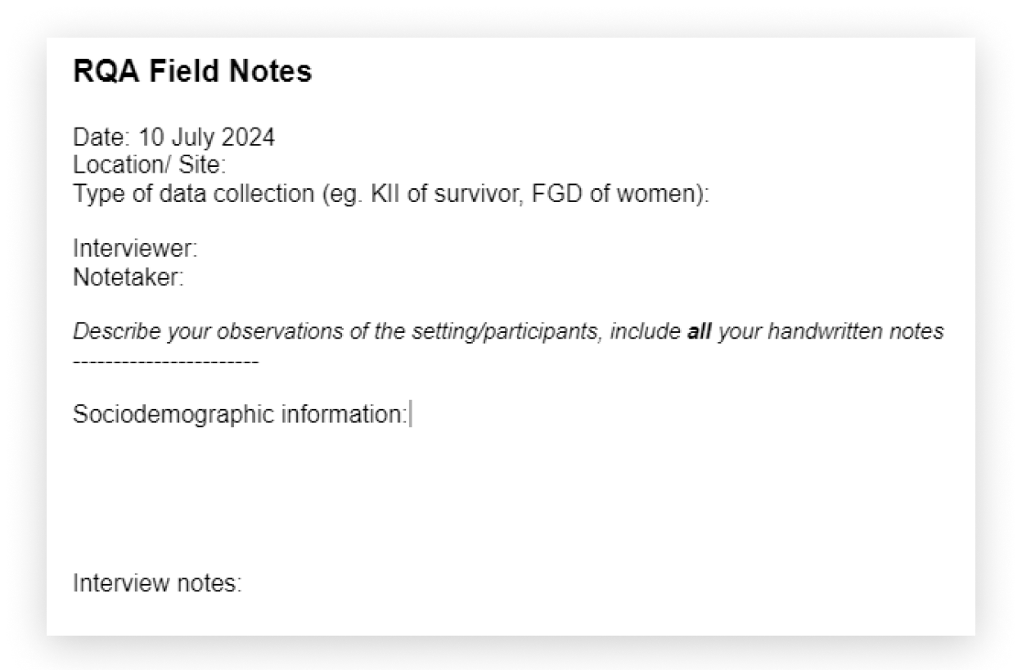
Note Write-ups: Instructions

