Slide 1
Qualitative data analysis (thematic analysis)
Moving from coding to generating themes

Slide 2
To understand and practice the different steps to coding and analysing qualitative data using thematic analysis methods. Session 1: Deductive and inductive coding with real data examples. Session 2: Generating themes from coded qualitative data.
Introduction

Slide 3
Objective of today’s session
To generate themes from coded qualitative data using the thematic analysis approach.

Slide 4
Steps of thematic data analysis - and how/where do we adapt for RQA
1
2
3
4
5
Step 1
Step 2
Step 3
Step 4
Step 5
Transcription and translation
Coding
Generating themes
Prioritising key findings and writing up themes
Using themes and key findings as an evidence base

Slide 5
Step 3: Generating themes
CODES
THEMES
Basic analytic units. You can think of them as labels (words or short phrases) given to a piece of text about a particular topic. Tools for organising your data.
The overarching ideas – the pattern or relationships across the data set. Emerge when we look over our codes and see how they combine to answer our research/assessment questions. Tend to be broader and more inclusive than codes (often combining several codes into one) and expressed in longer phrases or sentences. Involve analysis and interpretation, rather than just using the interview questions.

Slide 6
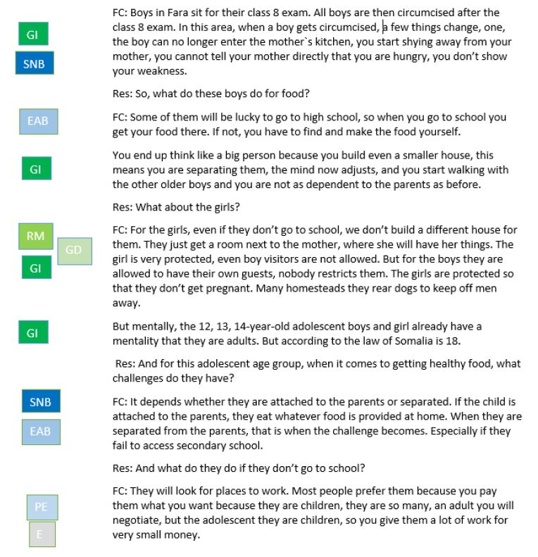
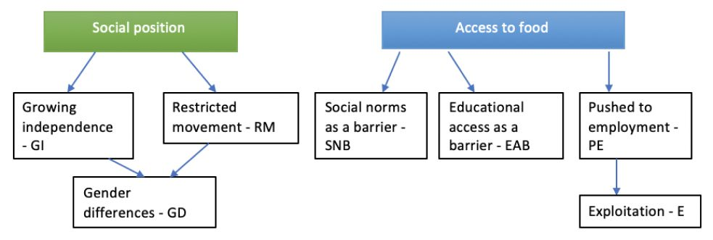
Coding in a Word document
KII – Research topic: adolescent health Location: Fara Village in Bagara, Somalia Participant: Fara village chief (FC)

Slide 7
Step 3: Generating themes
CODES
THEMES
Basic analytic units. You can think of them as labels (words or short phrases) given to a piece of text about a particular topic. Tools for organising your data.
The overarching ideas – the pattern or relationships across the data set. Emerge when we look over our codes and see how they combine to answer our research/assessment questions. Tend to be broader and more inclusive than codes (often combining several codes into one) and expressed in longer phrases or sentences. Involve analysis and interpretation, rather than just using the interview questions.
OVERARCHING THEME
Social position influences access to healthy foods for adolescents in rural Somalia

Slide 8
Deductive vs. inductive coding
What are the major issues facing survivors/caregivers? (illness narrative, careseeking & treatment, post discharge, community perceptions, CATI, aftermath)
Look back at your data and codebook from cholera RQA. What are some overarching themes?
REMEMBER, themes The overarching ideas – the pattern or relationships across the data set. Emerge when we look over our codes and see how they combine to answer our research/assessment questions. Tend to be broader and more inclusive than codes and expressed in longer phrases or sentences. Involve analysis and interpretation, rather than just using the interview questions.

Slide 9
Tips for generating themes
Generating themes is the creative part of analysis! The outcome of this step is a list of themes and maybe sub-themes, with all the data coded against them. Some of the individual codes may themselves become main themes (but not necessarily), some may become sub-themes. Some codes might not belong anywhere - keep these together and revisit them later. Some additional themes may continue to emerge as you group the data.

Slide 10
Generating themes from your (inductively) coded cholera RQA data (can use either Word or Excel)
Practical exercise

Slide 11
Examples of themes to emerge TBD TBD TBD TBD TBD
Generating themes

Slide 12
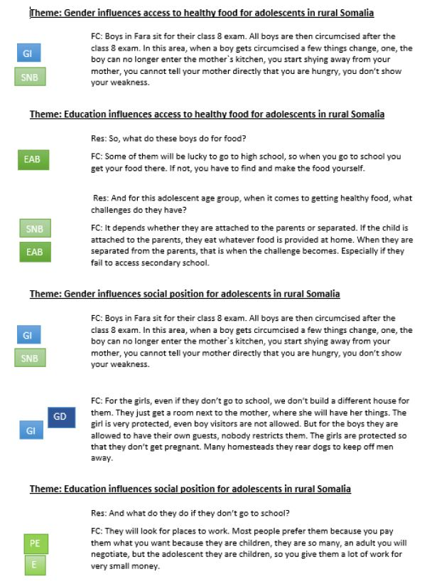
Coding in a Word document
Using Word to group coded data under themes

Slide 13
Using Excel to group coded data under themes

Slide 14
Ask yourselves: Do the themes link with the topic/idea being explored? Does the data support the themes? Is there sufficient data to make this a theme? Is the theme too broad or too narrow to be programmatically useful? If themes overlap, are they separate themes? Am I missing any themes? Does any of the coded data not fit anywhere?
Reviewing your themes

