Slide 1
Deductive Qualitative Analysis
Day 3 July 11, 2024

Slide 2
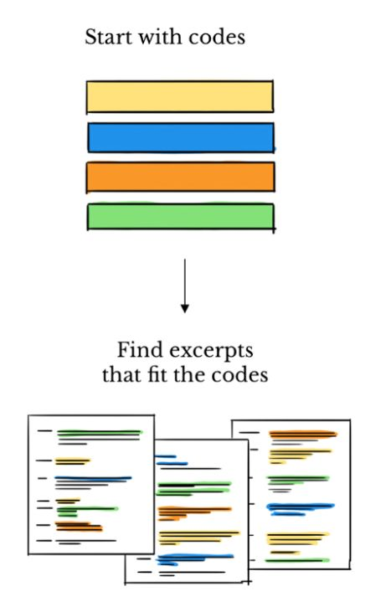
Deductive Analysis
When to use a deductive approach: When you already have an idea of the responses/topics Helpful with a larger coding team When time is limited/need to code quickly
Limitations: not ideal for exploratory analysis

Slide 3
Examples of using deductive approach: Hand Hygiene in Schools in 4 Countries
A priori codebook with clear definitions made it possible to look across settings to see what challenges are experienced across contexts, which are context specific
Locations
Four Coding Teams
Approach
Guatemala, El Salvador, Belize, and Kenya
Atlanta USA, Houston USA, Kenya, Guatemala
Deductive

Slide 4
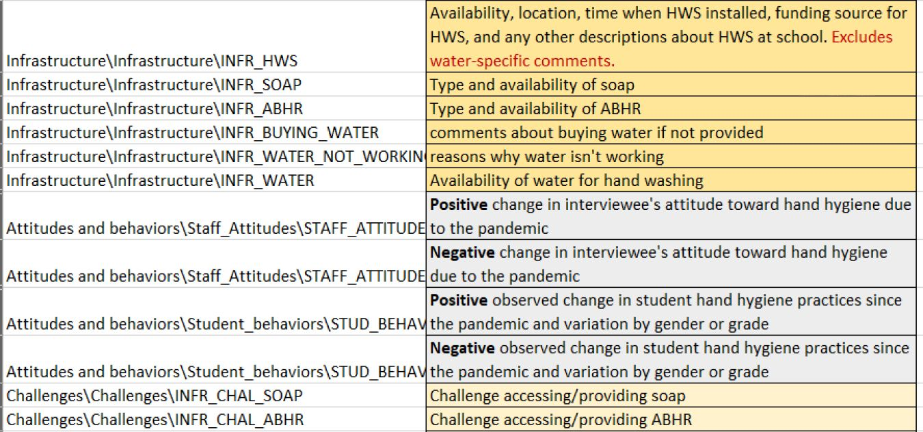
Using a pre-established codebook: example
General structure: Category / Code / Subcode

Slide 5
Using a pre-established codebook: example
General structure: Category / Code / Subcode
Category/Topic

Slide 6
Using a pre-established codebook: example
General structure: Category / Code / Subcode
Main Code

Slide 7
Using a pre-established codebook: example
General structure: Category / Code / Subcode
Sub-Code

Slide 8
Using a pre-established codebook: example
General structure: Category / Code / Subcode
Define your codes

Slide 9
Deductive Coding Process
01
03
Review the codebook, discuss with team
Select and code the data to the most specific level you can
02
04
Read-through of interview notes/transcript
Share with teammate for full review of codes Meet to review/resolve differences in codes

Slide 10
Deductive Coding: FAQs
What if multiple codes apply to the same segment of text?
What if something comes up in the data that doesn’t have an applicable code but seems important?
Double coding is okay! If the same 2 codes are being applied repeatedly, reconsider definitions.
Code as “miscellaneous/other” and then revisit with the team to create a new code if needed
How much text should I code as a “segment”?
Include the question, and any relevant text from the answer, to the sentence/phrase level (no need to include unlreated text that follows

Slide 11
Thank you!

Slide 12
Using a pre-established codebook
This is ONE example of a coding scheme, can be organized based on your needs [FEEDBACK] Type - questions, observations, suggestions? Category - questions about response processes, about disease, about vaccines Code - questions about disease symptoms, questions about vaccine safety

Slide 13
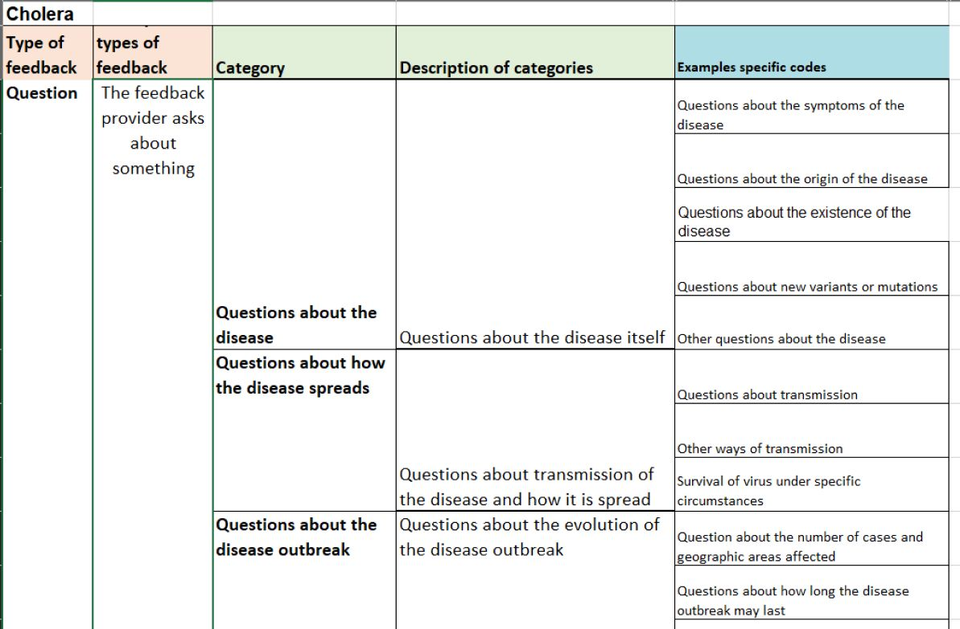
Coding feedback data

Slide 14
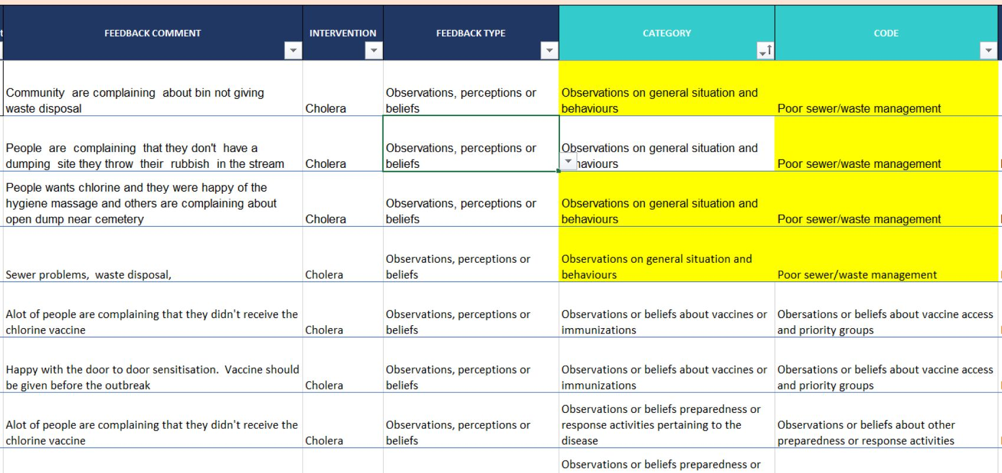
Coding community feedback data

