Slide 2
LEARNING OUTCOMES
Learn different basic options to analyse data collected with quantitative tools such as Knowledge, Attitudes and Practice/Perceptions (KAP) surveys and other quantitative tools.

Slide 3
Key questions in social science research
DATA TO ACTION:
Key questions in social science research
What information is needed?
Who needs this information?
Does this information already exist? Is there a related needs assessment or study?
Who can collect this information?
What methodology and tools should be used to collect and analyse this information?
How to ensure that this information goes back to communities? To inform community-level actions and decision-making of the broader response?
How to ensure that the information is used to make operational and/or strategic decisions?
How to track the information used to ensure that it effectively contributes to operational and strategic priorities?

Slide 4

Quantitative methods
Work with numbers
Test theories you have about a situation: e.g. pregnant women are less likely to use water chlorination tablets than non-pregnant women
Can establish causal relationships – e.g. X causes Y: trust in health system contributes to greater vaccine uptake
Produce generalizable results – those which are widely applicable – using statistical methods
The more representative the sample is – when it has characteristics of the whole population – the more likely it can be generalized to a wider population

Slide 5
Quantitative data analysis
Quantitative data analysis is used to describe the data, to measure differences between groups within the data, to assess relationships between the different things you are measuring in your research, and to test theories (or ‘hypotheses’) we bring to the research.

Slide 6
Descriptive and inferential statistics
Descriptive statistics focus on describing the data and the sample of the population we are studying.
Inferential statistics are used to make conclusions from data; specifically, to understand connections between the different factors you are measuring, and to decide whether something could have happened by coincidence or whether the findings are genuine and could be generalizable to the entire population.

Slide 7
Variables
Categorical variables >>> represent data that can be put into different groups
Continuous variables >>> represent amounts that are measurable in some way
Independent variable >>> the one you think might be the cause
Dependent variables >>> the ones you think might be the effect

Slide 8
Quantitative data analysis steps
RUNNING DESCRIPTIVE STATISTICS
RUNNING APPROPRIATE INFERENTIAL STATISTICS
DATA MANAGEMENT
UNDERSTANDING VARIABLE TYPES
Selecting the right statistical test
Looking for statistical significance

Slide 9
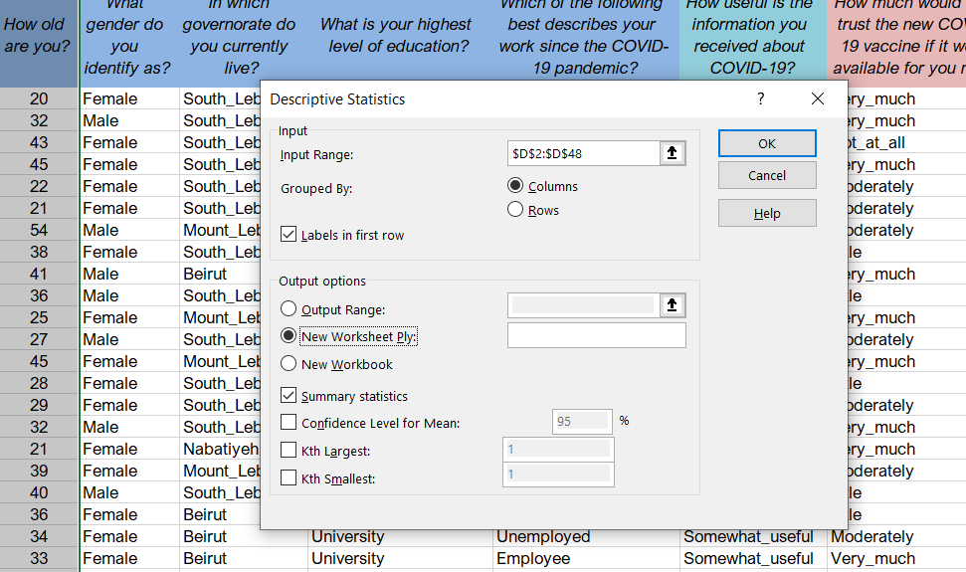
Descriptive analysis

Slide 10
Descriptive analysis
Age
Mean | 38.67
Median | 39
Mode | 32
Standard Deviation | 10.58
Skewness | 0.20
Range | 45
Minimum | 19
Maximum | 64
Sum | 1779
Count | 46

Slide 11
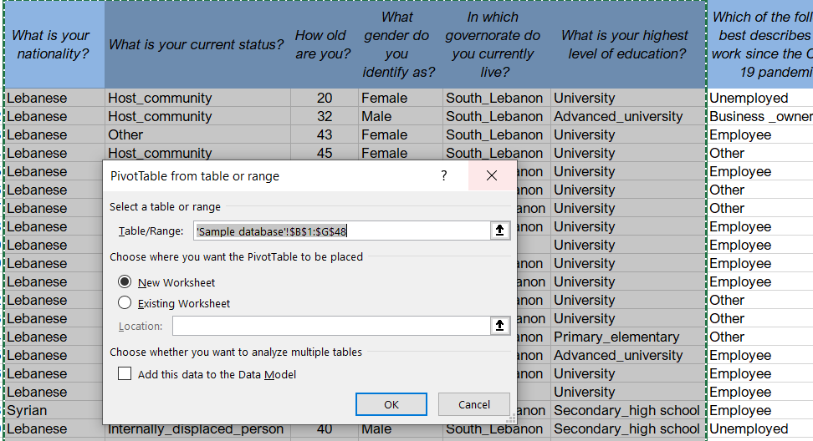
Crosstabs

Slide 12
Crosstabs
What is your nationality?
Row Labels | Frequency | Percentage
Lebanese | 44 | 94%
Palestinian | 1 | 2%
Syrian | 2 | 4%
Grand Total | 47 | 100%

Slide 13
Crosstabs
What is your nationality?
Row Labels | Frequency | Percentage
Lebanese | 44 | 94%
Female | 29 | 62%
Male | 15 | 32%
Palestinian | 1 | 2%
Female | 1 | 2%
Syrian | 2 | 4%
Female | 2 | 4%
Grand Total | 47 | 100%

Slide 14
Crosstabs
What is your nationality?
Row Labels | Frequency | Percentage
Lebanese | 44 |  | 94%
Female | 29 |  | 62%
Advanced_university | 5 |  | 11%
Primary_elementary | 1 |  | 2%
Secondary_high school | 4 |  | 9%
University | 19 |  | 40%
Male | 15 |  | 32%
Advanced_university | 4 |  | 9%
Secondary_high school | 3 |  | 6%
University | 8 |  | 17%
Palestinian | 1 |  | 2%
Female | 1 |  | 2%
University | 1 |  | 2%
Syrian | 2 |  | 4%
Female | 2 |  | 4%
Secondary_high school | 2 |  | 4%
Grand Total | 47 |  | 100%

Slide 15
Data to present | Chart to use
Comparison of two or more categories | Bar chart, doughnut
Binary data (i.e., yes/no responses) | Pie chart, bar chart
Change over time | Line graph, area graph
Correlation between two variables | Scatter graph
Frequency | Bar chart
Percentages | Bar chart, pie chart
Dispersion (how spread out your data set is) | Box and whisker plot, bar chart

Slide 16
SPSS
In SPSS, the steps to follow to conduct descriptive analysis are as follows:
For categorical variables use: Analyze >>> Descriptive Statistics >>> Frequencies >>> Choose the variable
For continuous variables use: Analyze >>> Descriptive Statistics >>> Descriptive >>> Choose the variable
Refer back to discussion on variables above, if necessary.
To run quantitative data on SPSS you would need the input of someone with experience using this program

Slide 17
Inferential statistics
Bivariate analysis can compare two variables to study their relationships, while multivariate analysis can compare more than two variables.
Predictions about differences between groups – for example, boys are taller than girls – looking at height differences between children grouped by their gender.
Relationships between variables – for example, women have less access to COVID-19 information – looking at the relationship between gender and access to information about COVID-19.

Slide 18
Inferential statistics
Regressions look at the extent to which changes in a predictor variable (gender) result in changes in outcome variable(s) (access to information about COVID-19).
Correlation describes the statistical relationship between two variables. It measures how far they are related and whether one causes the other or not.

Slide 19
Presenting findings and discussion
The findings of the study should be written in a succinct and precise format. Graphs, tables, charts and other non-text elements can help the reader understand the data, especially complex findings.
A discussion section should include:
Interpretation of results
Description of findings
Discussion of implications
Limitations
The conclusions section should include a summary of the main findings and actions to take forward. Tie key findings to any programme and/or policy recommendation.

Slide 20
Your
recommendations
are likely to be one of the most important parts
of your report.
Good recommendations
will mean that
your study findings are
more likely to
be used.

Slide 21
Summary
Quantitative data analysis is used to describe the data, to measure differences between groups within the data, to assess relationships between the different things you are measuring in your research, and to test theories (or ‘hypotheses’) we bring to the research.
Descriptive statistics focus on describing the data and the sample of the population we are studying.
Inferential statistics are used to make conclusions from data; specifically, to understand connections between the different factors you are measuring, and to decide whether something could have happened by coincidence or whether the findings are genuine and could be generalizable to the entire population.

Slide 22
Summary
The most frequently used descriptive statistics are the mean, median, mode, range, frequency, percentage standard deviation and skewness. These can be analysed through Excel or SPSS or other software.
The most common conclusions/predictions researchers try to make using inferential statistics include predictions about differences between groups and relationships between variables.
Regressions look at the extent to which changes in a predictor variable
(e.g. gender) result in changes in outcome variable(s) (e.g. access to information about COVID-19). Correlation describes the statistical relationship between two variables, measuring how far they are related and whether one causes the other or not.

