Slide 2
LEARNING OUTCOMES
Understand the Integrated Outbreak Analytics approach and its application in emergency response
Know different methods for ensuring the use of evidence for operational decision-making
Learn what is needed to set up and manage a tool for monitoring the use of evidence

Slide 3
Key questions in social science research
DATA TO ACTION:
Key questions in social science research
What information is needed?
Who needs this information?
Does this information already exist? Is there a related needs assessment or study?
Who can collect this information?
What methodology and tools should be used to collect and analyse this information?
How to ensure that this information goes back to communities? To inform community-level actions and decision-making of the broader response?
How to ensure that the information is used to make operational and/or strategic decisions?
How to track the information used to ensure that it effectively contributes to operational and strategic priorities?

Slide 4
Integrated Outbreak Analytics (IOA)
What is IOA?
An approach which brings together and analyses different data sources to generate a solid, reliable evidence base with which to inform operational decision-making for health emergency response.
What are some examples of data sources to include in the IOA process?

Slide 5

Examples of IOA for public health emergencies
  BIG OUTBREAKS
  Ebola
Explaining differential trends
in outbreak dynamics
Monitoring community health outcomes including impact
on SRMCH
Monitoring and identifying outbreak specific trends (exposure/risk follow up) for specific groups (e.g. children under 5)
  ENDEMIC OUTBREAKS
  Cholera, Plague
  Understanding disease dynamics
  Interaction with malnutrition, diarrhoea and gender?
  Knowledge and practices (prevention/ risk)
  Broader health dynamics
  BROADER IMPACTS
  COVID
  Monitoring and explaining the causes of trends in the use of health services
  Understanding the impacts of COVID-19
  On women/girls
  On other diseases
  Monitoring the impact of school closures on adolescent health
  LONG-TERM HEALTH
  MALNUTRITION
  Integrated factors recurrent
  in cases of anaemia
  Gendered dimensions of malnutrition
  Understand the relationships/ dynamics with WASH, malaria, existing health issues

Slide 6
Case example
Video explaining CASS and IOA
https://www.youtube.com/watch?v=-3EOn1yil1w
Use of IOA in the Democratic Republic of Congo (DRC) 2018-2020 – https://www.youtube.com/watch?v=7Sl7e24iKk4&t=3s

Slide 7

Ensuring the use of research evidence
Include the relevant stakeholders in survey design and study questions
Prioritize questions/information required by decision-makers
Triangulate and integrate data
Coordinate data well
Discuss results with different researchers and analysts before presenting
Systematically present results
Organize discussions with influencers and decision-makers

Slide 8
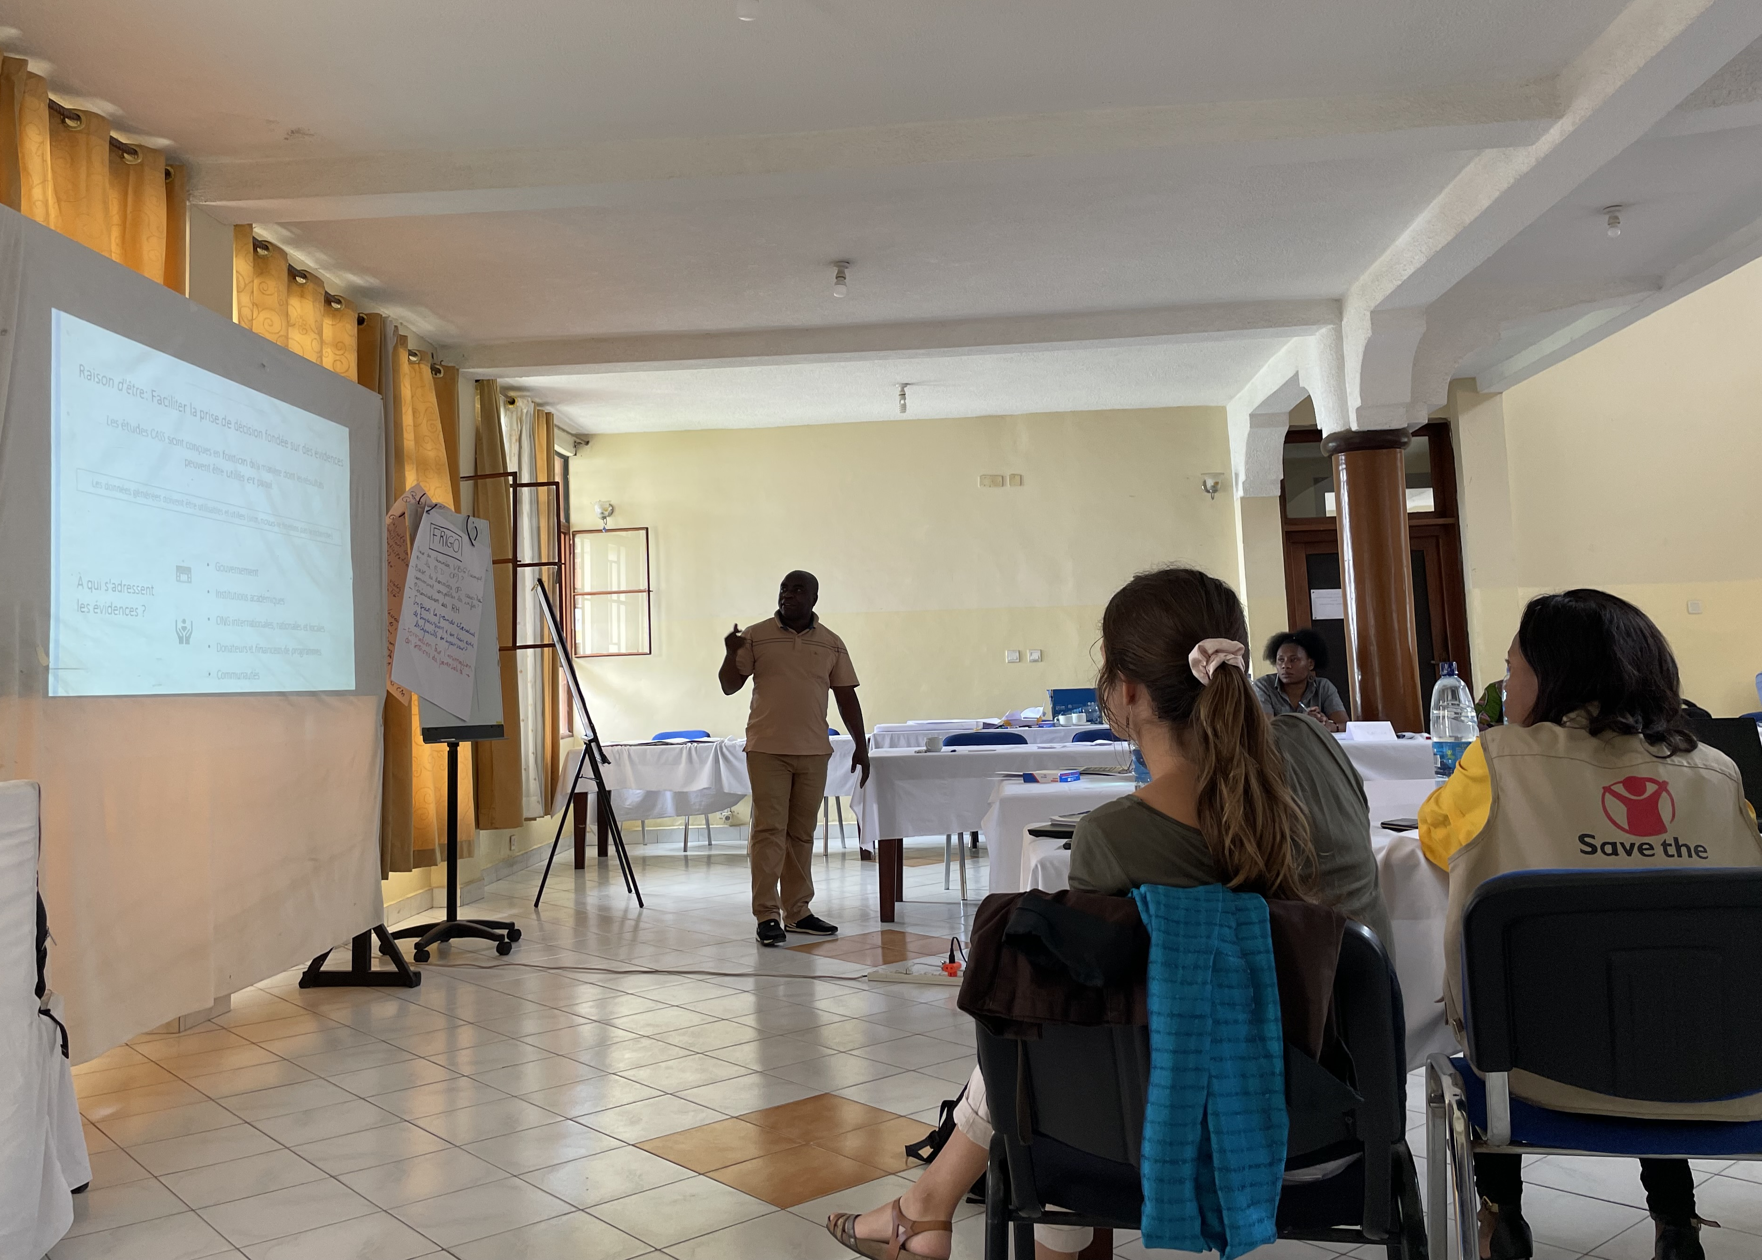
Co-development of actions based on IOA evidence
Those generating evidence should support those who are intended to use it.
The more involved they are, the more invested the response actors will be in using the data to influence decision-making
After the development of recommendations/actions, what should come next to make sure they are implemented?

Slide 9
Tracking the implementation of research recommendations
“
”
We’re doing social science but no one is using our data
Part of making sure that evidence is used is then actively tracking or monitoring if and how the evidence has been taken up.
Please think about any experiences from your work of when you had to track that recommendations made for a project were actually taken up.
What did you do?

Slide 10

Compiles recommendations co-developed
Follow up the consideration and implementation of the recommendations by the partners concerned
Documents the work of
the CASS with partners (when, who, where, what)
Contribute to meassuring
the impact of social science research on response interventions

Slide 11
Case example
Video explaining CASS and IOA
https://www.youtube.com/watch?v=-3EOn1yil1w
Use of IOA in the Democratic Republic of Congo (DRC) 2018-2020 – https://www.youtube.com/watch?v=7Sl7e24iKk4&t=3s

Slide 12
MONITO
A tool (database) to document and monitor the use of evidence generated through operational research. Agreed actions are recorded in the MONITO, and their implementation tracked over time.
A MONITO can help response actors do what they say they will do, when they say they will do it. So, in a way, it holds them accountable, while ensuring that the monitoring process does not become top-down ‘policing’.
Ethically, operational research is not possible to justify without a MONITO.
Not only does it help show whether research evidence actually gets used, but it allows researchers to evaluate their own performance and effectiveness,
and the relevance of data generated.

Slide 13
MONITO
What could this tool look like to make it work for you?
What is needed to ensure it works?

Slide 14

MONITO
Who will manage the tool: one person, or several?
What kind of indicators do we want to be able to produce with the tool (progress status per area, per actor, number of recommendations per actor, etc.)?
Important considerations for a MONITO
Do we want to group the recommendations
into major themes? If so, wich ones?
How can we avoid duplication of counting when the same recommendations has several responsible actors, or is applicable across different areas?

Slide 15
MONITO
Video on how the CASS MONITO tool was developed in the DRC, and how it is used to track the implementation of actions:
https://www.youtube.com/watch?v=-3EOn1yil1w (min. 9.20 – 36)
OR
https://www.youtube.com/watch?v=4zwyihBmAf8&t=298s (min. 10.39 - 40)

Slide 16
Summary
Integrated Outbreak Analytics (IOA) is an approach which brings together and analyses different data sources to generate a solid, reliable evidence base with which to inform operational decision-making for emergency response.
A crucial component of this approach is to involve those who will be using the data/evidence, at every stage of the research process, to make sure that the data will be both usable and used.
Part of making sure that evidence is used is then actively tracking or monitoring if and how the evidence has been taken up.

Slide 17
Summary
MONITO is one example of a tool (database) used by CASS to document and monitor the use of evidence generated through operational research. Agreed actions are recorded in the MONITO, and their implementation tracked over time.
A MONITO can help response actors do what they say they will do, when they say they will do it. So, in a way, it holds them accountable, while ensuring that the monitoring process does not become top-down ‘policing’.

