Slide 2
LEARNING OUTCOMES
Understand the concept of ‘vulnerability’ and how vulnerable groups are affected differently
during crises
Be familiar with how context, including the political economy and cultural and social norms,
can influence vulnerability
Recognize the value of contextual knowledge to emergency response

Slide 3
Key questions in social science research
DATA TO ACTION:
Key questions in social science research
What information is needed?
Who needs this information?
Does this information already exist? Is there a related needs assessment or study?
Who can collect this information?
What methodology and tools should be used to collect and analyse this information?
How to ensure that this information goes back to communities? To inform community-level actions and decision-making of the broader response?
How to ensure that the information is used to make operational and/or strategic decisions?
How to track the information used to ensure that it effectively contributes to operational and strategic priorities?

Slide 4

What do we mean by vulnerability?
What does vulnerability mean to you?
Who tends to be most vulnerable during a crisis?
What causes vulnerability?

Slide 5

Vulnerability & Social difference
Vulnerability
The characteristics of individuals, households or groups that put them at risk of physical or mental harm, and/or of being unable to meet their basic needs
(adapted by SSHAP from Wisner et al 2004 & ACAPS 2019).
Social difference
Dimensions of vulnerability
race/ethnicity
education
religion
gender
etc..
GENDER
RELIGIOUS
MINORITY
DISABILITY
 | Brainstorm What are more likely aspects of social difference – or possible types of vulnerability – that might be relevant in a humanitarian emergency?
INTERSECTING
VULNERABILITIES

Slide 6
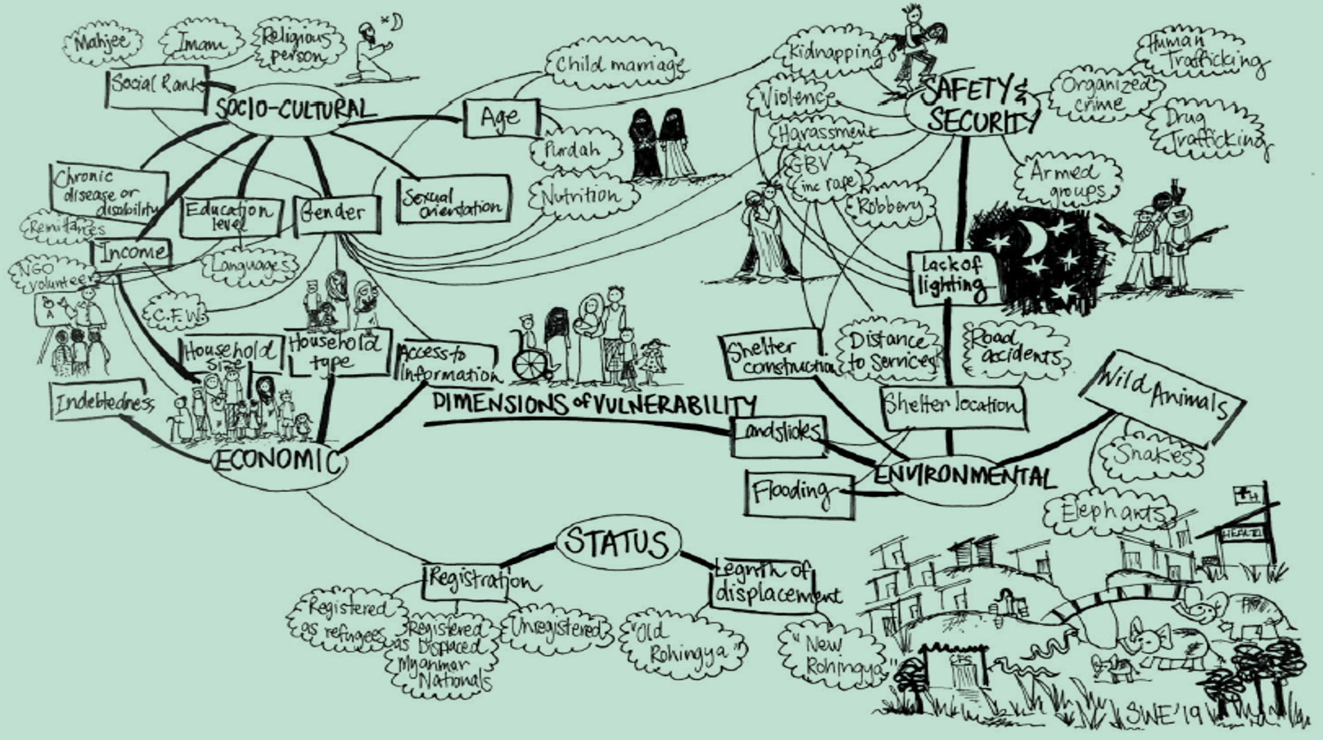
DIMENSIONS OF VULNERABILITY: COX’S BAZAR

Slide 7
Drivers of vulnerability: the role of context
What do we mean by context?
Context:
the different aspects of a setting that are important
for it to be fully understood, for example geography and infrastructure, language, livelihoods, religion and dominant ideas, etc.
It is important to understand context in order to understand vulnerabilities during (and following) a crisis.

Slide 8
Drivers of vulnerability: the role of context
Political economy
Power & political marginalization & exclusion (global, national, local)
Poverty & inequality
(Lack of) access to resources
Historic factors/legacies
Colonialism
Conflicts
Cultural & social drivers
Norms around roles
Taboos
Discrimination
Discuss
Share an example of how any of these three domains have impacted vulnerabilities in a context you are familiar with.
Consider:
Population level
Community level
Household level

Slide 9
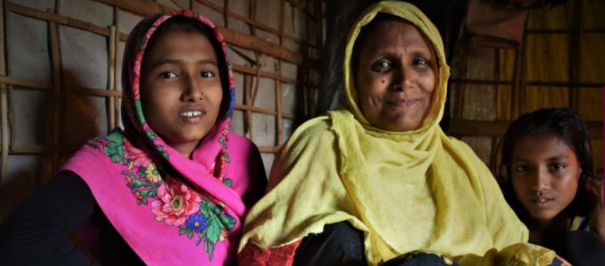
Resilience
Understand
Communities are first responders
Valuable experience, knowledge, networks & practices
Respond
Take stock of strengths & assets
Build upon existing forms of resilience
Support equitable resilience for the long term
Women-run gatherings organized around prayer
Belonging, safety, hope, space to relate
More comfortable than ‘safe spaces’ created by humanitarian organizations (Rahman 2019)
Example
Rohingya women’s taleems

Slide 10
Context analysis for public health emergency response
How can responders best support community resilience in humanitarian settings?

Slide 11
Context analysis for public health emergency response
WHY?
Supports response better able to address needs of vulnerable groups (immediate + longer term)
HOW?
Foresee
Investigate
Lessen its impact
Build on

Slide 12
Individual / Group Exercise
Think of a public health or humanitarian emergency you are familiar with
Who was/is particularly vulnerable during this crisis? In what ways?
Are there social groups you think might have been/might be vulnerable that have not been recognized?
What are some of the drivers that may have led to this vulnerability?
Are there examples of resilience within affected communities, & even vulnerable groups, that responders have/could have built upon?
How might have you designed an aspect of response differently (CE, contact tracing, treatment, etc.)
to ensure no one is left behind?

Slide 13
SUMMARY
Contextual knowledge is of critical importance during a humanitarian emergency.
It is important to understanding the broader social context of a setting in order to understand issues of vulnerability and inequality. Vulnerability is usually primarily created by social circumstances more than physical/biological characteristics.
Communities and community members are actually often the first responders to a crisis, and have valuable experience, knowledge, networks, skills and practices. Responders can support community resilience in humanitarian settings in several ways.
Context analysis is a social science research method which can support responses to be better able to address the needs of vulnerable groups, and build upon community resilience, in both the immediate and long term.

