Slide 1
Notes:
Prior to starting have handouts ready to post into the chat. You could post these ahead of time and refer back to them during the session.
We talked about why we want to do social science research and what questions we want to answer, and how it’s important to involve people affected. But how? So let’s start getting into that.
Mainly 2 approaches

Slide 2
LEARNING OUTCOMES
Know the difference between qualitative and quantitative data collection approaches to social science research
Know when to apply these different approaches, including to which types of research questions
Notes:
Facilitation notes
Talk through the learning outcomes on the slide. i.e this session is an introductory session to know the difference between qualitative and quantitative data collection approaches to social science research.
You need to have completed 4.1 before doing this session.

Slide 3
Key questions in social science research
DATA TO ACTION:
Key questions in social science research
What information is needed?
Who needs this information?
Does this information already exist? Is there a related needs assessment or study?
Who can collect this information?
What methodology and tools should be used to collect and analyse this information?
How to ensure that this information goes back to communities? To inform community-level actions and decision-making of the broader response?
How to ensure that the information is used to make operational and/or strategic decisions?
How to track the information used to ensure that it effectively contributes to operational and strategic priorities?
Notes:
Facilitation notes
This module relates to the questions highlighted on the Data to Action visual on this slide.
Read the questions highlighted – 1 and 5

Slide 4
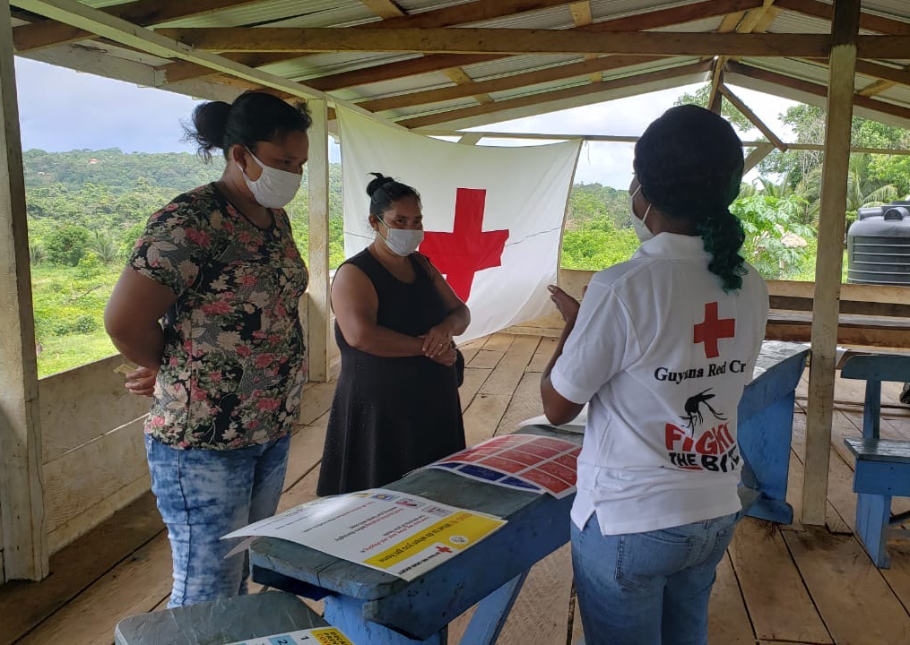
Quantitative vs Qualitative - DISCUSS
How are quantitative research methods different to qualitative research methods?
Answer in the chat – 10 minutes exercice
Notes:
Facilitation notes
10 minute exercise
Read question on the slide: How are quantitative research methods different to qualitative research methods?
Online: Invite the participants to write the answers in the chat function and summarize
Offline: Ask two or three participants to share their thoughts
Answer: Quantitative approaches differ from qualitative approaches in several ways. CLICK TO NEXT SLIDE

Slide 5
Quantitative approaches…
Use quantitative methods when you want to know ‘how many’ and/or ‘how often’
Work with numbers– the instrument used in quantitative research poses questions in which response options are assigned numbers
Generally uses surveying of a large group of people and a structured questionnaire that contain predominantly close-ended, or forced choice, questions.
Can test theories you have about a situation
Can establish causal relationships – e.g. X causes Y
Analysis often uses statistical methods
The more representative the sample is, the more likely it can be generalized to
a wider population
Notes:
Facilitation notes
Answer in the chat – 10 mintue exericse
Use quantitative methods when you want to know ‘how many’ and/or ‘how often’
Read dot points.

Slide 6

Quantitative approaches…
Often leaves gaps in information - including around 'why' and 'how'
Close-ended questions and tools limit outcomes, and response options are based on the selection of the researcher. So results might not always represent the actual situation
A labour intensive and resource-heavy data collection process
Usually, there is limited participation by affected persons in the development of questions and in the way the information collection process flows
Method least likely to lead to relationship-building for community engagement
Number-based estimates
Opportunity for relatively uncomplicated data analysis
The accuracy of the data can be checked
Can compare data between different communities within different locations
Data does not require individual judgement beyond consideration of how information will be presented
STRENGTHS
WEAKNESSES
Notes:
Facilitation notes
What might be some of the strengths of quantitative methods? What might be some of the weaknesses of quantitative methods?
Online: Invite the participants to write the answers in the chat function and summarize
Offline: Divide the room into two groups, half of the room to give strengths, half to give weaknesses
Answer: slide shows strengths and weaknesses of quantitative approaches. CLICK TO REVEAL
Quant is more heavy in the set-up. If all is set up well, analysis can involve point and click.
With quant methods, we want to be able to say something about a whole group of people, e.g. all youth in Bangara. But usually there is no way we could reach all youth in Bangara within a reasonable time to ask them. So, we can take a sample that we choose carefully to represent that population. But since we aren’t asking everyone, we take a small risk, that our sample won’t represent the population.
We can try to account for this by making sure we ask enough people. The more people we ask, the more we’re sure any differences are not due to our random unluckiness.
Accuracy (validity) and reliability (consistency)
Variation and sampling error – greater variation means greater potential error because of differences between people.

Slide 7
Qualitative approaches…
Use qualitative methods when you want to know how people feel and what they think – You don’t need to know how many people think or feel this way
Not based on numbers
Generally use interviews, focus groups discussions and observations
Exploratory: looking at factors such as cultural expectations, gender roles, ethnic and religious implications and individual feelings
Usually use a smaller sample size than quantitative approaches
Provide data that are usually rich and detailed, offering many ideas and concepts to inform your programme
Notes:
Facilitation notes
Handout 1 summaries the main differences between quantitative and qualitative approaches in social science research.
Use qualitative methods when you want to know ‘how people feel and what they think’
Read dot points.

Slide 8
Qualitative approaches…
Results in data which the accuracy of the data cannot be objectively checked
May require a more labour intensive analysis process (categorisation, recoding, etc.)
Needs skilled interviewers to successfully carry out the primary data collection activities.
Requires a detailed dissemination and visualisation plan (data is text and words not percentages and graphs)
Data does not as easily translate (as numbers) into PowerPoint presentation
Potentially more time intensive for recipients of this information to take in detailed findings
(see Session 5.3 for information on presenting and communicating evidence)
Rich and detailed information about affected populations and the impact of the emergency
Perspectives of specific social and cultural contexts (i.e. the human voice of the disaster)
Opportunity for more active participation in the research process and community engagement
Flexible and open tools means that the focus of research can be adjusted if appropriate
A data collection process which requires limited numbers of respondents
A data collection process which can be carried out with limited resources.
STRENGTHS
WEAKNESSES
Notes:
Facilitation notes
What might be some of the strengths of qualitative methods? What might be some of the weaknesses of qualitative methods?
Online: Invite the participants to write the answers in the chat function and summarize
Offline: Divide the room into two groups, half of the room to give strengths, half to give weaknesses
Answer: slide shows strengths and weaknesses of quantitative approaches. CLICK TO REVEAL

Slide 9
Group exercise – DISCUSS
What is the best approach to produce social and behavioural evidence relevant to community engagement/communications activities in an emergency – quantitative or qualitative?
Each group advocates for one approach – 10 minutes. Nominate a notetaker and feedback back response in plenary.
  Groups Yellow, Orange & Purple: Qualitative
  Groups Green & Blue: Quantitative
Notes:
Facilitation notes
What is the best approach to produce social and behavioural evidence relevant to your work in community engagement/communications in an emergency setting: quantitative or qualitative?
Assign groups the role of advocating for either quantitative or qualitative methods
Online: Invite the participants to write the answers in the chat function and summarize both sides of the debate. Spontaneously, popcorn style!
Offline: Ask two or three participants from each ‘side’ to give their view.
Bottom line: there is no one best approach, oftentimes we mix approaches in mixed methods. Moh Yin will tell us more about this in session 4.7.

Slide 10
Why are qualitative approaches important?
Allow an understanding of why and how affected people and communities cope with and are impacted by an emergency
Give us an opportunity to listen to people
Help to start a dialogue/conversation with people affected by an emergency situation
Can help to build relationships, acceptance and trust among the crisis-affected population
Better able to identify and support local resilience mechanisms for responding to crisis
Notes:
Facilitation notes
Answer – read
Understanding why and how allows us to direct resources where they are needed, and address root causes
Building relationships, trust that can lead to further points of contact and have successful programs
Leverage local strengths and resilience mechanisms

Slide 11

Why are quantitative approaches important?
Can provide findings which are widely applicable
Allow for the comparison of data between different communities within different locations
If the instruments are used at different points in time, they can also show trends in phenomena over time
Having repeated measures in a community offer a type of feedback loop
If repeated measures are done with the same group of people over time, can detect changes in individuals which could help address any service delivery issues people may be encountering
Notes:
Facilitation notes
Answer read
Oftentimes people choose to mix quantitative and qualitative approaches to get the benefits of both. We talk more about this in Session 4.7.
Carefully built sample and rigorous data – generalizable findings
Oftentimes people choose to mix quantitative and qualitative approaches to get the benefits of both. We talk more about this in Session 4.7.
Example of repeated measures over time:
Intention to seek health care upon onset of COVID-19 symptoms
In Afghanistan, the proportion of respondents intending to seek health care services upon the onset of
COVID-19 symptoms increased to more than half (between December 2020 and March 2021). However,
the proportion intending to treat themselves using home remedies was still high (28 per cent) by March
2021. Similarly, in India (April 2021) and Nepal (August and December 2020) the majority of respondents
reported that they would actively seek support from a health service by going to a clinic or hospital or
getting tested for COVID-19. In Pakistan, information from three time points (December 2020, January
2021 and March 2021) indicated that only a minority would practice active health seeking behaviour
(such as get tested, go to a clinic or hospital or call a helpline) and this changed little over time.
Community Rapid Assessment (CRA) on COVID-19
Time Series Social Data for Assessing Behavioral Change During COVID-19
UNICEF Evaluation Office
https://www.unicef.org/evaluation/community-rapid-assessment-cra-covid-19

Slide 12
SCENARIO - Group WORK
You are working in a response in Bangara which has been recently hit by a cyclone. You have been requested to lead a three-week in-depth assessment to ensure that migrants and other vulnerable populations in the hardest hit areas are included in the main community engagement activities in the country.
Ask yourself:
What information do we want to collect?
What is the most appropriate research approach?
Jamboard LINK: https://jamboard.google.com/d/1dJdZE9ROrgULIeAI--sCzjcdlLaFCH1HkXy5DcNNWeI/viewer?f=1
Notes:
Facilitation notes
Breakout rooms – 5 groups, 10 minutes total.
Report back in plenary one group 2 minutes.
Jamboard https://jamboard.google.com/d/1dJdZE9ROrgULIeAI--sCzjcdlLaFCH1HkXy5DcNNWeI/viewer?f=1

Slide 13
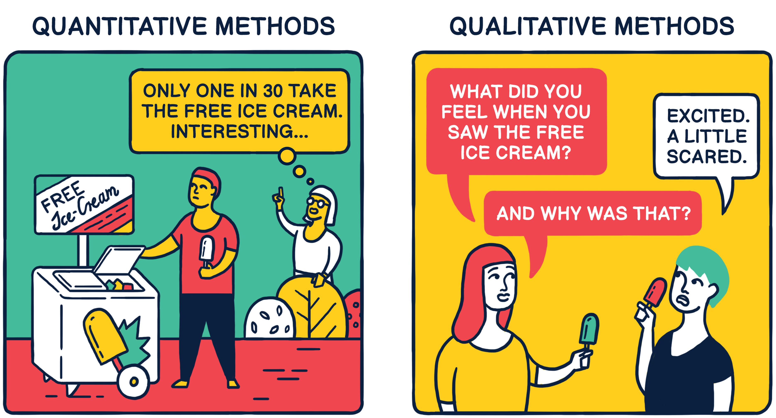

Slide 14
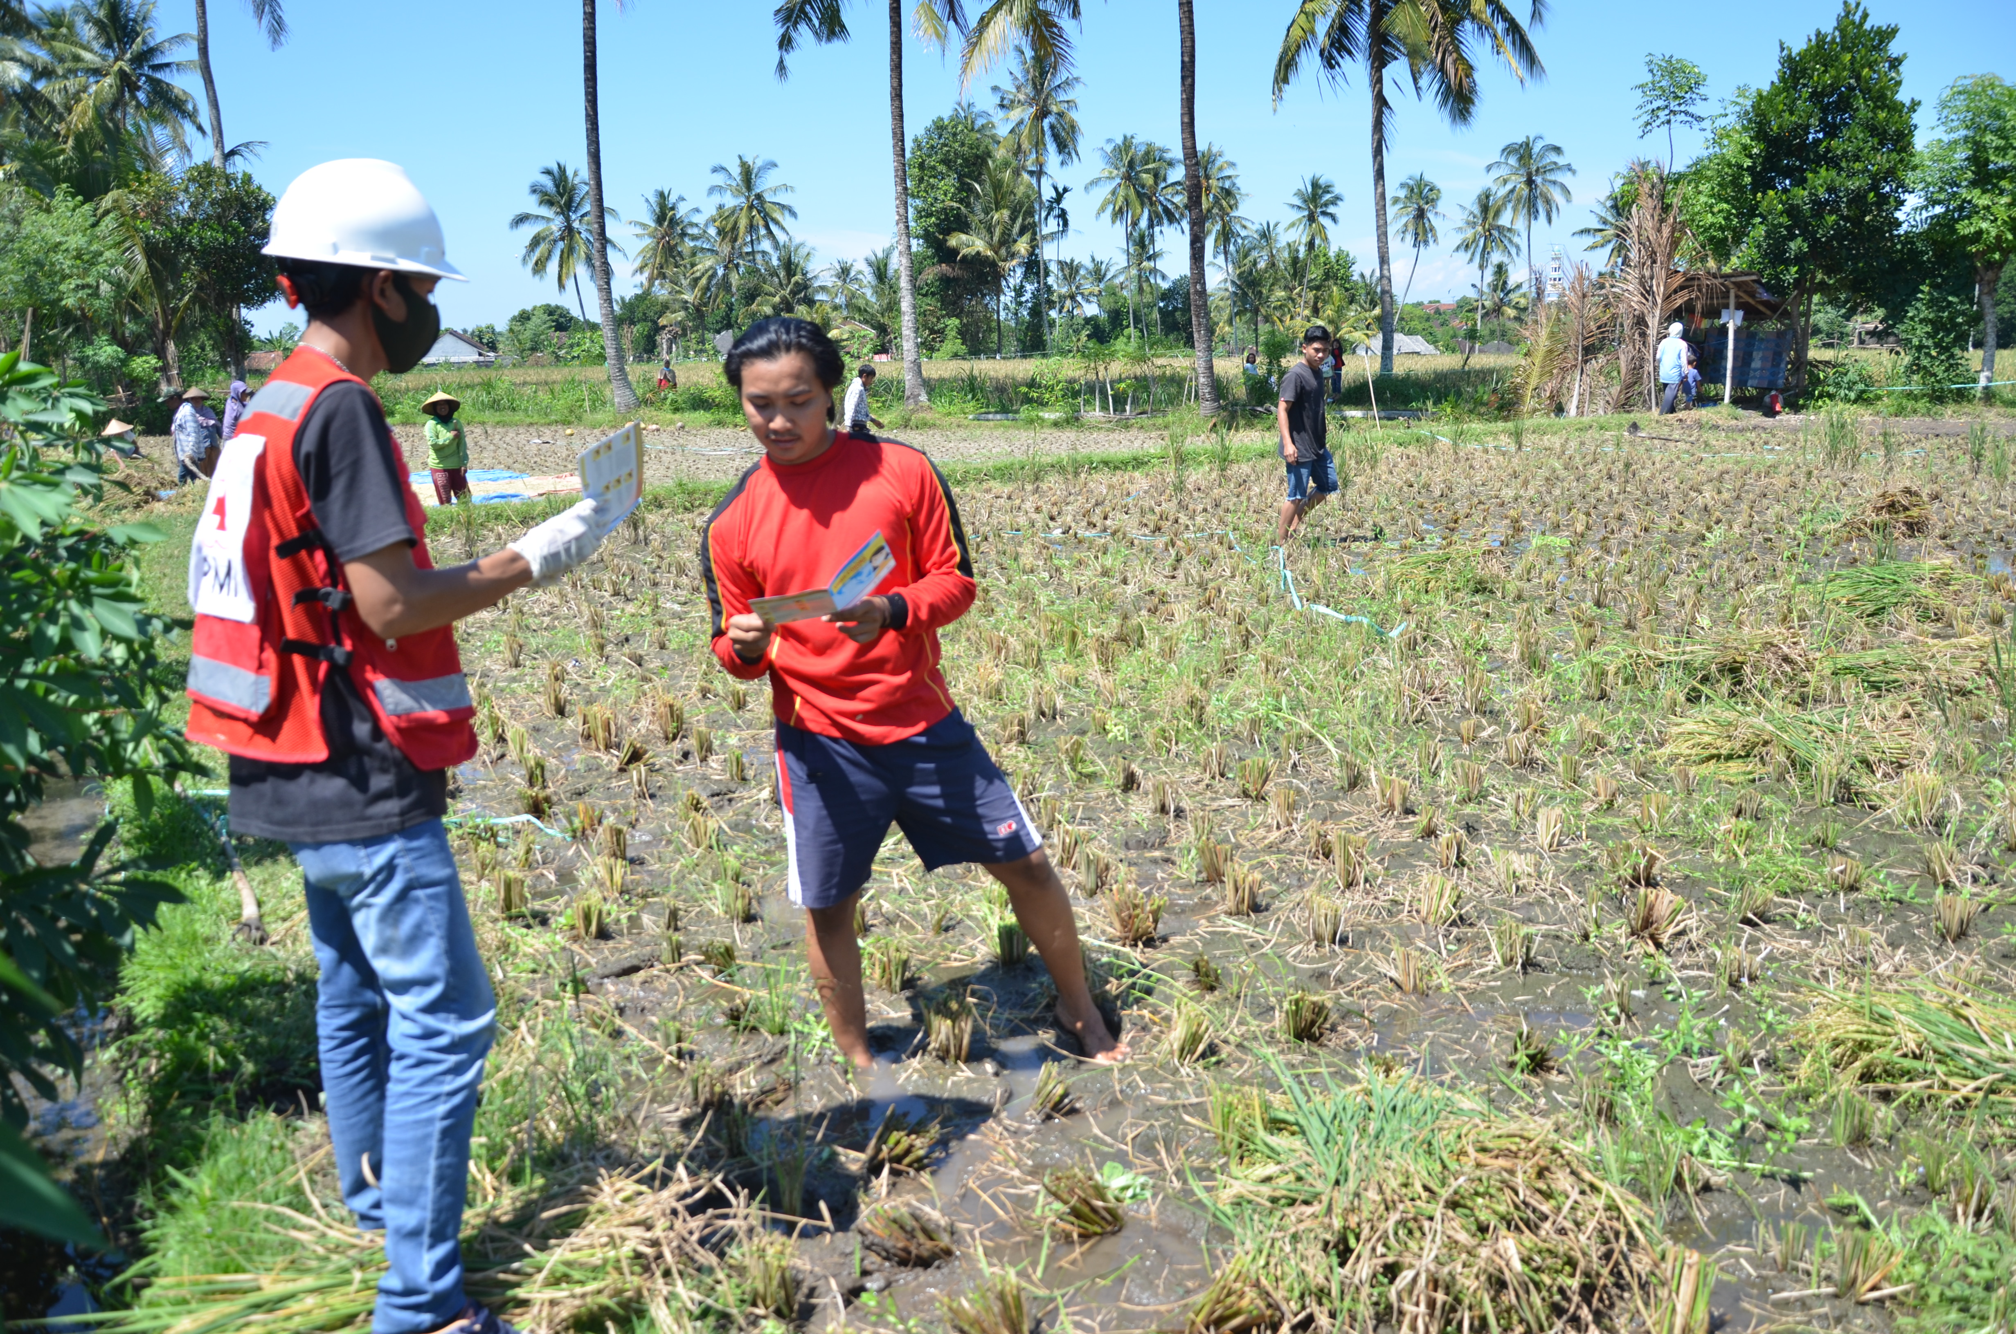
SUMMARY
Qualitative and quantitative methods are both helpful. They allow us to address different sorts of questions:
Use quantitative methods when you want to know ‘how many’ and/or ‘how often’
Use qualitative methods when you want to know how people feel and what they think
Notes:
Facilitation notes
Qualitative and quantitative methods are both helpful. They allow us to address different sorts of questions
Use quantitative methods when you want to know ‘how many’ and/or ‘how often’
Use qualitative methods when you want to know how people feel and what they think
Qualitative methods are important during an emergency because they:
Allow an understanding of why and how affected people and communities cope with and are impacted by an emergency
Give us an opportunity to listen to people
Help to start a dialogue/conversation with people affected by an emergency situation
Quantitative methods are important during an emergency because they:
Can provide findings which are widely applicable
Allow for the comparison of data between different communities within different locations
If the instruments are used at different points in time, they can also show trends in phenomena over time
Communications and community engagement work often tries to change knowledge, attitudes, beliefs, perceptions and practices so having repeated measures in a community, offers a feedback loop
If repeated measures are done with the same group of people over time, would be able to detect changes in individuals which could help address any service delivery issues people may be encountering, as well as changes in perceptions and experiences

