Slide 1
research

Slide 2
LEARNING OUTCOMES
Understand the steps to analyse data collected with qualitative methods like interviews, observations and focus group discussions

Slide 3
Key questions in social science research
DATA TO ACTION:
Key questions in social science research
What information is needed?
Who needs this information?
Does this information already exist? Is there a related needs assessment or study?
Who can collect this information?
What methodology and tools should be used to collect and analyse this information?
How to ensure that this information goes back to communities? To inform community-level actions and decision-making of the broader response?
How to ensure that the information is used to make operational and/or strategic decisions?
How to track the information used to ensure that it effectively contributes to operational and strategic priorities?

Slide 4
Key Informant Interviews
Held with people who can provide detailed information around the topic you want to know more on.
Use a set of predefined questions or a topic guide covering the area of interest.
Allow interviewees/key informants to provide both first-hand experiences and personal opinions.
A helpful method when seeking information on sensitive issues that are difficult to discuss in a wider group.
Also suitable when engaging vulnerable individuals who are difficult to reach and/or who require extra time to build trust on a one-to-one level.

Slide 5
Observations
When the researcher observes participants ongoing behaviour in a natural situation and takes very detailed notes.
Allow for thorough documentation of what people do in a given scenario and can provide direct information on their actions and behaviours.
Can be used to verify information collected verbally from participants – is what they say they do actually what they do?

Slide 6
Focus group discussions
Involve in-depth discussion with a group of people about their experiences and beliefs on a certain topic.
Based on a pre-set group of questions or a topic guide covering the area of interest.
Allow for members of the group to agree or disagree, which gives insight into the range of ideas and opinions, and levels of agreement and consistency.

Slide 7
Thematic analysis
Let us consider the data:
The analysis of interview, focus group and observation data can be quite complex.
It involves the analysis of both verbal and non-verbal communication.
The words and behaviours of participants will provide answers to the research question.

Slide 8
Step 1: Transcription and translation
If you recorded the discussion sessions or interviews, you will be able to produce a word-for-word transcript.
If time is short, you can choose to listen to the recording in real time and just take notes or note the most important points, rather than typing each word.
Translate the transcripts if the discussions were recorded in a language different from the language in which the analysis will take place.
If time is short, you may choose to transcribe directly into the target language.
If it was not possible to record the discussions (for example, if the participants did not agree to be recorded), you will need to work from your notes.
CHALLENGES / TOP TIPS?

Slide 9
Step 2: Coding
Once the transcribing and translation is done, the next step is reading and coding the data in the transcripts or notes.
A code is usually a word or a phrase that represents a recurring theme or idea in the data.
There are many ways this can be done, and the best way will depend on the amount and type of data you need to analyse and how specific the research question is, as well as the preferences of the analyst.
We will give two examples here, using the common software programs Word and Excel.

Slide 10
Step 2: Coding
DEDUCTIVE VS. INDUCTIVE CODING
Deductive coding means you create a predefined set of codes before starting your analysis. This can be useful if you already have a good idea of the research questions you want to answer and the types of themes that you want to explore. You might also have an idea of the types of themes that will emerge in your data after reviewing previous research.
Inductive coding means you do not have any predefined codes, but create the codes as you read through the data. This method can be useful if your research question is broader and you do not want to be influenced by preconceived notions of what might be the most important themes.
A good compromise is to use a mix of deductive and inductive coding.

Slide 11
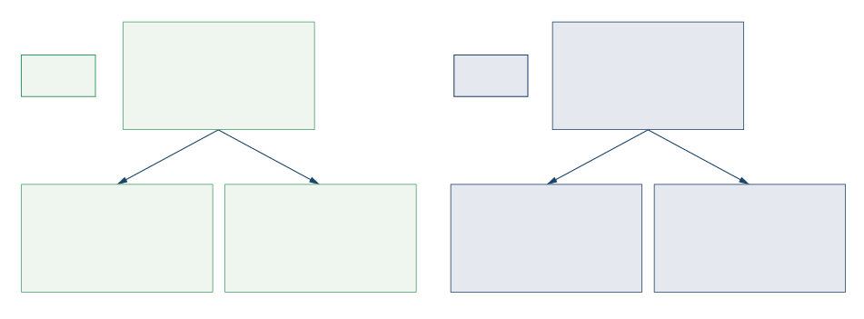
Step 2: Coding
CODING BOOK
CODES
PB
(Psychological
barriers to work)
SUB-CODES
HC
(Role of host
community
LM
(Low motivation)
PRB
(Perceived risk of borrowing money)
R
(Rejection)
RV
(Risk of violence)

Slide 12
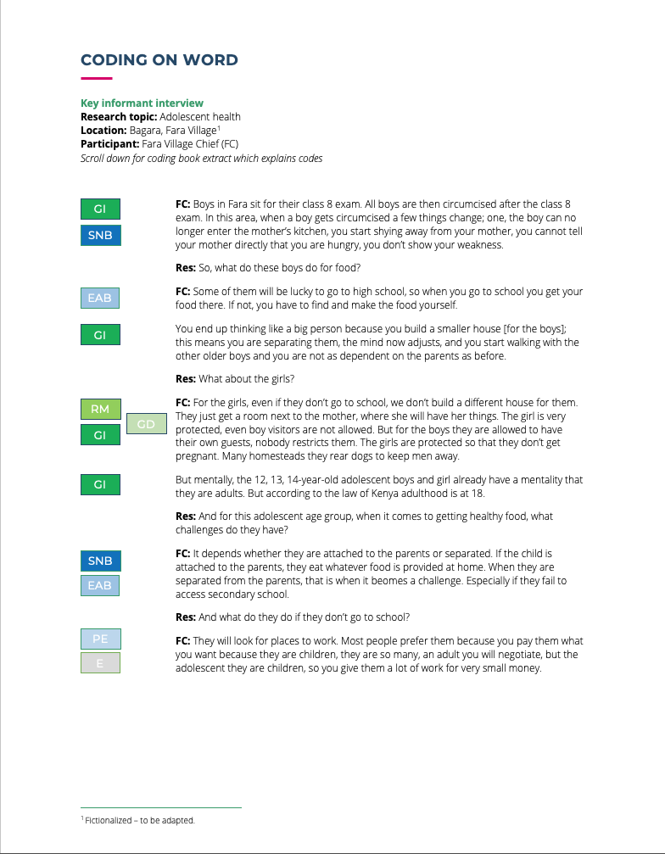
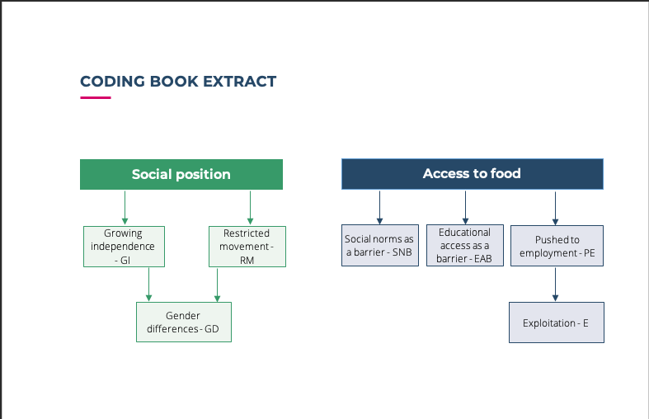
Step 2: Coding
CODING USING WORD
CODING ON WORD
CODING BOOK EXTRA

Slide 13
Step 2: Coding
CODING USING EXCEL

Slide 14
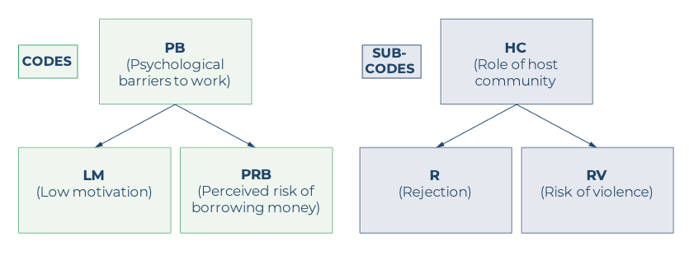

exercise
Look through the interview transcript in Handout 1.
Using either Microsoft Word or Excel, code the transcript.
Use this hierarchy of codes as a starting point.
Also feel free to identify new codes and themes.

Slide 15
Step 3: Identifying and grouping themes
The next step is to identify themes that have emerged from your data, see if there are links between the themes and categories of themes, and generate conclusions to your research questions.
WHAT IS THE DIFFERENCE BETWEEN CODES AND THEMES?
Codes are basic analytic units. You can think of them as labels (words or short phrases) given to a piece of text about a particular topic. They are really just tools for organizing your data. (E.g. ‘Gender differences’).
Themes begin to emerge when we look over our codes and start to group them into categories that are relevant to our research questions. They tend are broader and more inclusive than codes, and might be expressed in longer phrases or sentences. (E.g. ‘Gender differences influence access to healthy foods’).

Slide 16
Step 3: Identifying and grouping themes
When we start to identify and group themes, we think about how they relate to the research question.
Research question: What factors influence access to healthy food for adolescents in rural Kenya?
We have already started to identify themes and how they are related through the coding process, by creating a hierarchical code book.

Slide 17
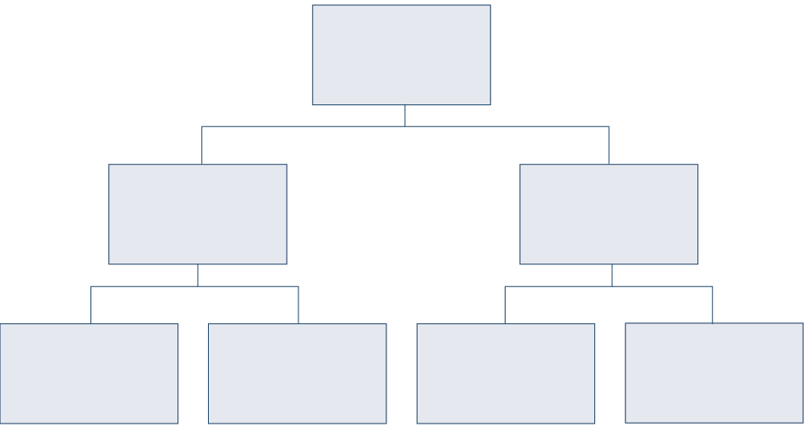
Step 3: Identifying and grouping themes
If we look back over our codes and how frequently they appear, we might realize that an overarching theme that relates directly to our research question is: ‘Social position influences access to healthy foods for adolescents in rural Kenya’.
Beneath this theme, we might have other related themes.
Social position influences access to healthy food
Social position
Access to food
Gender influences
social position
Education influences social position
Gender influences access to food
Education influences access to food

Slide 18
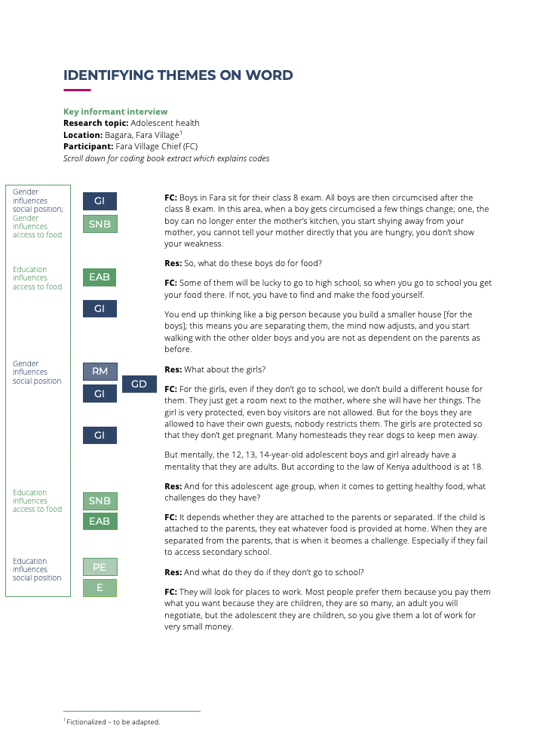
Step 3: Identifying and grouping themes
USING WORD

Slide 19
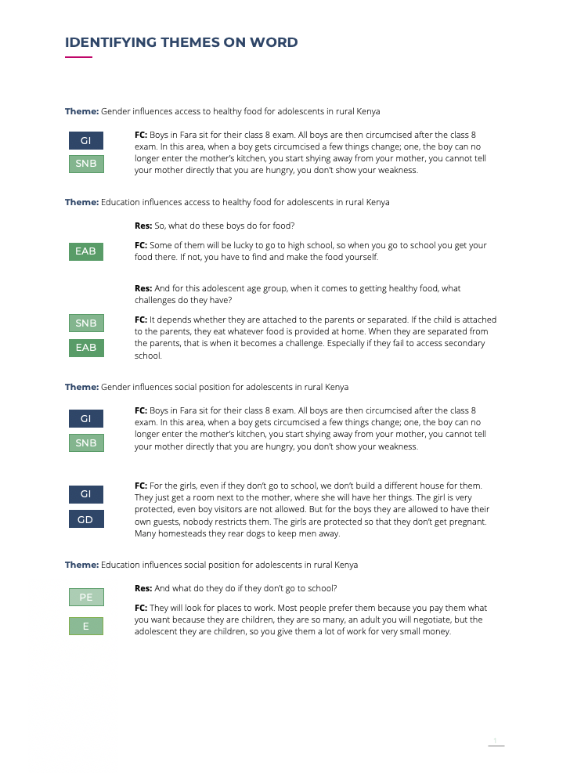
Step 3: Identifying and grouping themes
USING WORD

Slide 20
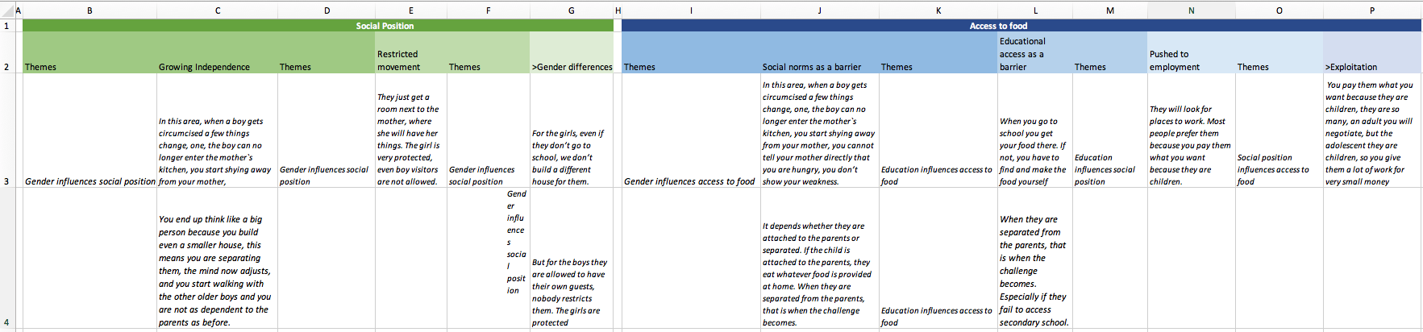
Step 3: Identifying and grouping themes
USING EXCEL

Slide 21
Step 4: Key findings
CONSIDER RESPONSE FREQUENCY
AND SALIENCY
BE AWARE OF RESPONSE BIAS
TRIANGULATION
PRESENTING FINDINGS

Slide 22
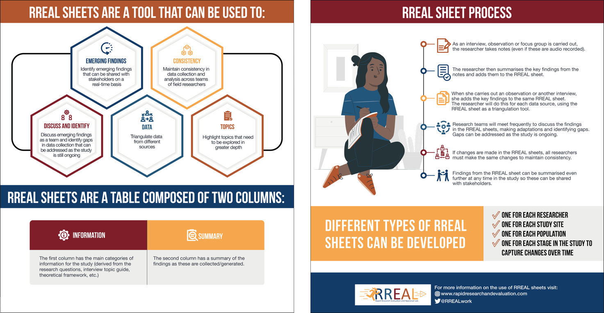
RREAL RAP sheets

Slide 23
Qualitative analysis software
These packages include:
NVivo
Dedoose
MAXQDA
ATLAS.ti
QDA Miner Lite

Slide 24
Descriptive analysis
Pros:
Less time consuming.
Easier to manage, organize, and move around when you have lots of data.
Easier to work with multiple coders (if everyone has the software).
Some packages can also manage photos, audio, videos, and spreadsheet data.
The use of software can be perceived as more credible, which can make findings more convincing.
Cons:
Many of the better options are expensive although these have ‘free trials’ available.
You need in-depth training on the specific packages to be able to use them, whereas most people are already familiar with Word and Excel.
All coders would need access to the software, whereas they likely already have Word and Excel.

Slide 25
Summary
There are many ways to analyse qualitative data, and thematic analysis is one of these. Thematic analysis is possible to do simply on Word or Excel software.
Steps to thematic analysis include:
Translation and transcription
Coding – including decided whether to use inductive or deductive coding and developing a coding book
Identifying and grouping themes from the data
Reporting key findings

Slide 26
Summary
Rapid Assessment Procedure (RAP) sheets developed by RREAL are another approach to rapidly analysing qualitative data as it is being generated.
Computer software packages dedicated to analysing qualitative data are used increasingly by social scientists, and there are a number of pros and cons related to their use.

