Slide 1
Triangulation of data: Why is it important and how does it work?

Slide 2
LEARNING OUTCOMES
Know the importance of data triangulation
Understand the steps of triangulating different forms and sources of data

Slide 3
Key questions in social science research
DATA TO ACTION:
Key questions in social science research
What information is needed?
Who needs this information?
Does this information already exist? Is there a related needs assessment or study?
Who can collect this information?
What methodology and tools should be used to collect and analyse this information?
How to ensure that this information goes back to communities? To inform community-level actions and decision-making of the broader response?
How to ensure that the information is used to make operational and/or strategic decisions?
How to track the information used to ensure that it effectively contributes to operational and strategic priorities?

Slide 4
Triangulation
“
the practice of using multiple sources of data or multiple approaches to analysing data to enhance the credibility of a research study
”
https://methods.sagepub.com/reference/encyc-of-research-design/n469.xml

Slide 5
Triangulation
Triangulation of data: combining several forms and sources of data – for example combining data produced through a social science research project with the latest epidemiological data
To:
Capture different aspects of the same topic to give a more detailed and balanced picture
Increase the accuracy and trustworthiness of the results
Broader and deeper insights can more effectively guide the design of communication or community engagement strategies and actions.

Slide 6
Triangulation
Why might triangulation be important to inform community engagement and/or communications activities in an emergency setting?

Slide 7
Triangulation
How might we best share data so it can be used by others?
Consider your own work setting and what has/has not worked well.

Slide 8
Forms | Sources
Quantitative and qualitative data Primary and secondary data Data from speaking with people versus data from observing people Social media posts ? | Government data Data from NGOs, CSOs Data collected from affected populations Media reports Social media Academic journals ?

Slide 9
Example
Evidence brief on RCCE & health seeking in the Rohingya context
Government policy and strategy documents)
Published academic journal articles
Community engagement related working group documents (meeting notes, TORs, etc.)
Community engagement actors' activity report
(I)NGO operational guidelines
Response actors' assessments
Response
dashboard data
Health system data

Slide 10
Triangulation
Different data sets can enrich one another by explaining different aspects of an issue.
One set of data can shed further light by explaining unexpected findings generated in another.
They can support or confirm the findings of the other data sets.
Certain data sets may also disagree with or contradict the findings of the others, which should be looked into more deeply.

Slide 11
Triangulation
Please give examples of when you have triangulated data in your work.
What type of data have you triangulated?
What were the different forms, sources, etc., used?
Any difficulties?

Slide 12
Practical steps
Identify the relevant forms and sources of data
Bring together the different data sets
Read through the findings of each
Pull out the findings that relate to your research question
Look across this data, ask yourself:
Do the data sets enrich each other by explaining different aspects of an issue?
Do the different data sets complement each other and shed further light?
Do the data sets support or confirm the findings of the others?
Do certain data sets disagree with or contradict the findings of the others?
Ask yourself why certain data sets bring different aspects of a topic to light

Slide 13
Triangulation
Do you have anything to add to this from your own experiences?
When two different sources of data have contradicted each other?
When one has supported the other?

Slide 14
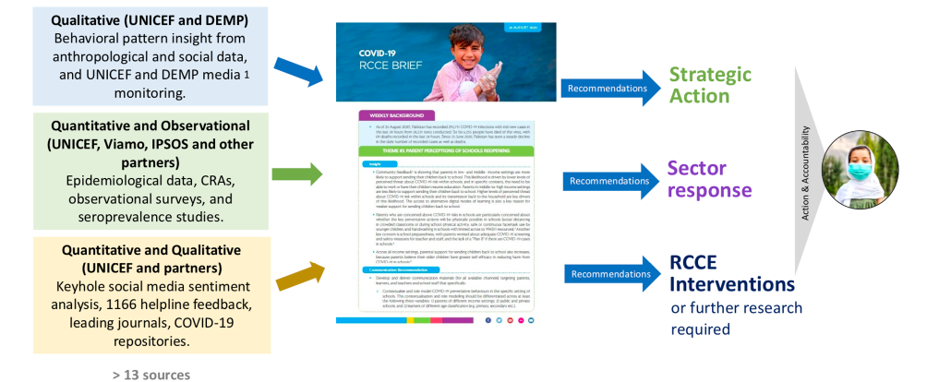
The systematic triangulation of data
Case example
COVID-19 in Pakistan

Slide 15
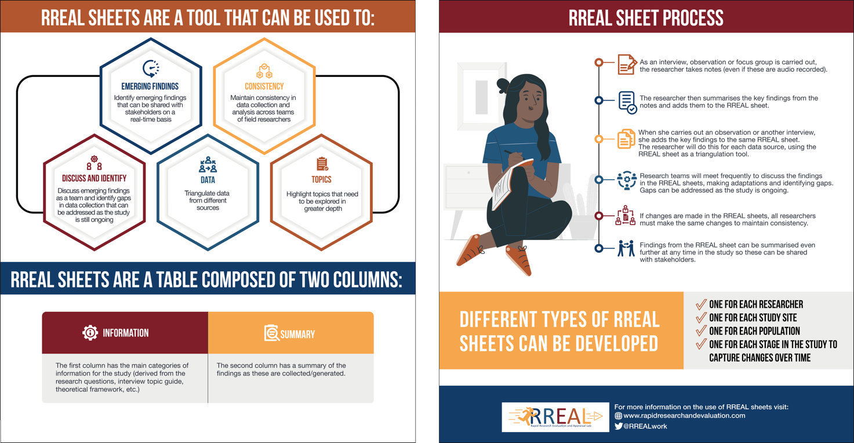
The systematic triangulation of data
Case example
RREAL RAP (Rapid Assessment Procedure) Sheets

Slide 16
Summary
Triangulation in research is ‘the practice of using multiple sources of data or multiple approaches to analysing data to enhance the credibility of a research study’.
During an emergency a lot of different information can be produced, which can seem overwhelming.
Triangulating this information can help us capture different aspects of the same topic to give a more detailed and balanced picture and increase the accuracy and trustworthiness of the results.
We can consider different forms and sources of data.

Slide 17
Summary
Practical steps to triangulate data include:
Identify the relevant sources of data for your area of interest/research question
Bring together the data sets and organize them
Read through the findings of each
Pull out the findings that relate to your research question
Look across the different types of data (cross-check) and ask yourself:
Do the data sets enrich each other by explaining different aspects of an issue?
Can one data set explain unexpected findings generated in another?
Do the data sets support or confirm the findings of one other?
Do certain data sets disagree with or contradict the findings of the others?
Ask yourself why certain data sets may bring different aspects of a topic to light?

