Slide 1
Understanding behaviour in humanitarian/emergency response: Models and theories

Slide 2
LEARNING OUTCOMES
Become familiar with decision-making and behavioural theories/models,
including the Behavioural Drivers Model (BDM)

Slide 3
Key questions in social science research
DATA TO ACTION:
Key questions in social science research
What information is needed?
Who needs this information?
Does this information already exist? Is there a related needs assessment or study?
Who can collect this information?
What methodology and tools should be used to collect and analyse this information?
How to ensure that this information goes back to communities? To inform community-level actions and decision-making of the broader response?
How to ensure that the information is used to make operational and/or strategic decisions?
How to track the information used to ensure that it effectively contributes to operational and strategic priorities?

Slide 4

The role of behaviour
Define in your own words what ‘behaviour’ is and how it plays a role
in a health emergency or humanitarian crisis.
What sort of ‘behaviours’ might we be interested in changing in our work?
Behaviour related to health or well-being includes actions taken by individuals
that may be intentional or unintentional and that can promote or lessen
the health or well-being of the individual or others.
E.g. Wearing a face mask, washing hands, treating water with chlorine,
seeking treatment at the local health facility level, etc.

Slide 5
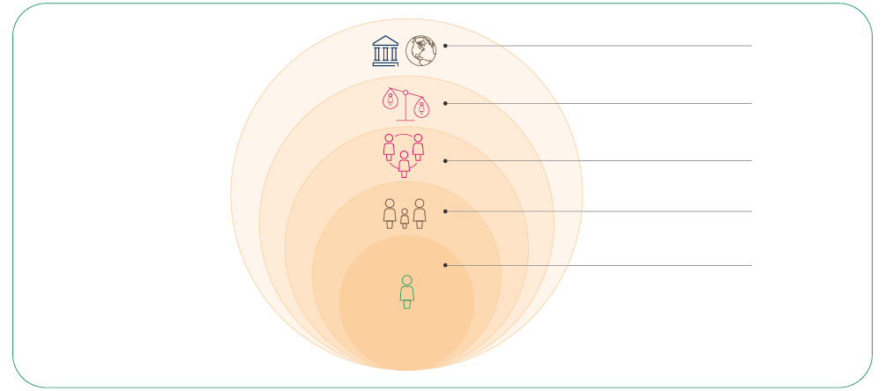
The Social Ecological Model (SEM)
POLICY/ENABLING ENVIRONMENT
(national, state, local laws)
ORGANIZATIONAL
(organizations and social institutions)
COMMUNITY
(relationships between organizations)
INTERPERSONAL (families, friends, social networks)
INDIVIDUAL
(knowledge, attitudes, behaviours)

Slide 6

Revisiting the Behavioural Drivers Model
What drives a behaviour?
PSYCHOLOGY
SOCIOLOGY
ENVIRONMENT

Slide 7
Application of a model – Context analysis:
Rapid Remote Context Analysis Tool (RR-CAT)
Desk review of academic and grey literature of affected areas/populations to understand
knowledge gaps and themes in the literature
Interviews or use of a brief scoping questionnaire with local social scientists or other key
stakeholders in the area
Note: Area experts can provide ongoing insights to programmes, analysis, or understanding context.
Remote interviews (e.g. via Zoom or WhatsApp) with stakeholders (community health workers,
local leaders, religious leaders, women’s associations) in affected communities.
This can also be complemented with social media analysis.

Slide 8
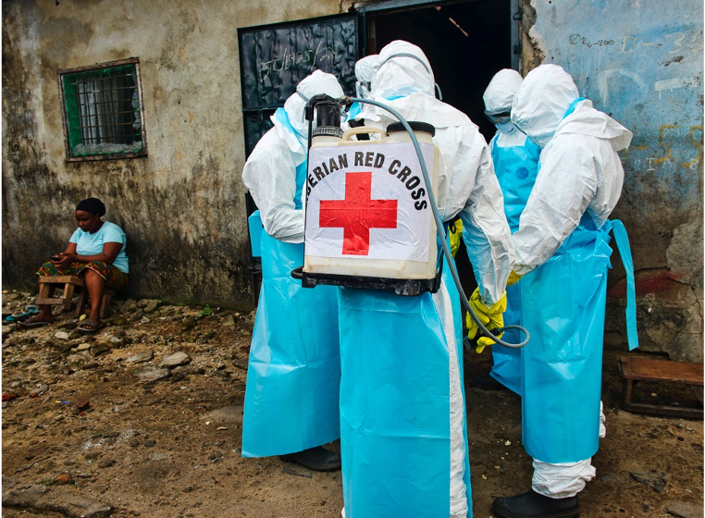
Group exercise: Who to engage with?
Members of the Safe and Dignified Burial Team, Liberian Red Cross.

Slide 9

Example:
EXCERPT FROM THE WHAT ANTHROPOLOGISTS
DO BOOK SERIES (JOHNSON 2021).
Brief except on ‘Understanding disease transmission’ which requires first understanding local contexts and human behaviours.

Slide 10
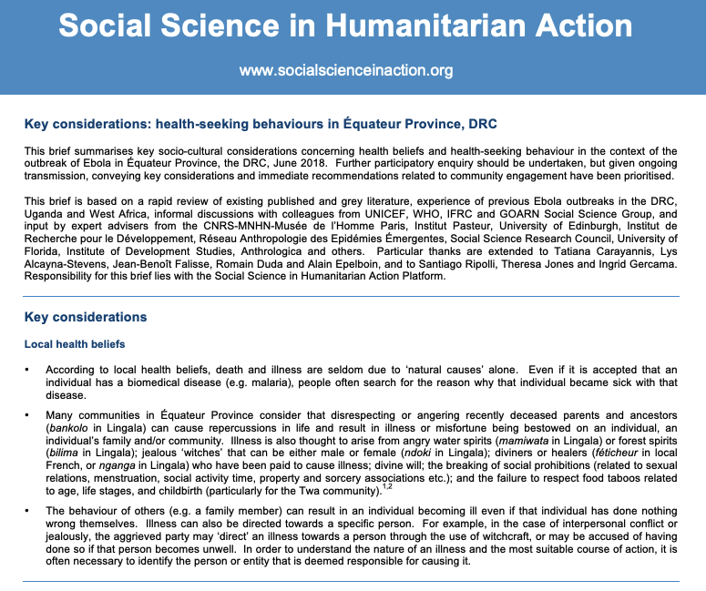
Example:
SSHAP BRIEFING ON THE CONTEXT OF HEALTH-SEEKING BEHAVIOURS IN ÉQUATEUR PROVINCE, DRC
Brief is based on rapid review of the published
and grey literature, past experience, and informal discussions with colleagues
Example key consideration:
One cultural belief among some communities
in the province is that disrespecting or angering the deceased can cause problems in your life
Therefore, both biomedical and spiritual/cultural aspects should be considered in health programming
https://www.socialscienceinaction.org/resources/key-considerations-health-seeking-behaviours-equateur-province-drc/

Slide 11
SUMMARY
Understanding behaviour is of critical importance during a humanitarian emergency.
There are a number of models or theories that social science uses to understand why people do the things they do.
The Social Ecological Model considers the different levels of personal and environmental factors that determine behaviours.
The Behavioural Drivers Model assesses a wide range of behavioural drivers – including behavioural, sociological and environmental – and provides guidance on how to operationalize theory to practice.

