Slide 2
LEARNING OUTCOMES
Gain familiarity with additional social science tools that can be used and adapted to identify inequalities and vulnerabilities
Be able to initiate a rapid context analysis to identify inequalities and vulnerable groups within a specific community
Gain familiarity with approaches to vulnerability assessment
Know how to conduct a power analysis

Slide 3
Key questions in social science research
DATA TO ACTION:
Key questions in social science research
What information is needed?
Who needs this information?
Does this information already exist? Is there a related needs assessment or study?
Who can collect this information?
What methodology and tools should be used to collect and analyse this information?
How to ensure that this information goes back to communities? To inform community-level actions and decision-making of the broader response?
How to ensure that the information is used to make operational and/or strategic decisions?
How to track the information used to ensure that it effectively contributes to operational and strategic priorities?

Slide 4

Context analysis
What kinds of contextual information do you/would you find useful
as a responder to a crisis?

Slide 5
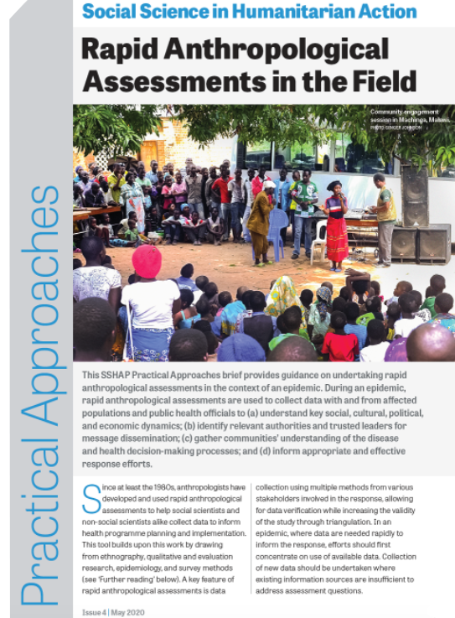
Context analysis
Existing knowledge – both formal, published and ‘lay’ knowledge – on social, cultural, economic and political factors.
Asks where, why and how people do things which contribute to resilience and vulnerability and either facilitate or impede participation in interventions.
Rapid Remote Context Analysis Tool (RR-CAT)
Rapid Anthropological Assessments in the Field (RAA)

Slide 6
Context analysis
Select one of the question modules or assessments that are most relevant to the work of the group.
What kinds of questions might be asked/adapted under that ‘question module’ or ‘assessment’?

Slide 7
Rapid ethnographic methods
Spending time and paying close attention to social life and processes in a particular setting in which a researcher is embedded
Observations, informal conversations, formal interviews, participatory exercises conducted with members of a community, etc.
‘Thick descriptions’
In an emergency setting work can be intensive (over a period of weeks), and provide insights in real time to responders if they engage in productive collaborative relationships

Slide 8
Rapid ethnographic methods
Identify research questions, tailor them to be specific, and involve stakeholder audiences (think about dissemination from the outset)
Understand time and resources needed (e.g., ethics approval)
Study design (sampling, data collection tools)
Implement with a team of research assistants
Rapidly disseminate findings using 1-2 page briefings, PowerPoint slides, short videos, or other formats

Slide 9
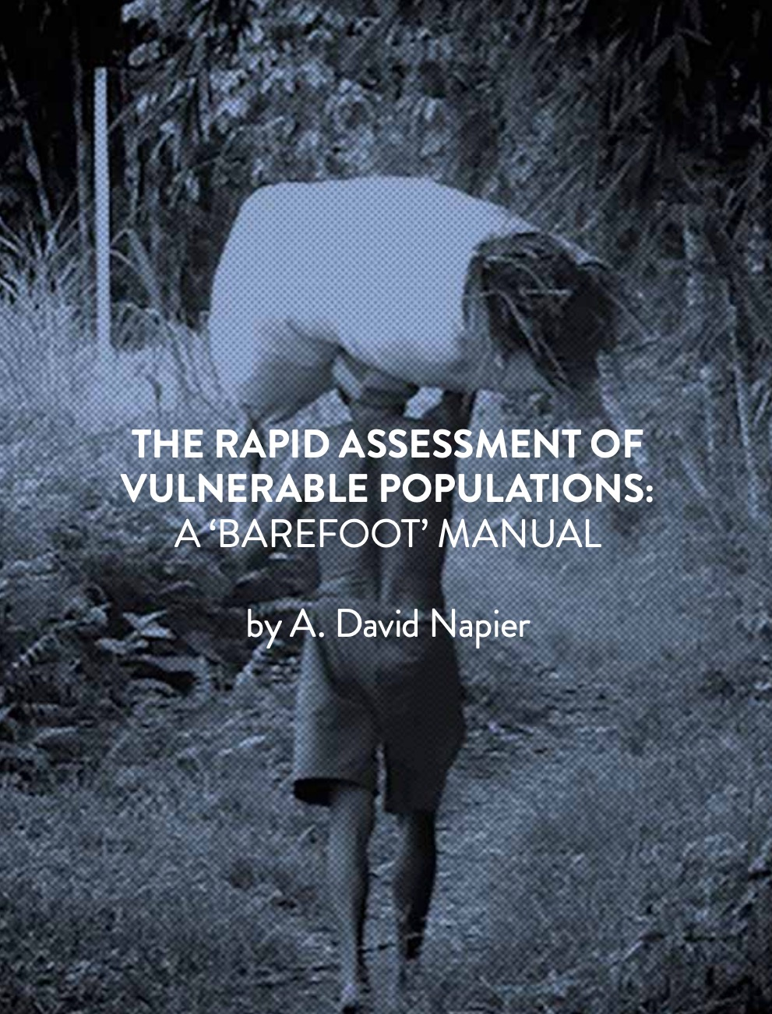
Vulnerability assessments
Vulnerability can shift and change dramatically under crisis conditions
It is critical that responders understand all of these dynamics as they are playing out on the ground in order to ensure equitable response and resource distribution
Rapid Assessment of Vulnerable Populations: A ‘Barefoot’ Manual
Knowledge of existing external (formal) responses
Knowledge about local community responses
Vulnerability identification on the ground

Slide 10
Vulnerability assessments
External response | Community response | Assessing vulnerability
Nature of assistance received (and from which government agencies, UN agencies, international NGOs, local NGOs)? Period (when)? Temporary or long-term? Type (kind of assistance provided?) Needs met? Can everyone access? Specific criteria established for those who are elibible? | Nature of community cooperation (presence or absence?) Temporary or long-term? New forms of community response? Can everyone access? Sustainability (will they continue and/ or grow?) How to best work with them to enhance sustainability, or replace them if they are harmful? | Identifying the vulnerable (who suffered most?) Type of vulnerability? Coping patterns? Kind of adjustment? Stable or unstable? Temporary or long-term?

Slide 11
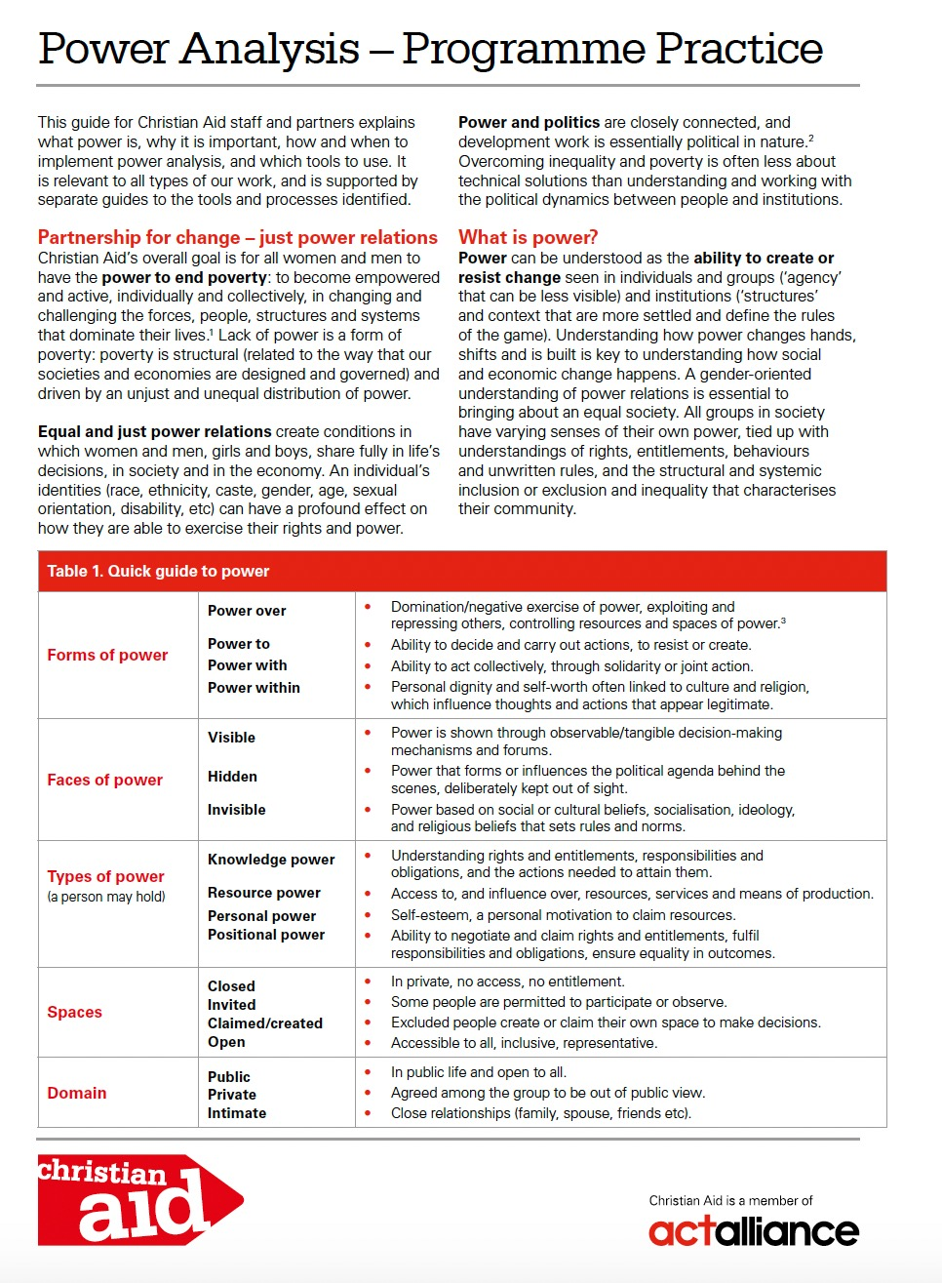
Power analysis
It is important to understand how power is created, maintained, or resisted.
To improve equity and access, or achieve fairness and justice.
These are underlying issues that affect how different groups are able to manage and recover from a crisis.
Power mapping:
Is a participatory process that involves people with a stake in a particular situation
Uses participatory group discussions and mapping techniques
Identifies who has the power to change things and who influences who (and how)
Identifies targets for influence, things or people who are blocking change, and possible ways to work with them

Slide 12
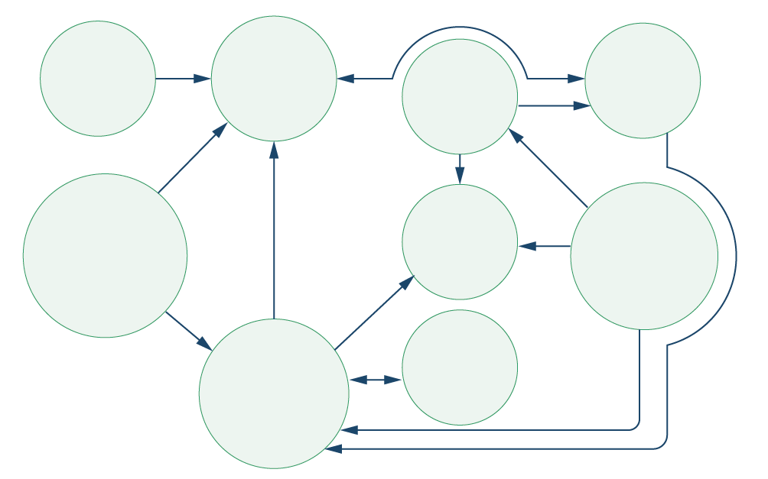
Power analysis
SOCIAL
MEDIA
COMMUNITY
RELIGIOUS
LEADERS
DHO
CHIEFS
PHUs
MINISTRY OF
HEALTH
INGO
CHWs

Slide 13
SUMMARY
Context analyses ask where, why and how people do things which contribute to resilience and vulnerability and either facilitate or impede participation in interventions
Trained social scientists (or others with similar training) through online searches and conversations with experts, can conduct rapid reviews of this knowledge, and bring it together and present it in a way that is usable and useful to responders, who can in turn design or adapt response activities in appropriate ways
Two tools to assist with this are the Rapid Remote Context Analysis Tool (RR-CAT)
and the Rapid Anthropological Assessments in the Field (RAA) Tool

Slide 14
SUMMARY
Rapid ethnographic methods are another way of rapidly gathering contextual information, particularly at a local level. They generally involve spending time and paying close attention to social life and processes in a particular setting in which a researcher is embedded
Vulnerability assessments like the Rapid Assessment of Vulnerable Populations: A ‘Barefoot’ Manual appreciate that vulnerability can shift and change dramatically under crisis conditions. The tool was developed specifically for understanding the dynamics of vulnerability, and for building on capacity in local communities impacted by crisis scenarios for immediate action, as well as long-term change
In a humanitarian emergency, it is important to understand how power is created, maintained, or resisted in a specific context. A power analysis or power mapping is a participatory process that involves people with a stake in a particular situation analysing how power relations affect it and might be changed for the better

