Slide 2
LEARNING OUTCOMES
Become familiar with the definition of operational social science
and why it is important in time-sensitive settings
Understand where the generation of quality operational social science research
fits into the humanitarian/emergency programming cycle

Slide 3
SOCIAL SCIENCE FOR ENGAGING AFFECTED COMMUNITIES
Individuals’ and communities’ capacity to respond to the crisis.
People’s belief system, sociocultural norms, and traditions
Individuals’ and communities’ knowledge and resources
People’s perceptions, attitudes, practices and behaviours
‘Rumours’
People’s needs and priorities and how they are changing
Are systems functioning, available and accessible
Trust in services, policies, information
WHAT WE WANT TO UNDERSTAND
People’s preferences to access information and their information needs
Languages people speak and prefer to communicate with each other and response actors
Existing vulnerabilities and social inequalities
Existing social networks, informal and formal community leadership structures and related social and power dynamics

Slide 4
OPERATIONAL SOCIAL SCIENCE RESEARCH
Generates data and findings that can be translated into action
to improve humanitarian strategies and operations
Theoretical research | Operational (applied) research
Gathers knowledge about a phenomenon Ideas and knowledge oriented | Tackles a ‘real world’ question and attempts to solve a problem Practical and solution orientated

Slide 5
OPERATIONAL SOCIAL SCIENCE RESEARCH
Focuses on social science data that is:
Operationally relevant
Timely
Rapidly generated
Easy and quick to digest and understand
Shared with and acted on by key stakeholders as relevant
And in consideration conducting ethical social science activities
And by understanding that speed does not mean sacrificing quality
RESPECT FOR
AUTONOMY
NON-MALEFICENCE
(DO NO HARM)
BENEFICENCE
(INTEND GOOD)
JUSTICE
(TREAT PEOPLE EQUITABLY)
FOLLOW THROUGH
(ENSURE IMPACT)
COLLABORATIVE
(CO-DESIGNED, OWNED)

Slide 6

HUMANITARIAN/EMERGENCY RESPONSE CYCLE
Can you describe the different phases of a humanitarian/emergency response?

Slide 7
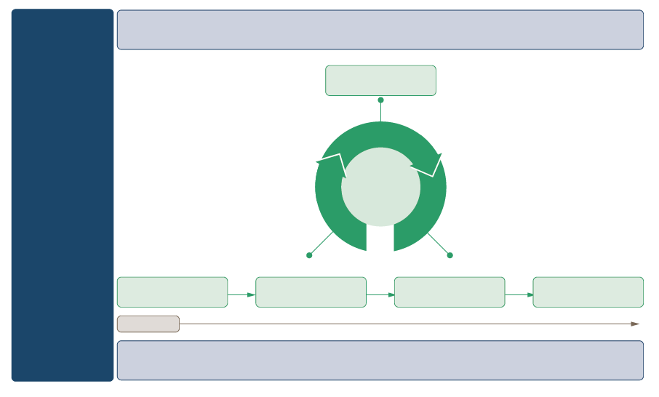
EXAMPLE: HEALTH EMERGENCY DISASTER MANAGEMENT CYCLE
NAPHS
READINESS
Developing
Implementing
Testing
RISK
ASSESSMENT
NHEROP
PREVENTION
PREPAREDNESS
RESPONSE
RECOVERY
TIME
HEALTH EMERGENCY AND DISASTER RISK MANAGEMENT
NAPHS: National Action Plan for Health Security or any otehr capacity development plan
NHEROP: National Health emergency Response Opreations Plan

Slide 8
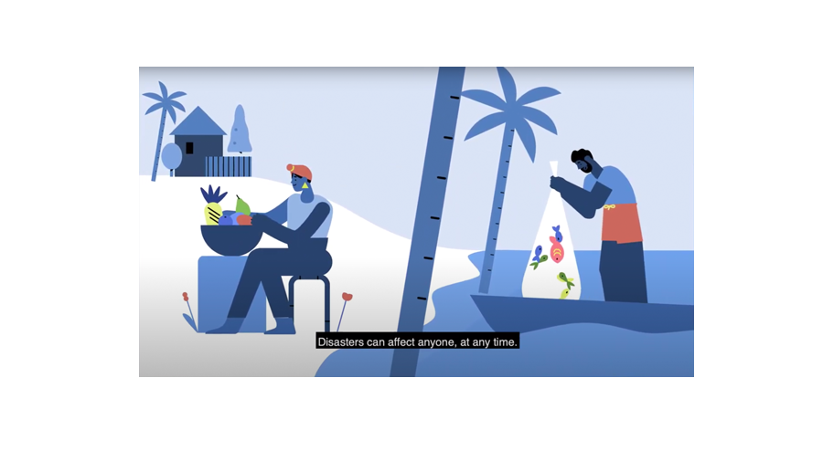
This is OCHA

Slide 9
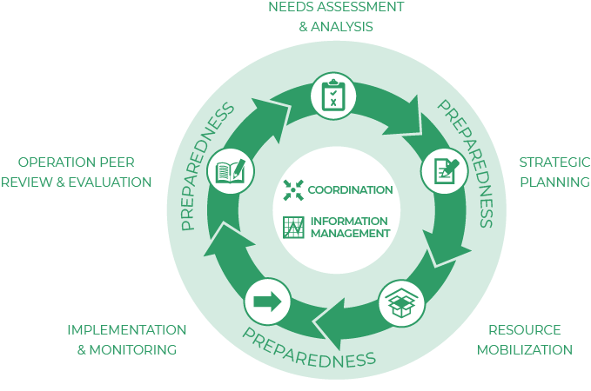
EXAMPLE: Humanitarian Programme Cycle

Slide 10
HUMANITARIAN/EMERGENCY RESPONSE CYCLE
When do you think operational social science could and should be implemented?
What sort of information could be collected (e.g. community feedback) at which stage
to inform the design and delivery of community engagement and/or communications strategies?

Slide 11
NEEDS ASSESSMENT & ANALYSIS
Existing vulnerabilities and how they have changed
Historical leadership structures and social structures
Social influencers, formal and informal stakeholders
Community organization and structures, existing outreach networks, past and current community initiatives
Gender roles
Knowledge vis a vis specific issues
Sociocultural norms, values, traditions
Perceptions, practices and behaviours

Slide 12
NEEDS ASSESSMENT & ANALYSIS
Languages
Information preferences, needs and access
Access to public services
Government structures (health services (including public health)/water supply/education)
Population (numbers and profile), average household size
Priority needs of affected population
What does a successful response look like for the crisis-affected communities?

Slide 13
NEEDS ASSESSMENT & ANALYSIS
“
NGOs come here, gather information, and don’t come back. People are frustrated. Other organizations follow in their steps, and people are no longer willing to engage in conversations
”
Village woman Sri Lanka
What would you do to avoid such a situation?

Slide 14
NEEDS ASSESSMENT & ANALYSIS
Formative research ‘is the process by which researchers or public health practitioners define a community of interest, determine how to access that community, and describe the attributes of the community that are relevant to a specific public health issue’.
See https://www.cdc.gov/hiv/pdf/statistics/systems/nhbs/nhbs-msm4-formativeresearchmanual.pdf

Slide 15
STRATEGIC PLANNING
During this phase, initial assessment data triangulated with existing information (see above, secondary data analysis) is used to inform the design and delivery of RCCE strategies and other related wider response activities.
Assessment data is critical to understand how best to (continuously) support community-led action and response. It helps to:
Identify what level of engagement (e.g., consultation, information, demonstrating acceptance, planning and acting together, negotiation, taking decisions) might be practical or appropriate at the different stages of the response – and in view of the local context.
Inform the appropriate methods to meaningfully involve a diverse community in decisions that affect them.

Slide 16
STRATEGIC PLANNING
Develop a robust Monitoring & Evaluation plan
Identify gaps for further research

Slide 17
RESOURCE MOBILISATION
Develop a robust Monitoring & Evaluation plan
Identify gaps for further research

Slide 18
IMPLEMENTATION AND MONITORING
Do people access accurate, trustworthy information in their local language and through trusted information sources?
        Who are the trusted information sources (by population / risk group)?
        Do they access the information sources they trust?
        Do the information sources represent a diverse community?
Do people feel that they are meaningfully engaged in the response?
Are high-risk groups including marginalized and vulnerable population groups meaningfully represented in decision-making processes and able to influence decisions that affect them?
What can be barriers or enabling factors to promote, strengthen and ensure the involvement of the local population in response activities?
Do people know how to provide feedback and do they believe their views are taken into consideration when decisions are made around the support they receive?

Slide 19
IMPLEMENTATION AND MONITORING
Which factors influence people’s behaviours and practices (preventive and responsive?)
        Information?
        Socio-economic and structural factors?
        Local level of experiences for example of a disease outbreak?
        Cultural and social dynamics?
Do people feel that they are meaningfully engaged in the response?
On family dynamics, inter and intra) community dynamics
Protection
Health
Socio-economic situation
Socio-cultural norms and local beliefs?

Slide 20
IMPLEMENTATION AND MONITORING
It is important to note that there are typical questions that emerge over the course of a typical response, as well as novel questions that may be unique to the particular situation.
Taking action and closing the loop - We need to ensure that social data, including community feedback, are shared and discussed with key response stakeholders (including affected communities) and acted upon.
The response team should also seek (with the help of a social science expert where necessary) to systematically integrate findings with other data sources.

Slide 21

IMPLEMENTATION AND MONITORING
HWC and services provision (availability, risks, changes
Transdisciplinary sciences wich are integrated and analysed together
Events, timelines (policies, political,restrictions) & response strategies
Evidence which is used and usable
Transdisciplinary sciences wich are integrated and analysed together
Health services data (DHIS2 or direct collection
Markets, prices, movements
Track evidence use by location, analysis over time
Outbreak response data, VACC, surveillance, WASH-IPC
Context: conflict,gender, traditions,culture

Slide 22
Implementation and monitoring
What do you think is the connection between social science research
and monitoring RCCE activities?

Slide 23
Operational review and evaluation
Did the community receive the support they needed? e.g., Was the provision of cash transfers useful? Did the expansion of school feeding programmes help to prevent early marriage and pregnancy?
Was the support provided in an effective and appropriate way?
Did the response activities contribute to individual and community-level behaviour change?
What should be done differently?
How can the programme exit be safely managed?

Slide 24
Key questions in social science research
DATA TO ACTION:
Key questions in social science research
What information is needed?
Who needs this information?
Does this information already exist? Is there a related needs assessment or study?
Who can collect this information?
What methodology and tools should be used to collect and analyse this information?
How to ensure that this information goes back to communities? To inform community-level actions and decision-making of the broader response?
How to ensure that the information is used to make operational and/or strategic decisions?
How to track the information used to ensure that it effectively contributes to operational and strategic priorities?

Slide 25
SUMMARY

