Slide 2
LEARNING OUTCOMES
Know the key ethical principles that guide social science research
Become familiar with the different ethical requirements and approval processes when doing operational social science research in a humanitarian context
Understand the importance of gaining community-level approvals

Slide 3
Key questions in social science research
DATA TO ACTION:
Key questions in social science research
What information is needed?
Who needs this information?
Does this information already exist? Is there a related needs assessment or study?
Who can collect this information?
What methodology and tools should be used to collect and analyse this information?
How to ensure that this information goes back to communities? To inform community-level actions and decision-making of the broader response?
How to ensure that the information is used to make operational and/or strategic decisions?
How to track the information used to ensure that it effectively contributes to operational and strategic priorities?

Slide 4
Key ethical principles
Consider your current work with communities.
Which ethical principles guide your work?

Slide 5
Key ethical principles
Ethical principle | Application
Respect for persons Individuals should be treated as independent individuals, not under the control of others People with diminished ability to act independently require special protection | Informed consent The person should have the capacity to give consent and should have the power of choice without constraint or coercion – without feeling forced or persuaded The person should have sufficient knowledge and understanding to enable him or her to make the right decision If someone is under the legal age of adulthood, ‘assent’ should be gained from them, and consent should be gained from a caregiver over the legal age of adulthood Right to withdraw This should be possible at any time during the research, without consequence This includes the right to ask for the tape-recorder to be switched off Privacy and Confidentiality Respect confidentiality – participants should be able to choose whether their statements are public and attributable (quoted ‘on record’) or whether their statements are anonymous or not to be quoted (‘off record’). Respect privacy – participants should be able to speak in a comfortable setting free from onlookers; participants should never be forced to reveal information about themselves that the participant does not wish to reveal. Data should be anonymized (where the participant does not request attribution), identifiable information should be removed and data should not be able to be linked to any one person Data should be stored securely

Slide 6
Key ethical principles
Ethical principle | Application
Do No Harm No harm should be done to participants Beyond this, benefit should also be gained from participation in research. Common questions researchers ask themselves include: Should this be a social or a personal benefit? Who should decide what the benefit should be? Research should be necessary and meaningful – the research should be unique and it should contribute to the greater good | Assessment of risks and benefits The nature of risks and benefits should be assessed in a step-by-step way. ‘Risk’ can be defined as: the probability of harm or injury (physical, psychological, social or economic) occurring as a result of participation in research. The potential benefit of the work should outweigh the probability and severity of risks. More information https://www.research.uci.edu/compliance/human-research-protections/irb-members/assessing-risks-and-benefits.html
Justice Treat people equally, fairly and respect their rights The risks of research should be negligible | Selection of participants In participant selection, wherever you can include a wide range of people; think about gender, ethnicity, and marginalized groups

Slide 7
Humanitarian settings
Power differences
Research independent of assistance
Privacy
Secure data storage
?????

Slide 8
Ethical approval processes
University review boards
Institutional/agency review boards
National/governmental review boards
Community approval
Ethical Review Board (ERB)

Slide 9
Ethical approval processes
UNIVERSITY REVIEW BOARDS
INSTITUTIONAL/
AGENCY REVIEW BOARDS
NATIONAL/
GOVERNMENTAL REVIEW BOARDS
COMMUNITY APPROVAL
ETHICAL REVIEW BOARD (ERB)

Slide 10
Ethical approval processes
Why do ERBs exist?
When is research, research?
Are ERBs best placed to make sure ethical principles are followed?
What happens when an emergency has dismantled structures for review?
Researchers should carry ethical principles with them throughout their work, and use them to guide their decisions and actions.
Ethical practice should lie first with the researcher, not the system

Slide 11
Community approvals
How might ethical approval be approached with communities involved in the research?

Slide 12
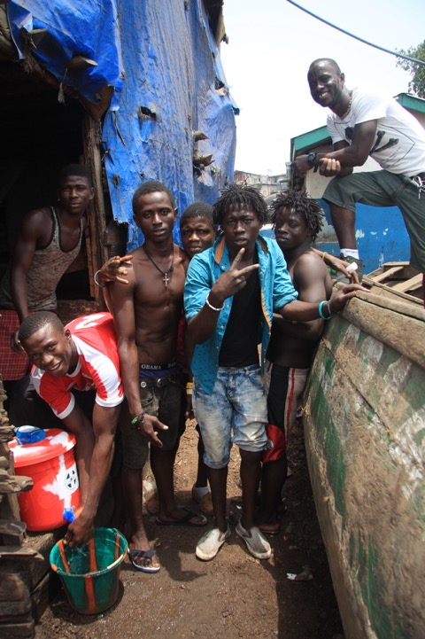
Community approvals
Acknowledge the leadership of the community
Acknowledge the members of the community
Ask their permission to enter the community
Explain the research that you are planning to carry out and the potential benefits and risks
Seek permission to conduct the research
Consider who you obtain permission from
Be prepared to continue doing this every day, if need be, during the research process
Consider establishing formal mechanisms such as community advisory boards that can oversee ethical issues during the roll-out of research

Slide 13
Indigenous health research
Primary responsibility for research governance lies with the communities where the research will take place
In practice, this means the community convenes its own research jury, consisting of community members, to assess the risk and benefits of the research
Or it may mean the affected communities has complete control over the research budget, and the hiring and management of investigators, to explore a research question that the community themselves define and prioritize

Slide 14
Case example
‘Social Science Research in a Humanitarian Emergency Context’
This case highlights the issues raised above about research needing to be independent of other forms of assistance.
It also raises the importance of paying attention to local social norms and communicating with local communities.
What are the other key lessons learnt takeaways from the case study?

Slide 15
SUMMARY
The ethical principles that guide operational social science research include respect for persons, doing no harm, and justice
These are applied practically in different ways, including getting voluntary informed consent from participants, allowing the right to withdraw from the research at any time, maintaining privacy, weighing risks and benefits of participating in research, and in the selection of participants
Formal ethical approval from an institutional ethics review board is often required for formal research to be carried out
The humanitarian community has yet to tailor the ethics review process to the setting and to the method – it is largely still a one-size-fits-all approach
Despite the existence of these institutional approval processes, researchers should carry ethical principles with them throughout their work
Ethical practice should lie first and foremost with the researcher and not the system
Perhaps the most important review and approval process for truly ‘ethical research’ should happen at the level of the community affected by the issue in question

