Slide 2
LEARNING OUTCOMES
Know how to plan and design social science research that is responsive to communities
Understand the roles that affected communities should play in the different stages of social science research

Slide 3
Key questions in social science research
DATA TO ACTION:
Key questions in social science research
What information is needed?
Who needs this information?
Does this information already exist? Is there a related needs assessment or study?
Who can collect this information?
What methodology and tools should be used to collect and analyse this information?
How to ensure that this information goes back to communities? To inform community-level actions and decision-making of the broader response?
How to ensure that the information is used to make operational and/or strategic decisions?
How to track the information used to ensure that it effectively contributes to operational and strategic priorities?

Slide 4

Listens first
Supports communities to take their own action
Understands & prioritizes the needs of communities
Creates and maintains trust
LOCALIZED RESEARCH
Understands & builds on local knowledge and expertise
Involves & engages people
in design, roll-out and evaluation
Sets up two-way communication
Builds local capacity

Slide 5
Why localize research?
Select a research topic that is truly relevant to that setting
Build on local expertise and knowledge to make sure the research is addressing the most important questions, in the best possible way
Turn findings into actions that are realistic and acceptable – so they can actually work
Establish buy-in for any action or change that may result from the research
Ensure the research informs and supports community-level action
Promote the active rather than passive role of communities

Slide 6
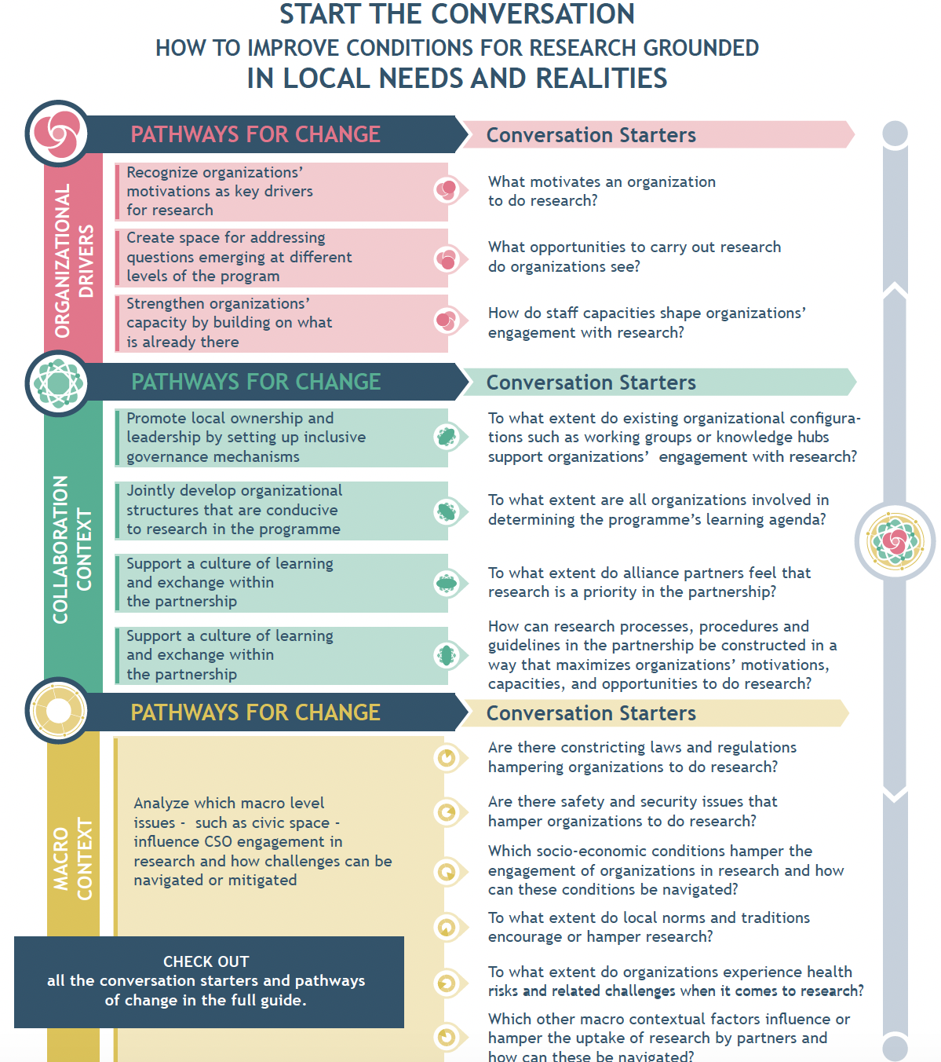
Why localize research?
HANDOUT 1
See WNCB’s website for additional details

Slide 7
Why localize research?
What are some practical ways to involve affected community members in the design of social science research?
Include community members from the earliest planning phases of research
Establish a ‘steering committee’ / community advisory board
Form research teams which include a range of community members
Create two-way communication channels and feedback loops
Build the social science capacity of the local area
???

Slide 8

Diverse communities

Slide 9
Group exercise
Defining information needs
Identifying who needs to know this information
Checking whether this information already exists
Deciding who can collect this information
Selecting methodology and tools to collect and analyse this information
Communicating information back to communities so it informs community-level decision-making and action
Ensuring information can support operational and/ or strategic decisions
Tracking information use to ensure that it contributes effectively

Slide 10
SUMMARY
Localized research puts the needs of communities affected by a crisis first. It brings in and builds on existing local knowledge, skills and other resources
Communities should be involved in all stages of the research process, including:
Defining information needs
Identifying who needs this information
Checking whether this information already exists
Deciding who can collect this information
Selecting methodology and tools to collect and analyse this information
Communicating information back to communities so it informs community decision-making and action
Converting information so it can support operational and strategic decisions
Tracking information use to ensure that it contributes effectively to decision-making

Slide 11
SUMMARY
Include the communities that the outcomes of the research will impact, from the earliest planning phases
Establish a ‘steering committee’ / ‘community advisory board’ or similar
Form research teams which include a range of community members from affected communities
Create two-way communication channels and feedback loops
Build the social science capacity of the local area

