Slide 2
LEARNING OUTCOMES
Be able to identify opportunities to create an enabling environment for uptake of social science findings within response pillars, technical clusters and sectors
Be able to identify opportunities to embed operational social science across different phases of a community-centred response
Understand what an enabling environment looks like at the community level to ensure that research can inform local action

Slide 3
Key questions in social science research
DATA TO ACTION:
Key questions in social science research
What information is needed?
Who needs this information?
Does this information already exist? Is there a related needs assessment or study?
Who can collect this information?
What methodology and tools should be used to collect and analyse this information?
How to ensure that this information goes back to communities? To inform community-level actions and decision-making of the broader response?
How to ensure that the information is used to make operational and/or strategic decisions?
How to track the information used to ensure that it effectively contributes to operational and strategic priorities?

Slide 4
An enabling environment: The ‘cluster’ approach
Clusters are groups of humanitarian organizations (UN and non-UN) working in the same sector: protection, education, WASH, etc.
There are global and country-level clusters. Global clusters are always active.
Country-level cluster activities include:
Supporting service delivery by coordinating the Humanitarian Response Plan
Informing strategic decision-making, including preparing needs assessments and analysis of gaps and undertaking information management
Planning and implementing cluster strategies and plans, including funding requirements and proposals
Monitoring and evaluating progress
Building national capacity in preparedness and contingency planning
Carrying out necessary advocacy activities

Slide 5
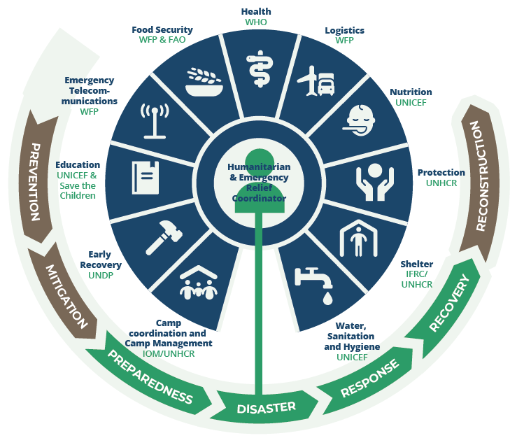
The ‘cluster’ approach

Slide 6
Aspects of an enabling environment
What might need to exist within the emergency response environment to make sure that the findings of social science research are actually used?

Slide 7

Aspects of an enabling environment
Existing knowledge and capacity
Structural factors – where social science ‘sits’
Collaboration readiness – speaking the same language
Relationships and trust
Flexibility
and adaptability
in response action
Economic factors

Slide 8
Individual exercise
Write some notes about what you see as the pros and cons of the different options for where social science can sit:
Embedded in community engagement/communication sector
Cross-cutting across operations
Stand-alone, independent social science pillar

Slide 9
Collaboration readiness
Have you had experience where people from a social science background had challenges communicating with those from a different discipline? What happened and what were the consequences?
Giving examples specific to your field of expertise (or to a specific emergency response), how would you explain the value of social science evidence?

Slide 10
Case example
Working in an enabling environment
CASE EXAMPLE
Longer-term engagement – relationship and reputation building in Sierra Leone

Slide 11
Group exercise
What aspects of an enabling environment are critical to promote at different stages of an emergency response?
In your group discuss each point described in relation to:
Preparedness
Response
Recovery
Existing knowledge and capacity
Structural factors – where social science ‘sits’
Collaboration readiness – speaking the same language
Relationships and trust
Flexibility
and adaptability
in response action
Economic factors

Slide 12
An enabling environment at the community level
What might be some of the aspects of an enabling environment at the community level?

Slide 13
Summary
The ‘environment’ (for this work) are the systems, institutions and actors that make up the emergency response that our social science research intends to influence. This includes a host of response pillars, technical clusters and sectors, and the communities affected by the crisis.
There is no single formula for creating an enabling environment: much will depend on the setting and the nature of the emergency response. In each context, however, we can pay attention to the following factors:
Existing knowledge and capacity
Structural factors, including where social science ‘sits’ in the humanitarian infrastructure
Collaboration readiness in terms of speaking the same ‘language’
Strong relationships and the establishment of trust
Flexibility and adaptability in response action
Economic factors, including what financial and human resources are available to implement any recommendations made

Slide 14
Summary
These factors are of differing importance depending on the phase of the response: preparedness, response or recovery.
To ensure that social science evidence supports community-level action, it is important to understand what an enabling environment looks like at the community level
Many of the factors are the same, in terms of community involvement in the research – engagement of important community structures and decision-makers, strong relationships and trust with key community-level personnel, familiarity with social science within the community, being open to input from social science research, and having adequate community-level resources to implement any recommendations of the research.

