Slide 1
Community feedback mechanism: Design and data collection
Notes:
This session focuses on the application of qualitative approaches to design and manage a community feedback mechanism. It introduces community feedback and explains its role in a response. It describes how to set up and collect community feedback data, using examples from the Red Cross. It links the IFRC Community Feedback Kit to the social science operational research context

Slide 2
LEARNING OUTCOMES
Become familiar with community feedback data and its role in public health emergency responses
Be able to describe or set up a simple feedback system
Become familiar with methods to collect community feedback

Slide 3
Key questions in social science research
DATA TO ACTION:
Key questions in social science research
What information is needed?
Who needs this information?
Does this information already exist? Is there a related needs assessment or study?
Who can collect this information?
What methodology and tools should be used to collect and analyse this information?
How to ensure that this information goes back to communities? To inform community-level actions and decision-making of the broader response?
How to ensure that the information is used to make operational and/or strategic decisions?
How to track the information used to ensure that it effectively contributes to operational and strategic priorities?
Notes:
Position this session in the question flow. Explain that this module mainly addresses question area 4 and 5, but we will touch on 1, 2, 3 and 6.

Slide 4
Notes:
This diagram is from the feedback system in Eastern DRC set up during the Ebola outbreak of 2018.
Community feedback: Using the example of IFRC’s community feedback process, Red Cross volunteers collect the comments and questions that come to them during their routine community engagement activities. These are then transcribed in batches. Qualitative thematic analysis is applied to each batch. This is coded, usually in a standardized way, to enable changes in the information collected to be tracked over time.

Slide 5
Community feedback
What do we mean by community feedback?
Notes:
Community feedback is simply any insight shared by members of the community we are working for and interacting with.
Community members may share insights that include questions, suggestions, observations, beliefs, perceptions, concerns and statements of thanks.
These insights could be shared in different ways: formally or informally, in a structured or unstructured way, directly or indirectly.
Feedback could be proactively collected, or reactively received when community members wish to share.
Feedback could be positive, neutral or negative.
Feedback could be about anything, but we are usually interested in community members’ experiences with the activities we are conducting, the current situation of the community, or other topics relevant to our work, such as health beliefs.
It is communities’ right to share their feedback with us, and our responsibility to manage and handle it appropriately.
A community feedback mechanism is a system that allows community members to provide information on their experience of the broader humanitarian system.. A community feedback mechanism is organized in a cycle of collecting, making sense of, acknowledging and acting on what’s shared by community members. The system includes different ways (channels) for collecting/receiving feedback, tools for managing, analysing and sharing feedback, and processes to act on the data and inform communities about actions taken.
Community feedback is an essential part of all response operations, including risk communication, community engagement and emergency response operations. By recognising, respecting and valuing local knowledge, community feedback mechanisms are an opportunity to build and maintain trust with communities and accountability to them. Organizations have an obligation to listen to community members and respect their right to give feedback. More specifically, community feedback can be used to answer both operational and theoretical social science research questions or as a monitoring and evaluation tool. It’s a source of information to triangulate or combine with other sources in the response. Community feedback can complement other methods to validate their findings, explain further, or offer a divergent perspective. Community feedback is often used in cross-analysis with other social sciences.

Slide 6
Community feedback
What do we mean by community feedback?
Community feedback is any insight shared by members of the community. Community members have a right to give their feedback.
A community feedback mechanism is a system that allows community members to provide information on their experience of the broader humanitarian system.
It’s an essential part of the response. By recognizing, respecting and valuing local knowledge, we build and maintain trust and remain accountable. It’s our obligation to listen.
Notes:
Community feedback is simply any insight shared by members of the community we are working for and interacting with.
Community members may share insights that include questions, suggestions, observations, beliefs, perceptions, concerns and statements of thanks.
These insights could be shared in different ways: formally or informally, in a structured or unstructured way, directly or indirectly.
Feedback could be proactively collected, or reactively received when community members wish to share.
Feedback could be positive, neutral or negative.
Feedback could be about anything, but we are usually interested in community members’ experiences with the activities we are conducting, the current situation of the community, or other topics relevant to our work, such as health beliefs.
It is communities’ right to share their feedback with us, and our responsibility to manage and handle it appropriately.
A community feedback mechanism is a system that allows community members to provide information on their experience of the broader humanitarian system. A community feedback mechanism is organized in a cycle of collecting, making sense of, acknowledging and acting on what’s shared by community members. The system includes different ways (channels) for collecting/receiving feedback, tools for managing, analysing and sharing feedback, and processes to act on the data and inform communities about actions taken.
Community feedback is an essential part of all response operations, including risk communication, community engagement and emergency response operations. By recognising, respecting and valuing local knowledge, community feedback mechanisms are an opportunity to build and maintain trust with communities and accountability to them. Organizations have an obligation to listen to community members and respect their right to give feedback. More specifically, community feedback can be used to answer both operational and theoretical social science research questions or as a monitoring and evaluation tool. It’s a source of information to triangulate or combine with other sources in the response. Community feedback can complement other methods to validate their findings, explain further, or offer a divergent perspective. Community feedback is often used in cross-analysis with other social sciences.

Slide 7
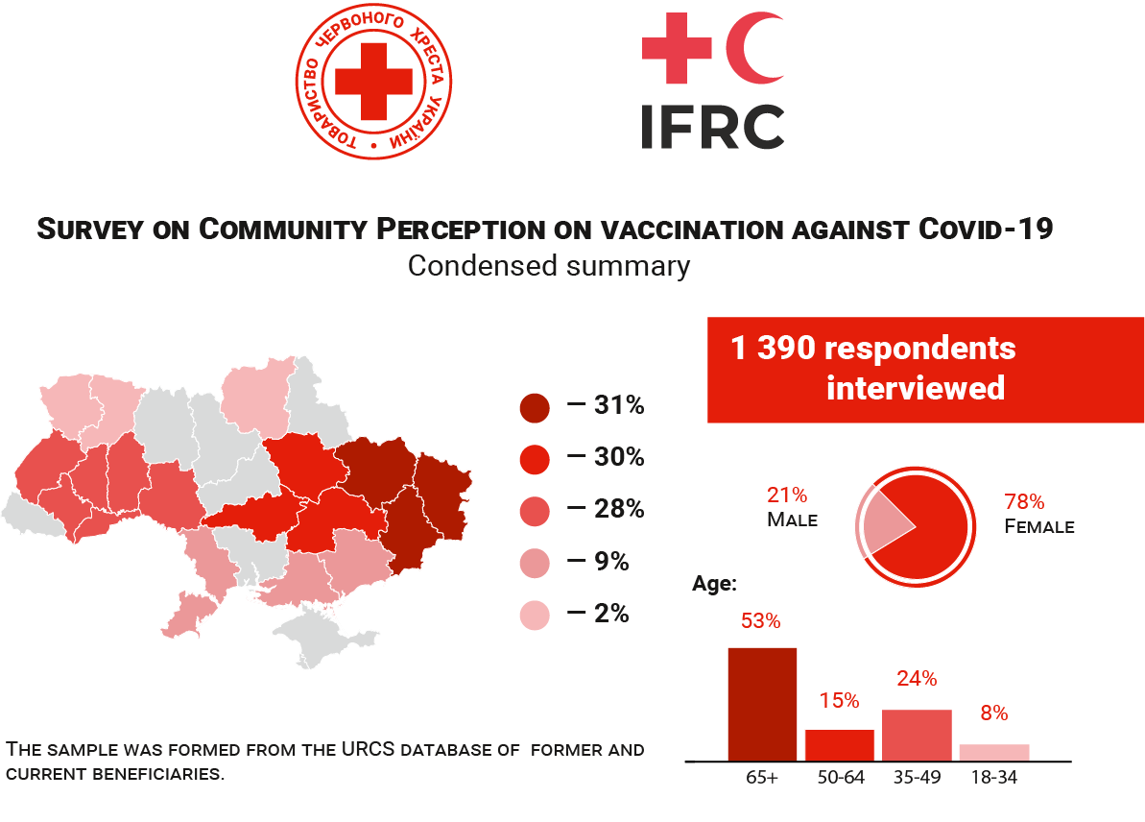
Example: Understanding community perceptions on COVID-19 in Ukraine
Perception survey
Open unstructured feedback
“
Questions about COVID-19 testing
Where can I make a free test without
a referral from a family doctor?
Man 50-59, Poltava region.
”
Questions about treatment
“
What is the treatment algorithm
if COVID-19 infection is suspected.
Woman, age 40-49, Poltava region
”
Notes:
Example: Understanding community perceptions on COVID-19 in Ukraine
During the COVID-19 response, the Ukrainian Red Cross set up a new feedback mechanism to better understand the perceptions of community members on COVID-19. Communities were asked to share the main observations, beliefs, questions, concerns or suggestions they hear in their communities about COVID-19, as well as to share the feedback on the URCS response to COVID-19. The feedback was collected through several channels, including face-to-face surveys, focus group discussions, phone calls, community meetings. The feedback was used to improve the way the Ukrainian Red Cross supports the response to COVID-19, including updated communication plans, finding new ways to engage communities, working with media to better reach communities and make sure they receive the information they need, coordination with key health actors and sharing feedback findings with them. The Ukrainian Red Cross has since developed its own feedback policy which ensures a systematic and consistent approach to how community feedback is handled, shared and responded to across the National Society.

Slide 8
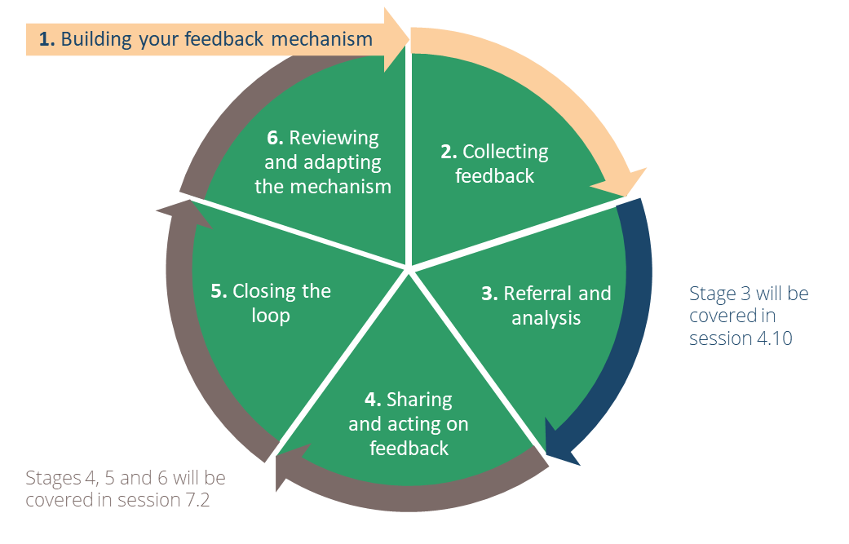
Community feedback cycle
1.
Building your feedback mechanism
Community members are involved and included at each stage
We work together across silos – no “us and them”
Data and actions taken are owned by the community
Respectful listening is at the heart of community feedback
6.
Reviewing and adapting th mechanism
2.
Collecting feedback
3.
Referral and analysis
5.
Closing the loop
4.
Sharing and acting on feedback
Notes:
This graphic visualizes the 6 stages of the Community Feedback cycle
Building your feedback mechanism
Collecting feedback
Referral and analysis
Sharing and acting on feedback
Closing the loop
Reviewing and adapting the mechanism
Each stage might have multiple steps within it.
In this session, we will cover stages 1 and 2: Design and data collection. In session 4.10 we will learn about referral and analysis. Session 7.2 covers sharing, action, closing the loop and reviewing the mechanism.
Key considerations of community feedback mechanisms
Community feedback mechanisms take a participatory, collaborative approach. This means involving community members in the design, collection, prioritization, analysis, sharing, action and final outcome of the feedback provided. Rather than “us and them”, community feedback involves diverse perspectives across silos, to work together.
Community feedback mechanisms play a role, whether formal or informal, in public health and emergency responses. Sometimes this role involves social science research. When feedback mechanisms are applied to answer social science operational research questions, community members are part of the research team. Community feedback data are owned by community members and feedback is ultimately addressed by the community, in that it triggers actions by and within the community. At its core, community feedback involves respectfully listening to community members and supporting them to make changes.
Community feedback analyses take a qualitative or mixed methods approach. Open unstructured feedback is best analysed using a qualitative method. Perception surveys, which have a mix of quantitative survey questions and open answer options, need both analysis methods to make sense of the data. (Like in the Ukraine example we just saw).

Slide 9

Community feedback cycle
Feedback is a two-way street:
Community members share their feedback on what’s going well and what isn’t
People in a position to act on this feedback listen
Together we determine what to do based on the feedback
Any actions taken need to be shared back to community members
COMMUNITY MEMBER WITH FEEDBACK
THOSE WITH POWER TO ACT
Notes:
Community feedback is a two-way street
When feedback mechanisms are in place, we need to act on what we receive, which includes both the positive and negative.
Acting means discussing what is going well, on what isn’t going well, and what this means for our ways of working.
These discussions should include the community, as well as others who are in the position to act on the feedback.
Once it is clear what needs to happen, this needs to be shared and discussed with those who first contributed the feedback.
If certain changes can’t be made, make sure the community knows why not. This is to manage their expectations and allow them to plan accordingly.
Functioning feedback mechanisms are:
Owned by the community: The mechanism is designed, implemented, monitored and evaluated together with the community to ensure it increases accountability.
Effective: Clear procedures are in place to adequately, in a timely manner, and efficiently, handle the different types of information and ensure feedback is shared and discussed with those who are best placed to act.
Accessible and inclusive: Regardless of who you are and which channels of communication you are using, you can access the mechanism, share information and expect a response.
Safe: Feedback data are collected, stored, analysed, shared and acted upon ensuring the safety of the persons sharing the information at all times.
Confidential: The confidentiality of the person sharing feedback, as well as other relevant parties, is respected at all times.
Complementary and collaborative: Community feedback mechanisms avoid duplication of other systems and feedback mechanisms which are already in place and working. They make sure to build on, tap into and strengthen already existing structures and activities.
Transparent: Information about the mechanism and its processes, and how feedback was addressed (or not) is easily visible, accessible, available in multiple formats and frequently communicated.

Slide 10
Community feedback
Functioning feedback mechanisms are:
Owned by the community
Effective
Accessible and inclusive
Safe
Confidential
Complementary and collaborative
Transparent
Notes:
Functioning feedback mechanisms are:
Owned by the community: The mechanism is designed, implemented, monitored and evaluated together with the community to ensure it increases accountability.
Effective: Clear procedures are in place to adequately, in a timely manner, and efficiently, handle the different types of information and ensure feedback is shared and discussed with those who are best placed to act.
Accessible and inclusive: Regardless of who you are and which channels of communication you are using, you can access the mechanism, share information and expect a response.
Safe: Feedback data are collected, stored, analysed, shared and acted upon ensuring the safety of the persons sharing the information at all times.
Confidential: The confidentiality of the person sharing feedback, as well as other relevant parties, is respected at all times.
Complementary and collaborative: Community feedback mechanisms avoid duplication of other systems and feedback mechanisms which are already in place and working. They make sure to build on, tap into and strengthen already existing structures and activities.
Transparent: Information about the mechanism and its processes, and how feedback was addressed (or not) is easily visible, accessible, available in multiple formats and frequently communicated.

Slide 11

Community feedback mechanisms, community engagement and the emergency response
Why are community feedback mechanisms important to community engagement and/or communications activities?
Notes:
Here are some ways that community feedback mechanisms support risk communication and community engagement and the response:
Increase accountability to the community
Provide information on how to mitigate or prevent harm
Improve quality of programming
Give opportunities to involve local community members and build capacity
Monitor activities and react to real-time issues
Assess needs of communities to build relevant programs that respond to local needs
Reach out to those who are vulnerable and need the most support
Understand the context and broader situation
Evaluate programs and operations to learn for future responses/events, and how to work with communities better
Core questions of RCCE that feedback can help answer (Session 1.2) are:
What are people’s needs and priorities and how are they changing?
Are systems (health, social) functioning, available and accessible?
What is the degree of trust in services, policies (e.g. public health measures) and information.
What capacity do individuals and communities have to respond to the crisis?
What are people’s belief systems, sociocultural norms, and traditions?
What knowledge and resources do individuals and communities have?
What are people’s perceptions, attitudes, practices and behaviours?
What ‘rumours’ or misinformation are circulating?
What are the existing vulnerabilities and social inequalities?
What are the existing social networks, informal and formal community leadership structures and social and power dynamics?
Feedback mechanisms can also help answer:
What are communities’ suggestions on how to improve the response?
What are existing solutions led by the community?
What are people’s concerns and questions, and how are they changing?
Feedback mechanisms need information on these RCCE questions in order to succeed:
How do people prefer to get information and what are their information needs?
Which languages do people speak and prefer to use with each other and response actors?
Note: These are not the only questions we need to answer before setting up a feedback mechanism. Other important questions are: do people feel comfortable to share feedback? What are their suggestions to share feedback? How do they want to be involved in the process? More to come later in this session.

Slide 12
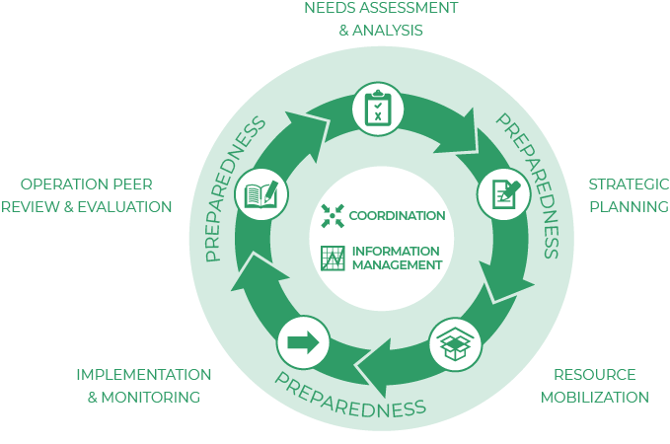
Community feedback mechanisms, community engagement and the emergency response
Why are community feedback mechanisms important to emergency responses, humanitarian and public health programming?
Notes:
Community feedback and the Humanitarian Programme Cycle
Community feedback mechanisms can inform all five elements of a humanitarian response
Here are some ways that community feedback mechanisms support emergency responses, public health programs and the humanitarian sector:
Course-correcting actions
Providing a continuous iterative improvement process
Improve quality and effectiveness of programmes and response work
Ensure that services are responding to needs
Here are some links with public health and humanitarian emergency response issues (Session 1.1):
To identify potential gaps or tensions between how the response is being designed and delivered and how communities see and interpret it.
To understand local priorities for action, even where they contradict with the priorities of emergency response operations.
To identify local capacities, resources, resilience and current actions.
And ultimately, to use this information to adapt the design and delivery of services and the way response actors engage with communities throughout the response

Slide 13
Community feedback channels
Where and how can we collect community feedback data? What are some examples you’re familiar with?
Notes:
Community engagement activities (door to door awareness raising, radio talk shows or community events)
Social media monitoring
Perception surveys
Feedback boxes
Observation notes (see session 4.4)
Questions to Whatsapp groups or radio shows
An informal conversation with a staff member
Via a phone call to a call centre
In the form of responses to structured surveys

Slide 14
Community feedback channels
Feedback channels are the ways we collect insights and experiences shared with us. Feedback channels need to be diverse so all have a fair chance to be heard.
Examples:
Face to face
Phone calls
Voice recorder
Written or visual communication
Reactive channels wait for people to come give their feedback.
Proactive channels ask or actively solicit feedback.
A mix of channels is most accessible.
Notes:
Feedback channels: People communicate in different ways
The ways we collect insights and experiences shared by community members are called feedback channels. Feedback channels need to be diverse to make sure everyone has a fair chance to be heard.
Channels can include:
Face to face interactions, e.g., via a helpdesk, during community meetings or focus group discussions, in-person surveys or interviews.
Phone calls, e.g., via a hotline, phone surveys or interviews, radio show with call-in, or interactive voice response.
Voice recorder, where the device is placed in a safe place for community members to use it independently.
Written or visual communication, which can be online, e.g., e-mails, social media, chat bots or other online messaging applications, or offline, e.g., letters, feedback boxes, SMS messages.
We can collect feedback reactively (waiting for people to come give their feedback) or proactively (asking or actively soliciting feedback). It’s important to have a mix of both, for accessibility.

Slide 15
GROUP exercise
Reactive channels wait for people to come give their feedback.
Proactive channels ask or actively solicit feedback.
Split into two groups –
Group 1: What are some examples of reactive (unsolicited) ways to collect feedback? What are their advantages and disadvantages?
Group 2: What are some examples of proactive (solicited) ways to collect feedback? What are their advantages and disadvantages?
Come back and share your discussion

Slide 16
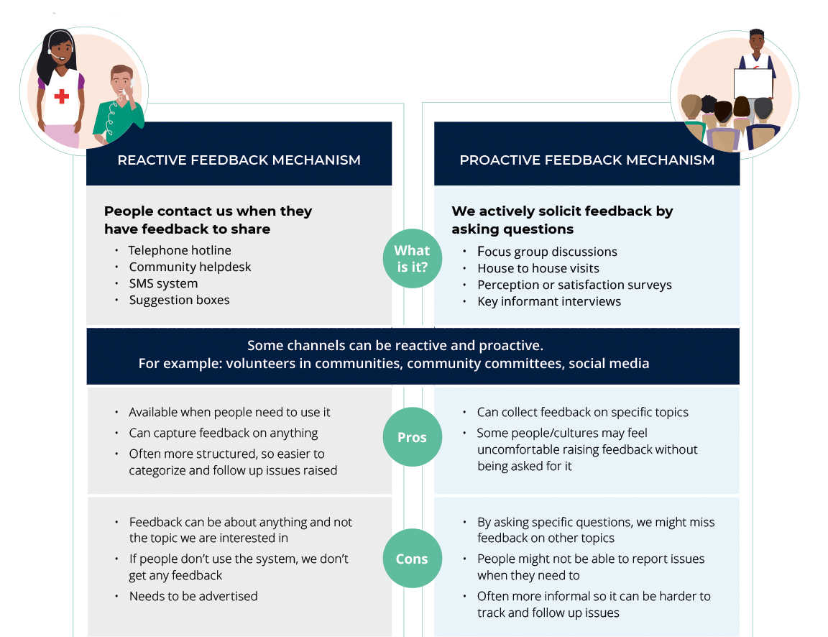
GROUP exercise
See Handout 1
A Red Cross Red Crescent Guide to Community Engagement And Accountability (p. 105)
Notes:
Explain:
Reactive (unsolicited) feedback channels:
People contact us when they have feedback to share
Example channels:
● Hotline
● Helpdesk
● Suggestion box
Advantages:
● Available when people need to use it
● Can capture feedback on anything
Disadvantages:
● If people don’t use the system, you don’t get any feedback
● Needs to be advertised
Purposes best suited for:
● Fixing issues timely (e.g., issues with cash transfers)
● Providing needed information
● Confidential handling of sensitive feedback
Proactive (solicited) feedback channels:
We actively solicit feedback by asking questions
Example channels:
● Focus group discussions
● Perception surveys
● Key informant interviews
Advantages:
● Can collect feedback on specific topics
● People might not come forward to share feedback otherwise
Disadvantages:
● By asking specific questions, you might miss feedback on other topics
● People might not be able to report issues when they need to
Purposes best suited for:
● Understanding the community
● Meaningful two-way dialogue
● Monitoring key metrics
Most feedback channels can be used for both ways of collecting feedback. For example: call centres can receive calls but also conduct phone-based surveys, household visits can be used for asking specific questions, but also for recording unsolicited feedback.

Slide 17
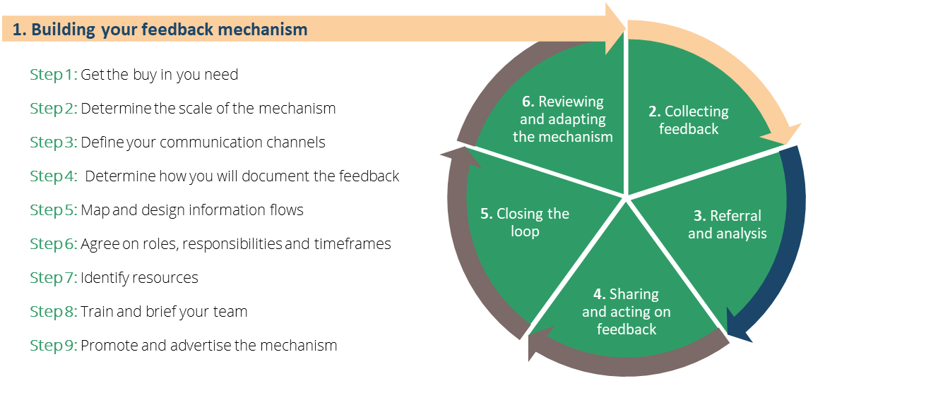
STAGE 1: Building your community feedback mechanism
Also see Handout 2: A Red Cross Red Crescent Guide to Community Engagement And Accountability (p. 103)
Notes:
This figure visualizes the different steps of designing and setting up a community feedback mechanism.
Explain the steps in the figure, that lead up to the Community Feedback Cycle.
Design of a Feedback Mechanism: Get buy-in from the community, management and key teams. Determine what kind of information is already received by the community, what additional channels might be required (based on the context and the community preference) and plan the feedback process together with the community. Clearly identify the processes to collect, manage, and share the community feedback and the roles and responsibilities of everyone involved.
This stage is important because it will launch us into the feedback cycle!
The steps to designing a feedback mechanism are:
Get buy-in from management, staff, communities
Scale the feedback mechanism
Define communication channels
Determine how you’ll document feedback (design data collection tools and processes)
Map information flows
Agree on roles, responsibilities, timeframes
Identify resources
Train and brief your team
Promote the feedback mechanism

Slide 18
STAGE 1: Building your community feedback mechanism
1. Get buy-in
Management
Key teams who will support the community feedback mechanism and act on the feedback
The community who will be giving feedback
Relevant partners who may also collect feedback, do operational research or be interested in the information
Notes:
Steps for setting up and designing your feedback system
Step 1: Get buy-in: Need staff time, funding and commitment to make changes
Management
Key teams:
Programme and operations who will act on feedback
Information management who will manage, analyze and visualize data
Information technology and logistics for equipment and resources
Program monitoring and evaluation for coordination
Protection, Gender and Inclusion (PGI) teams for handling sensitive feedback and Human resources/legal for investigations
The community who will be giving feedback
The community has a right to be involved and give feedback
Share the plans and involve them
Relevant partners who may also be collecting feedback, operational social science research, or have an interest

Slide 19
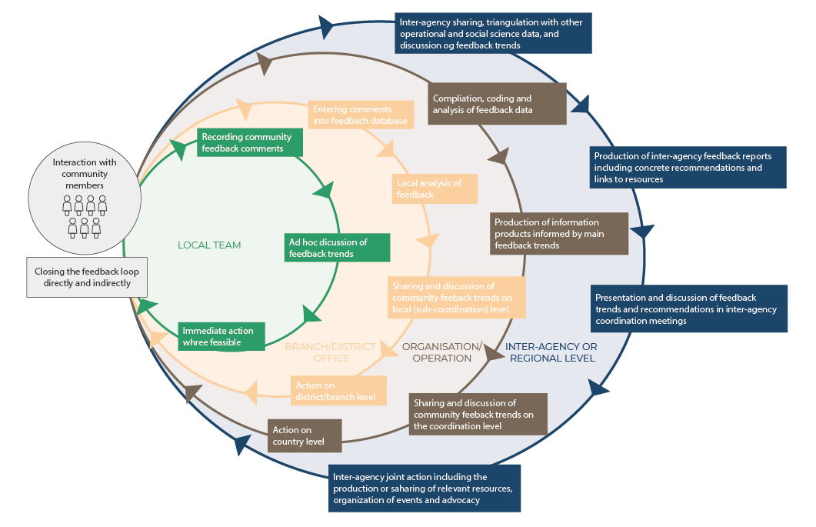
STAGE 1: Building your community feedback mechanism
2. Determine the scale of your feedback mechanism
Aim for one central mechanism
The local level is critical and cannot be left out; other levels may also be considered
Notes:
Step 2: Scale the feedback mechanism: Aim for one central mechanism
Feedback mechanisms must be local-level. They can also be district/branch-level, organizational-level or regional-level
Key questions to ask the community and your team:
What is the purpose or goal of the feedback mechanism (beyond ensuring accountability)?
Where will we be collecting data?
Who needs to see what information within my team, organisation, and among external stakeholders?
What resources do we need to set this up? What resources are available?
What are the long-term needs related to feedback for the community and the local teams?

Slide 20
STAGE 1: Building your community feedback mechanism
3. Define your communication channels
What already exists?
What does your audience prefer?
Information Provision Channels | Feedback Channels | Response Channels
How we can share information about our organisation, partners, programs, and response plans with the community in the areas where we work. Used to advertise the feedback mechanism, as well as share requested information. | How we collect insights from communities about our work and services, and anything else of importance to the community. This can include broad information about cultural and contextual conditions for the target population | How we respond to community feedback, usually during our process of “closing the loop”. Remember that channels for collecting feedback are not always the appropriate channels to respond to the feedback.
Notes:
Step 3: Define your communication channels based on what already exists and what’s preferred by your target audience. You will need to think through information provision channels, channels through which to collect feedback, and channel to respond to the feedback.
Information Provision Channels
Are channels through which we can share information about our organisation, partners, programs, and response plans with the community in the areas where we work. These channels can be used to advertise the feedback mechanism, as well as share requested information.
Feedback Channels
Are channels through which we collect insights from communities about our work and services, and anything else of importance to the community. This can include broad information about cultural and contextual conditions for the target population.
Response Channels
Are the channels through which we respond to community feedback, usually during our process of “closing the loop”. It is important to remember that channels for collecting feedback are not always the appropriate channels to respond to the feedback.
Refer to session 2.4 and 5.2 of this training package for choice of communications channels depending on the community and stakeholders.

Slide 21
STAGE 1: Building your community feedback mechanism
4. Determine how you will document feedback
Informed verbal consent
Explain how and well you’ll record feedback
Start small
Plan for capacity-building
Evaluate which channels still work for the community
Keep the volume of data meaningful but manageable
Notes:
Step 4. Determine how you will document feedback - Design data collection tools and processes
Keep ethics at the forefront of your design. Reminder:
Do no harm – assess the risks and benefits of your feedback mechanism for community members, and explain these to community members
Respect for persons – community members have a right to give feedback, a right to withdraw from giving feedback at any time, and a right to privacy and confidentiality
Justice – select participants equitably and many perspectives are represented
To apply these ethical principles, incorporate informed verbal consent into your feedback mechanism: explain why any information is recorded or written, and explain what feedback is and why it’s being collected to any community members who are involved.
Keep your data collection tools and processes simple and small-scale to start. Start with 1-2 channels and a few feedback collectors. You can monitor how things go and decide when to scale up the mechanism when things are running smoothly.
Plan for experienced volunteers and staff to become trainers (capacity-building). Then once the mechanism is running smoothly, start to scale up. Constantly evaluate which channels are most comfortable for the community since they can change at any time. Think about when you will have enough feedback data for a meaningful analysis, and when you will have more than you could manage to analyze or use. An effective, ethical feedback mechanism will stay within these bounds.
The methods you’ll use to analyse your community feedback will be primarily qualitative (see Session 4.4 and 4.6).

Slide 22
STAGE 1: Building your community feedback mechanism
 | Open feedback | Structured feedback
General description: | Listening to feedback from communities about community priorities | Actively soliciting feedback from communities about specific topics
Feedback shared: | Formally and informally | Formally
Channels and activities for collecting this kind of feedback: | Community meetings, interactive radio shows, hotlines, discussions after community events, informal conversations during daily activities, etc. | Perception or Knowledge, Attitude and Practices (KAP) surveys, focus group discussions, key informant interviews, social media polls, etc.
Topics covered: | Any topic the community wants to comment on | Topics pre-determined by aid organization
Timing: | Open and varied, whenever community members want to share | Specific times pre-determined by aid organization
Type of data generated by feedback: | Qualitative data | Qualitative data and/or quantitative data
Useful for: | Understanding the thoughts and priorities of communities in real-time | Answering specific questions that can help to design programs, activities, and strategies
See Handout 3
Notes:
The channels you use to collect feedback will influence what type of feedback data you receive: open feedback or structured feedback. These are described in the table.
Note: Formal feedback sharing is also called solicited/proactive. Informal sharing is also called unsolicited/reactive.

Slide 23
STAGE 1: Building your community feedback mechanism
4. How will you document the feedback? Design data collection tools and processes
Understand your sample and how different groups are included in your feedback dataset.
Create data management and collection tools.
Test these tools with your data collectors and with community members.
Ask how easy these tools are to use and understand.
Develop your sampling strategy.
Document standard operating procedures that give instructions for each of the data collection and management tools, including roles, responsibilities, and timeframes.
Test your processes for handling sensitive data
Notes:
Step 4. Design data collection tools and processes
Understanding the sample of feedback you will analyse
Sessions 4.3 and 4.4 discuss quantitative and qualitative sampling methods. In social science research, because we can’t realistically ask every single person to participate in our research, we use sampling to conduct research with a smaller group of people, and then we apply those findings (generalize) to a subset or the whole community.
Community feedback is slightly different, because community feedback is collected alongside our operations and activities. Our sample is partly determined by who our organisation interacts with and serves. It’s important for data collection to be somewhat independent enough from programmatic activities, to be able to be scaled up or down as needed.
Monitoring and understanding how different groups within your community are represented in the feedback is important. This way, you can ensure that you are hearing from all layers and perspectives of the community. For example, hearing from community members across age groups, genders, geographic areas or language groups may shed light on very different impacts of an event or emergency. If you find that you are not hearing from one group, especially those who are more vulnerable or marginalized due to the power structures in your context, you could adjust your data collection strategy to reach them
Key questions to ask your team when setting up data management tools and processes:
How will you document the feedback collected from different channels?
E.g. Mobile devices, paper forms, direct entry into a database
How will informed consent be ensured? (Refer back to Session 3.2)
What tool will be used to document the feedback?
Mock up a simple form, create a database, or set up the required software
How will you decide how much feedback to collect, and when there is enough or too much to analyse?
This applies to proactive feedback collection
It’s called a sampling strategy
How will sensitive feedback be handled?
It should be stored and addressed separately to protect privacy and confidentiality
Sensitive feedback can be more time-sensitive and should be prioritised

Slide 24
GROUP exercise
Explore the following community feedback data collection and management tools.
Example form for recording open community feedback on paper
Example form for recording open community feedback using a KoBo survey
Example Excel logbook for community feedback
Example perception survey in Kobo
Notes:
Provide links in the chat or ahead of time; or do a live demonstration depending on access to materials and technology

Slide 25
STAGE 1: Building your community feedback mechanism
5. Map and design information flows
This is important to set expectations and to avoid harming communities
Consider:
Where information gets stuck
Closing the loop
Sensitivity and criticality
Notes:
Step 5. Map and design information flows
Vital for the success of the system. Otherwise communities are set up for disappointment (refer to do no harm principle)
Identify gaps where information is getting lost or stuck
Closing the Loop – Regardless of how the feedback is managed internally, the outcome is always relayed back to the community or the individual who raised the feedback
Sensitivity and criticality – The information flow is dependent on the kind of feedback you are receiving from the community. There will be different processes for handling sensitive, critical, project/operational, and ‘big picture’ feedback.

Slide 26
STAGE 1: Building your community feedback mechanism
6. Agree on roles, responsibilities and timeframes
Information management, Performance measurement, monitoring and evaluation
Data management support
Community
Programme or operations staff
Leadership
Feedback
manager
Human Resources and Prevention of Sexual Exploitation and Abuse
Security
Feedback
collectors
Notes:
Step 6. Agree on roles, responsibilities and timeframes
Go through each stage of the feedback cycle and consider:
Who is already doing this work?
Who has the capacity to fill gaps and/or reinforce what is already happening?
Who can play an enabling or supporting role?
Decision-making should be carried out by community members as much as possible, so that decisions are made locally and quickly.
The table lists key roles and responsibilities within a community feedback mechanism. Keep in mind that one person can carry out multiple roles and responsibilities. Community members may also be operations staff, for example.
In general, routine feedback should be responded to within two weeks, or ideally within a few days. Sensitive and critical feedback should be acted on immediately (within a day). This includes acknowledging the person who submitted the feedback and explaining the next steps to them.

Slide 27
STAGE 1: Building your community feedback mechanism
7. Identify resources
Your team and its diversity
Materials or tools
Expertise and training
Budgets
* Dedicate at least one staff member to drive and manage all stages and steps of the process.
Notes:
Step 7. Identify resources you will need based on the roles and responsibilities identified. Think through:
How many people will be needed on the team? Who might be available? (Human resources)
Keep protection factors and the diversity of your team in mind. By ensuring that your team is diverse, for example gender-balanced and inclusive of minority language speakers, it’s more likely that the community will be able to communicate with and trust in your team. The feedback mechanism will become more accessible. Diversity will also strengthen the quality of your data and the interpretation of your results.
Consider the skillsets of your team as well (social science research)
What materials or tools are needed? How could they be obtained? (Material support)
What expertise and training will the team need? (Technical support)
What budgets will be needed to obtain additional resources? (Financial support)
Build a budget for the feedback mechanism
Tip/lesson learned: Dedicate at least one staff member to drive and manage all steps of the process.

Slide 28
STAGE 1: Building your community feedback mechanism
8. Train and brief your team
How the feedback mechanism works and their role
Including answering community questions and how to flag critical/sensitive feedback
Listening and communication skills
Qualitative data collection
Protection and prevention of sexual exploitation and abuse
Analysis and presentation skills
Information on the context of the emergency
Other skills like computer skills
Notes:
Step 8. Train and brief your team
Everyone involved in the feedback mechanism needs to know how it works and their role in the mechanism. This way, they can more accurately explain it to the community. Feedback is meant to improve the organization, and not to criticize anyone’s individual work.
Training should include:
Listening and communication skills (Session 4.3, 4.4)
Qualitative data collection (Session 4.4)
Protection and Prevention of sexual exploitation and abuse (Module 3)
(if applicable) data entry and computer skills
Analysis and presentation skills
The overall functioning of the feedback mechanism
Essential information on the context you are working in (e.g. public health measures if you’re working in a health emergency)
Practice sessions on answering the community’s questions or saying “I don’t know”
When and how to flag critical or sensitive feedback
Plan refresher trainings as the emergency and your feedback mechanism evolve. Plan to debrief with data collection teams to learn how your processes can improve. Offer psychosocial support, should they need it, since community feedback can include emotionally and morally difficult topics.
Refer to module 4.4, “Key informant interviews” section for best practices for collection of open community feedback.

Slide 29
STAGE 1: Building your community feedback mechanism
9. Promote and advertise your feedback mechanism – Promote within your organisation and within the community
Key messages can include:
Communities have a right to give feedback
Positive, neutral and negative feedback are welcome since they help organisations improve
There will be no foreseen negative consequences if people complain
(Based on the design of your feedback mechanism) Where responses will be shared, and the timeframe for sharing responses (closing the loop)
Sensitive or serious complaints will be handled safety and confidentially
Notes:
Step 9. Promote the feedback mechanism within the community and your organization
This is essential for communities to be able to give feedback. Use communications channels commonly used by the community.
Key messages can include:
Communities have a right to give feedback
Positive, neutral and negative feedback are welcome since they help organizations improve
There will be no foreseen negative consequences if people complain
(Based on the design of your feedback mechanism) Where responses will be shared, and the timeframe for sharing responses (closing the loop)
Sensitive or serious complaints will be handled safety and confidentially
Brief all staff and volunteers in your organization on the functioning and purpose of the feedback mechanism, and why it’s important. Include information on how community members can access the feedback mechanism.

Slide 30
STAGE 2: Collecting community feedback
Listen to and acknowledge community members (see Handout 4)
Ensure informed consent before collecting any information
Use the tools you developed in stage 1, step 4
Give an initial response to feedback
* Revisit Session 4.4 on qualitative data collection (e.g. key informant interviews) for some best practices on collecting community feedback.
Notes:
Feedback Collection: Feedback from the community can come through a formal channel (like a hotline or suggestion box) or through informal channels (like conversations with staff during other activities). No matter what form of feedback, it needs to be collected, recorded, and processed. This also means recording information about when and where it was collected and some information about who the feedback came from.
Once your feedback system is set up, and data collection is underway, remember these key principles:
Listen to and acknowledge community members
Refer to the active listening tips in session 4.4 and Important skills for effective listening (handout or link)
Communicate with community members using their preferred language and in a setting where they feel safe
Acknowledge the feedback by thanking the person, addressing the feedback if possible, and letting them know how and when they can expect a follow-up
Ensure informed consent before collecting any information (including writing or recording)
Explain what feedback collection is, what information you’ll be recording (and what you’ll be leaving out), how the data will be used and let the person know they can choose not to give feedback or to anonymously give feedback
Check that the person understands and ask if they have any questions
Give an initial response to feedback, where possible
Ask for contact information for follow-up, if appropriate
To help feedback collectors respond, consider developing the following tools:
A repository of key information including answers to frequently asked questions
A list of services and activities
A referral framework
“I don’t know” is an acceptable response as well, and is much preferred over giving a false or misleading answer

Slide 31
Summary
Community feedback is simply any information shared by members of the community we are working for and interacting with. A community feedback mechanism is a way to systematically and regularly listen to and act on this feedback.
Community feedback mechanisms function in a cycle. The six stages in the cycle are:
Building your feedback mechanism
Collecting feedback
Referral and analysis
Sharing and acting on feedback
Closing the loop
Reviewing and adapting the mechanism
Notes:
The next stages of the community feedback cycle are covered in sessions 4.10 and 7.2.
In this session we covered:
Community feedback is simply any information shared by members of the community we are working for and interacting with. A community feedback mechanism is a way to systematically and regularly listen to and act on this feedback.
Community feedback mechanisms function in a cycle. The six stages in the cycle are:
Building your feedback mechanism
Collecting feedback
Referral and analysis
Sharing and acting on feedback
Closing the loop
Reviewing and adapting the mechanism

Slide 32
Summary
Functioning feedback mechanisms are:
Owned by the community
Effective
Accessible and inclusive
Safe
Confidential
Complementary and collaborative
Transparent
The steps to set up your community feedback mechanism are:
Get buy-in
Determine the scale of the feedback mechanism
Define your communication channels
Determine how you will document the feedback
Map and design information flows
Agree on roles, responsibilities and timeframes
Identify resources
Train and brief your team
Promote the feedback mechanism within the community and your organization
Notes:
Functioning feedback mechanisms are:
Owned by the community
Effective
Accessible and inclusive
Safe
Confidential
Complementary and collaborative
Transparent
The steps to set up your community feedback mechanism are:
Get buy-in
Determine the scale of the feedback mechanism
Define your communication channels
Determine how you will document the feedback
Map and design information flows
Agree on roles, responsibilities and timeframes
Identify resources
Train and brief your team
Promote the feedback mechanism within the community and your organization

