Slide 1
Training package: Using social science for emergency preparedness and response
For more information contact: Social Science Team Lead & Research Specialist, Ginger Johnson (gijohnson@unicef.org)

Slide 2
Competency framework and training informed by:
Results from the social science needs assessment (conducted by the Collective Service in ESAR from December 2020 to March 2021)
UNICEF Social Science for Community Engagement survey results with humanitarian partners (conducted in February and March 2021)
Feedback from the WCAR social science coordinator providing technical country support
Coordination with Integrated Outbreak Analytics (IOA) working group members
Pilot (direct) training implemented by the Collective Service in five countries in 2021-2022
Trainer of Trainers (ToT) session with IFRC community engagement and accountability staff across 6 regions conducted in 2022

Slide 3
7 key competency domains identified
1. Social science in humanitarian action and health emergencies
2. Context analysis and behavioural drivers and barriers
3. Ethics in operational research
4. Implementation of social science research approaches
5. Evidence synthesis, interpretation and dissemination
6. Translating knowledge to action
7. Tracking the uptake of socio-behavioural evidence

Slide 4
Content creation
The content was co-produced with partners from the Social Science in Humanitarian Action Platform (SSHAP), the Institute of Development Studies (IDS), Translators Without Borders (TWB), Médecins Sans Frontières (MSF), London School of Hygiene and Tropical Medicine (LSHTM), the Rapid Research Evaluation and Appraisal Lab (RREAL) at University College London (UCL), UNICEF’s Social Science Analytics Cell (CASS), the International Federation of the Red Cross and Red Crescent Societies (IFRC), Centers for Disease Control (CDC), Oxfam, READY Initiative at Johns Hopkins University (JHU). Content reviewed by UNICEF and WHO. Development of this training package was led by Anthrologica for the Collective Service.

Slide 5
What’s included in the training package?
07 modules with associated sessions (27 sessions in total).
Each session has a detailed Facilitator Guide and Facilitator PowerPoint with relevant linked documents for a skilled facilitator(s) to lead an online or offline training in a group setting.
Each of the modules and sessions answer one or more of the following ‘from data to action’ social science research questions:

Slide 6
DATA TO ACTION:
Key questions in social science research
What information is needed?
Who needs this information?
Does this information already exist? Is there a related needs assessment or study?
From data to action: The learning journey
Who can collect this information?
What methodology and tools should be used to collect and analyse this information?
How to ensure that this information goes back to communities? To inform community-level actions and decision-making of the broader response?
How to ensure that the information is used to make operational and/or strategic decisions?
How to track the information used to ensure that it effectively contributes to operational and strategic priorities?

Slide 7
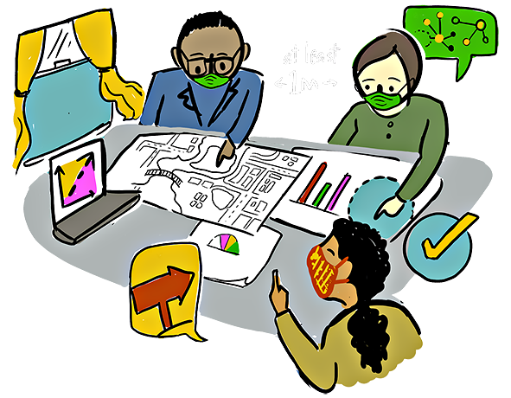
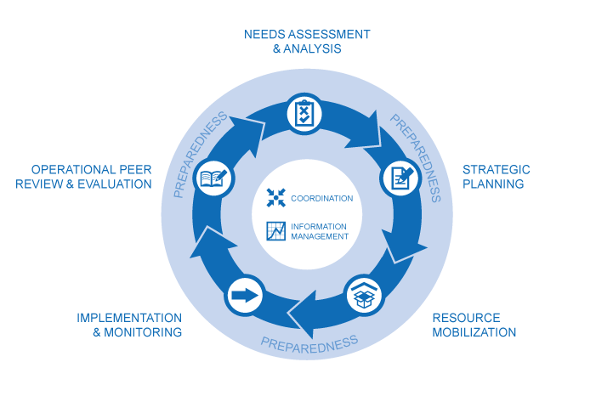
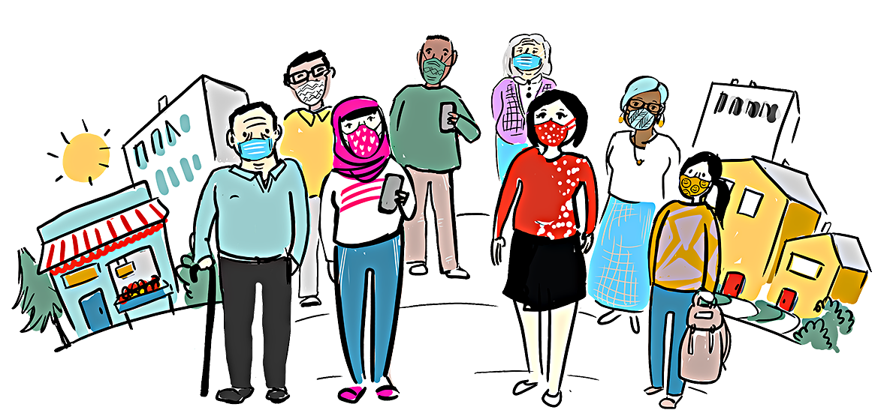
Data to Action Learning Journey
System
Mapping
Needs Assessment
Accountability
Contextual Analysis
Socio-
Behavioural
Studies
Feedback
B
2
C
A
D
OUTCOME
B
Understanding
the Situation
OUTPUT
For a collective approach
3
A
Implementation & Monitoring
1
Coordinated
Planning
A
Interventions
For an iterative and data-driven implementation process
Coordination
Mechanism
IMPACT
INPUT
B
Community-Led Planning
5
4
Evaluation
& Learning

Slide 8
DATA TO ACTION:
Key questions in social science research
What information is needed?
Understanding
the situation
Who needs this information?
For collaborative approach
Does this information already exist? Is there a related needs assessment or study?
Needs assessment
Who can collect this information?
Coordinated
Planning
What methodology and tools should be used to collect and analyse this information?
How to ensure that this information goes back to communities? To inform community-level actions and decision-making of the broader response?
Implementation & Monitoring
How to ensure that the information is used to make operational and/or strategic decisions?
How to track the information used to ensure that it effectively contributes to operational and strategic priorities?
Evaluation
& Learning

Slide 9
7 key competency domains 7 modules

Slide 10
01. COMPETENCY - Social science in humanitarian action and health emergencies
Understand the value of social science as a necessary element to strengthen and improve community-centred approaches in health emergencies and humanitarian responses. KNOWLEDGE / ATTITUDE
Understand the different types and approaches of operational social science research which are relevant for the effective design, delivery, and continuous adjustment of community engagement approaches and strategies. KNOWLEDGE
Recognise existing (and emerging) communication/engagement coordination structures (global, regional, national) and position social science within them. KNOWLEDGE / SKILL
Understand the need to advocate for and implement integrated initiatives to increase the availability and use of operational social science outputs in emergency preparedness and response. KNOWLEDGE / ATTITUDE

Slide 11
01
Module
Social science in humanitarian action and health emergencies
Sessions:
1.1 - Introduction to social science – definition, approaches and role in humanitarian action
1.2 - Operational social science research in the humanitarian/emergency response cycle
1.3 - Advocating for the inclusion of social science in emergency response activities that engage communities

Slide 12
02. COMPETENCY - Context analysis and behavioural drivers and barriers
Understand how social differences, and specifically inequalities along social and economic dimensions, can contribute to varying degrees of vulnerabilities to and during emergencies. KNOWLEDGE / SKILL
Understand how to identify the drivers and barriers to the uptake of behaviours critical to the response to humanitarian action. KNOWLEDGE / SKILL
Know about rapid strategies to establish and deepen understanding of social determinants, historical, political, socio-cultural, and economic context to mitigate vulnerabilities of specific population groups. KNOWLEDGE / SKILL
Understand language challenges and risks of conducting social science research which is not language-sensitive, and recognise value of language-sensitive research to support community engagement and/or communications activities. KNOWLEDGE / SKILL / ATTITUDE

Slide 13
02
Module
Context analysis and socio-behavioural drivers and barriers
Sessions:
2.1 - Understanding context, vulnerability and inequality in public health and humanitarian emergencies
2.2 - Understanding behaviour in humanitarian/emergency response: models and theories
2.3 - Rapid strategies to understand the political, socio-cultural, and economic factors that increase vulnerability
2.4 - Understanding the importance of language in social science research

Slide 14
03. COMPETENCY - Ethics in operational research
Understand the importance of adhering to ethical standards when designing and implementing operational social science research and related data collection in humanitarian contexts. KNOWLEDGE / SKILL / ATTITUDE
Understand how to design operational social science research protocols and informed consent forms to adhere to ethical standards, and how to engage Institutional Review Boards (IRB) boards for rapid ethical approval. KNOWLEDGE / SKILL / ATTITUDE
Know how to translate and operationalise ethical standards in local contexts. KNOWLEDGE / SKILL / ATTITUDE
Know how to apply ethical standards to collect data and report findings back to communities. KNOWLEDGE / SKILL / ATTITUDE

Slide 15
Module
03
Ethics in
operational research
Sessions:
3.1 - Ethical principles and approvals for social science research in a humanitarian/emergency context
3.2 - Promoting the meaningful translation and application of ethical principles

Slide 16
04. COMPETENCY - Implementation of social science research (pt 1)
Plan and design operational social science research that is actionable, collaborative, draws on local expertise and gives voice to communities’ knowledges, capacities, and needs. KNOWLEDGE / SKILL / ATTITUDE
Distinguish between qualitative and quantitative approaches for collecting and analysing operational social science research. KNOWLEDGE
Understand how to best sequence and integrate quantitative and qualitative approaches. KNOWLEDGE / SKILL
Know how to evaluate the rigor of the approaches used, the data collected, and the analysis completed. KNOWLEDGE / SKILL
Know how to apply quantitative approaches to collect data in operational social science research. KNOWLEDGE / SKILL
Know how to apply qualitative approaches to collect data in operational social science research. KNOWLEDGE / SKILL

Slide 17
04. COMPETENCY - Implementation of social science research (pt 2)
Understand how to analyse data collected with quantitative tools such as Rapid Needs Assessment (RNA) surveys, and Knowledge, Attitude and Practice/Perception (KAP) surveys. KNOWLEDGE / SKILL
Understand how to analyse data collected with qualitative methods like interviews, observations, and focus group discussions (FGDs). KNOWLEDGE / SKILL
Know how to apply mixed methods approaches to assess community perceptions, practices, and socio-behavioural trends. KNOWLEDGE / SKILL
Understand how to systematically triangulate social science data with other types of data to generate robust evidence. KNOWLEDGE / SKILL
Understand community feedback data and its role in emergency response and able to set up a simple feedback system using multiple methods. KNOWLEDGE / SKILL
Understand how to structure and analyse community feedback data, including recognising and appropriately handling critical or sensitive (e.g. PSEA) feedback. KNOWLEDGE / SKILL

Slide 18
Module
Implementation of social science research
04
Sessions:
4.1 - Localised research: designing operational social science research that is responsive to communities
4.2 - Quantitative and qualitative approaches to generate data in operational social science research
4.3 - Quantitative data collection methods: Rapid needs assessment (RNA) surveys, and knowledge, attitudes and practice/perceptions (KAP) surveys
4.4 - Qualitative data collection methods: in-depths interviews, observations, and focus group discussions
4.5 - Quantitative data analysis in operational social science research
4.6 - Qualitative data analysis in operational social science research
4.7 - Mixing different methods to produce quality evidence to inform action
4.8 - Triangulation of data: why it is important and how does it work?
4.9 - Community feedback mechanism: design and data collection
4.10 - Community feedback mechanism: consolidation and analysis

Slide 19
05. COMPETENCY - Evidence synthesis, interpretation and dissemination
Understand where and how to access and assess quality social science knowledge to plan an evidence synthesis of socio-behavioural trends capable of informing regional, national, and sub-national level community engagement strategies and approaches. KNOWLEDGE / SKILL
Know how to develop an evidence synthesis that integrates stakeholders values and needs to facilitate the uptake of socio-behavioural evidence in programme and policy. KNOWLEDGE / SKILL / ATTITUDE
Understand strategies and approaches to effectively transform social science data and evidence into actionable findings. KNOWLEDGE / SKILL
Understand essential strategies, approaches and formats to effectively present data to decision-makers, addressing their interests and using their language and terminology. KNOWLEDGE / SKILL / ATTITUDE
Know the importance of communicating research back to communities in an inclusive manner. KNOWLEDGE / ATTITUDE
Understand social science research as part of a broader engagement and uses research findings to support existing community-level solutions and actions. KNOWLEDGE / SKILL / ATTITUDE

Slide 20
Module
Evidence synthesis, interpretation and dissemination
05
Sessions:
5.1 – Evidence synthesis for social and behavioural data
5.2 - How to transform social science data and evidence into actionable findings
5.3 - How to effectively communicate and present research to different audiences
5.4 - Feeding back to communities and using findings to support community-level solutions and actions

Slide 21
06. COMPETENCY - Translating knowledge to action
Know the common challenges and opportunities to translate operational social science research useful to inform health emergency and humanitarian response actions. KNOWLEDGE / SKILL
Understands the practical considerations to translate evidence to inform clear and actionable recommendations in different contexts. KNOWLEDGE / SKILL
Understand how to create an enabling environment within the response pillars and technical clusters/sectors to systematically embed operational social science across the different phases of a community-centred response. KNOWLEDGE / SKILL / ATTITUDE

Slide 22
Module
06
Translating knowledge
to action
Sessions:
6.1 - Translating social science research into action
6.2 - Enabling environments for the uptake of social science evidence in emergency response

Slide 23
07. COMPETENCY - Tracking the uptake of socio-behavioural evidence
Know what it takes to create a system to effectively track and monitor the uptake of operational social science research outputs in community-centred responses. KNOWLEDGE / SKILL / ATTITUDE
Understand complex feedback systems for course correction, and learn how to use and present community feedback to follow up on actions taken and make recommendations. KNOWLEDGE / SKILL

Slide 24
Module
Tracking the uptake of
socio-behavioural evidence
07
Sessions:
7.1 - Tracking the use or ‘application’ of integrated operational social science outputs: integrated outbreak analytics and monitoring
7.2 - Using community feedback to take action and ‘close the loop’

