Slide 2

ACTIONABLE FINDINGS
Useful in that they address critical information gaps (missing information) that a programme/response needs to solve a particular issue, such as to improve acceptance of a service, increase uptake of practices & behaviours, etc.
Useful
Used
Usable in that they generate useful information that can be easily transformed and effectively communicated to influence and inform policy and practice.
Usable

Slide 3
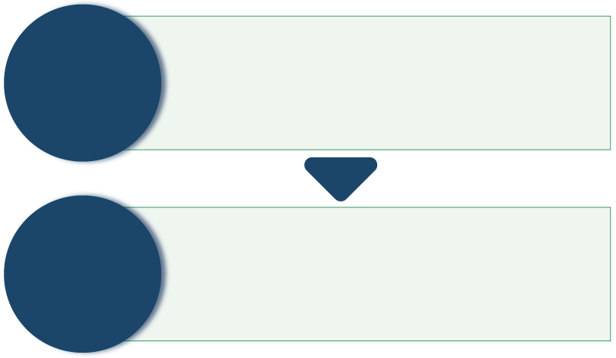
WHY DO WE NEED TO TRANSFORM DATA?
Raw material that has not yet been analysed and has minimal meaning beyond what is stated
That which is known about a certain topic/subject
DATA
Data that has been collected and transformed in a way that increases understanding of a certain topic/subject
Focused down on what is crucial in understanding that topic/subject
INFORMATION

Slide 4
PRACTICAL STEPS TO TRANSFORMING DATA
INTO ACTIONABLE FINDINGS
Begin at the research design stage
Frame actionable research
Transform analysed data into actionable findings
Transform those findings into actionable recommendations
Communicate them effectively to different audiences

Slide 5
COMMUNICATING ACTIONABLE FINDINGS
Social science research should produce findings which can be used to improve the coverage, quality and effectiveness of response activities. Actionable findings are both useful and usable.
We need to actively work with the data that we collect and transform it into information that can be used.
There are some challenges to this, including:
A disconnect between researchers and practitioners/humanitarian responders
Producing short, focused summaries and practical, targeted recommendations and solutions is not always straightforward
Social science research often reveals problems that are political and structural, which can be harder to generate actionable recommendations for
Social science research can often produce findings based on a small sample of community members, limiting how far this data can create ‘action’ for a broader geographic scope

Slide 6
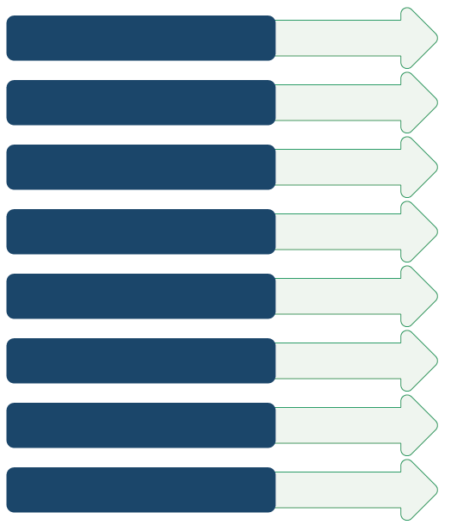
PRODUCTS – WHAT YOU PRODUCE
Policy brief
Academic journal article
Online blog/article
Manual/guideline document
Research/evaluation report
PowerPoint slides
Short video/animation
Infographics

Slide 7
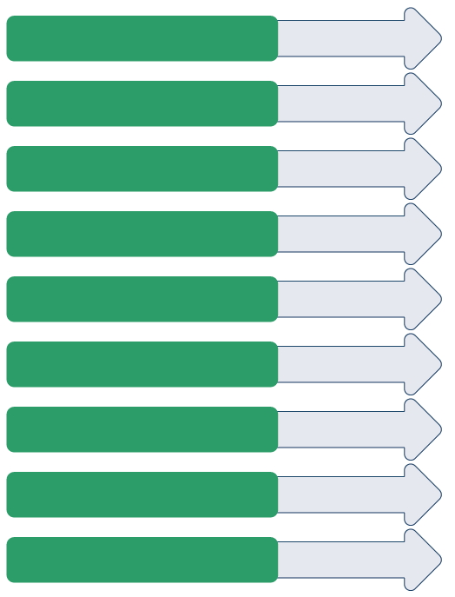
CHANNELS – HOW YOU DISTRIBUTE YOUR PRODUCTS
Working group/cluster/network meeting
Webinar
Conference
Public online resource collection
Social media
Policy review/policy development meeting
Informal meeting
Training sessions
Meeting/briefing with key stakeholders

Slide 8
KNOW YOUR AUDIENCE
Organizational interests and priorities
Personality traits
Interests and priorities
Values
Opinions
Political motivations and goals
Blockages for action
Language

Slide 9
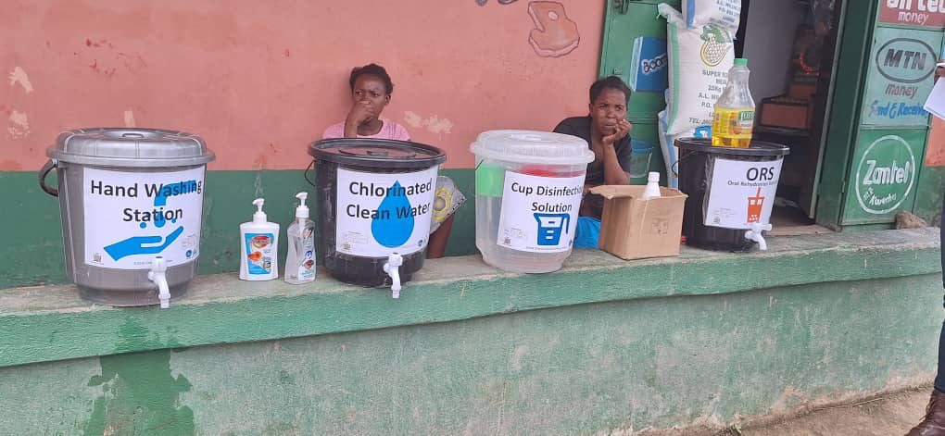
Round 2 + 3 Key Findings WASH and IPC
1. Household-level spraying for cholera-affected homes (CATI) is implemented variably.
2. ORPs are not well known and could be harmful if not well staffed and monitored
3. Communities are concerned that schools represent a high risk for cholera transmission and support the continued closure of schools.
Recommended Actions (non-exhaustive)
Consider psychological benefits (or cost) of household spraying (de/stigmatising?)
Roll out an ORP strategy with appropriate staffing/capacity, monitoring, transport capacity
Urgently support schools to meet the minimum standard for cholera prevention
  Develop child-friendly messaging, IEC materials, jingles around cholera prevention in schools

Slide 10
SUMMARY
When the findings and recommendations of social science research are effectively communicated to key actors in the response, this can significantly improve the way humanitarian response is designed and delivered.
When making a communication plan, follow these key steps:
Set SMART objectives
Identify priority users of the research findings
Get to know your audience – in terms of information needs, interests and priorities, and underlying motivations
Identify appropriate products, channels & opportunities to engage your audience
Construct a message that will help turn research findings into action

